Slide 1
ISEA Policy Webinar
2017 DG SREC Procurement
and the Advantages of Going Solar in 2017
February 9, 2017

Slide 2
Agenda
2017 DG REC Procurement timeline and process - Dylan DeBiasi
Future Energy Jobs Bill (brief review) - Shannon Fulton
2017 DG Procurement vs 2018 RPS implementation - Shannon Fulton/Dylan DeBiasi
Q&A Discussion
*Details concerning new RPS rulemaking will not be part of tonight’s webinar, as little information is known at this point.

Slide 3
Summary of 2017 DG REC Procurement
Notes:
dylan from CSG

Slide 4
2017 DG Procurement
Size Categories
Under 25kW
25-2000kW
Two Separate Procurement events
April 2017 (projected budget ~$20MM)
November 2017 (projected budget ~$20MM)
Includes Speculative Bidding for systems < 25kW
Systems Located in IL are Eligible
Behind the Meter
Any Energized Date
Multiple Technology Types
Bonding is Required for All Systems
5 Year Contracts
Paid on Quarterly Basis
Fixed Price
Notes:
-very similar to SPV procurement
-2 sizes
-2 rounds of procurement events one is expected in April one in November both around 20mm in budget
-now includes speculative bidding
-behind the meter systems with any energized date
-wind, solar thermal and PV, biodiesel, crops and unadulterated organic waste biomass, tree waste, and hydropower that does not involve new construction or significant expansion of hydropower dams
-there is a bonding requirement- more on this later
-5 year contracts that get paid out on quarterly basis
-fixed price

Slide 5
Speculative/Forecasted Bidding
Forecasted Bidding now Allowed!
Only Systems < 25kW
Still Need Minimum 1 MW bid
Very Similar to SPV
9 Months to Identify Systems
No Extension
Notes:
major difference between this year and prior years is that spec bidding is allowed now
this like the spv is only allowed for systems less than 25kW
after the bid date they will have 9 months to identified

Slide 6
Bonding Requirements
$4 per REC
Paid to IPA
Refundable Win or Lose
Forfeit if System is not Built or Identified in Time
Supplier Fee to IPA
Non-Refundable
Only Owed if System Wins Procurement
No More 10% of Contract Value Bond

Slide 7
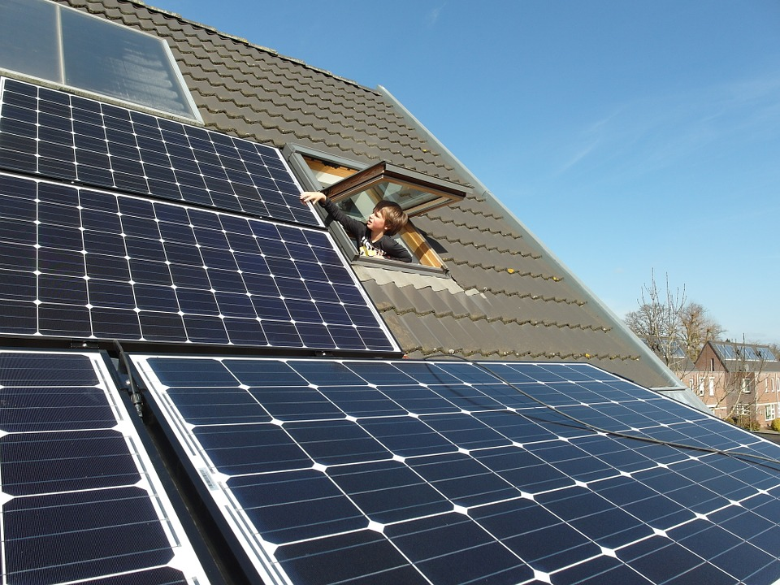
Bid Process
Systems submitted
LOI required for identified systems (all systems over 25kW)
Bond Payment
System Review
Identify speculative bid to aggregator
Bid date
Winning bids identified
Supplier fee paid to IPA
Identified systems have 1 year to be energized (estimated)
Speculative systems have 9 months to be identified
One year after identified to be energized (estimated)
Bond refunded with initial REC Delivery
Notes:
first step is to work with your aggregator to identify your systems with an LOI and figure out your speculative bid
then bond payments are owed
the identified systems are then submitted to the procurement administrator (NERA) for review
bid date then the winning bids are identified
a supplier fee is owed by all winning systems (depending on the system size and timing set by the IPA this may be required by your aggregator prior to the bid date)
this is estimated based on the rules from the supplemental procurement but identified systems have 1 year to build
speculative systems have 9 months to identify then 1 year after identified to build

Slide 8
SPV vs DG Procurements
2017 DG Procurement
Supplemental Procurement
2 Rounds (~$40MM total)
Speculative and Identified bidding
1MW min bid size
9 months to identify spec systems
Two size categories (less than 25kW and 25-2000kW)
Payments from Hourly ACP Fund
5 year contracts with quarterly payments
3 Rounds ($30MM total)
Speculative and Identified bidding
500 REC min bid size
6 months to identify spec systems (with option to extend for 3 months)
Two size categories (less than 25kW and 25-2000kW)
Payments from RERF Fund
5 year contracts with quarterly payments
Notes:
main point here is to reiterate the similarities and differences to spv
2 rounds vs 3
minimium bid size is bigger
no extension but 9 months instead of 6
same size categories
contract holder is the utilitys not the state so no budget issues with payment
same payment schedule

Slide 9
Previous Average Winning Bids
Procurement | Less than 25kW Average Price | Greater than 25kW Average Price | Overall Average Price
Supplemental Procurement 1st Round (June 18, 2015) | $168.58 | $101.09 (25kW-500kW) | $134.84
DG Procurement 2015 (October 8, 2015,) |  |  | $116.65
Supplemental Procurement 2nd Round (November 12, 2015) | $202.30 | $114.05 (25kW-500kW) $137.15 (500kW-2MW) | $137.15
Supplemental Procurement 3rd Round (March 31, 2016) | $230.98 | $108.60 (25kW-500kW) $99.32 (500kW-2MW) | $163.45
DG Procurement 2016 (June 23, 2016) |  |  | $141.00
Notes:
All totalled the Supplemental Procurement resulted in about 31MW of solar capacity - jury out on what actually gets built.
We can’t advise on specific pricing I would recommend talking to your aggregator about it.

Slide 10
Next Steps/ Upcoming Info
Draft Documents will be Published by IPA
Contracts
Procurement Rules
Bid Documents
Public Comment Period
Get Signed LOI’s from Systems (especially greater than 25kW)
Find an Aggregator to Bid in Your Systems
Carbon Solutions Group (contact@carbonsolutionsgroup.com)
SREC Trade (Installers@srectrade.com)
Notes:
draft documents should be coming in the next few weeks
they will be followed by a public comment period
you can start getting loi’s signed and into your aggregators now
the two aggregators that have identified to ISEA are CSG and SREC Trade

Slide 11
Future Energy Jobs Bill

Slide 12
Future Energy Jobs Bill Summary
Creates IPA Long Term Planning Process
$200M annually from Lines Charge (3 year phase-in/phase-out ARES)
Effective Date June 1, 2017 (Phases through 2017 & 2018)
Initial Utility Scale procurement (1:1 wind goals)
Year | Wind | Solar
2020 | 650 MW | 1,350 MW
2025 | 1,000 MW | 2,000 MW
2030 | 1,350 MW | 2,700 MW
* Currently 55 MW installed Renewable Energy
Sec 16-111.5(b)(5) (p 397), Sec 1-75(c)[(1)(A) (p 76), (1)(B) (p 77), (1)(C) (p 79), (1)(E) (p 82), (1)(G) (p 85) ]
Notes:
Sec 16-111.5(b)(5) (p 397)
IPA Long-term planning process: Sets forth the process for the IPA’s development and the Commission’s approval of the long-term renewable resources plan.
Sec 1-75(c)(1)(A) (p 76)
Establishes new long-term planning process to implement the RPS
Sec 1-75(c)(1)(B) (p 77)
Retains 25% by 2025 REC targets
Clarifies that new wind/solar build targets are prioritized over annual REC % targets
Establishes three-year phase-in of lines charge / phase-out of ARES self-supply
Sec 1-75(c)(1)(C) (p 79)
Sets explicit long-term new build requirements for wind/solar
By 2020: estimated 650 MW new wind / 1,350 MW new solar
By 2025: estimated 1,000 MW new wind / 2,00 MW new solar
By 2030: estimated 1,350 MW of new wind & 2,700 MW of new solar
New solar must be sourced as follows:
At least 50% from DG / community solar
At least 40% from utility-scale
At least 2% from brownfield
Sec 1-75(c)(1)(D) (p 81)
IPA benchmarking standards to ensure cost-effective procurements
Sec 1-75(c)(1)(E) (p 82)
Rate cap. Unchanged from existing law.
Creates estimated renewable resources budget (RRB) of $200+ M / yr.
Sec 1-75(c)(1)(F) (p 84)
Prioritization of available funds: (1) existing contracts; (2) funding for low-income; (3) funding for new build; (4) funding for all other REC targets
Sec 1-75(c)(1)(G) (p 85)
Sets initial utility-scale procurements for new wind/solar.
Establishes process to keep new wind/solar procurements in approximate balance (“1:1” language)

Slide 14
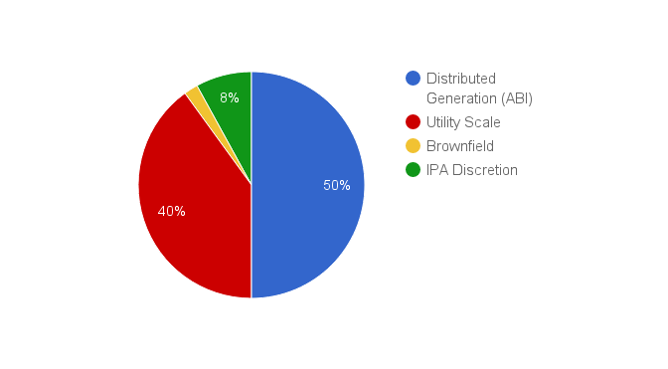
2-4 MM RECs from New Solar Resources
New Build Targets
Year | Solar
2020 | 1,350 MW
2025 | 2,000 MW
2030 | 2,700 MW
Sec 1-75(c)(1)(C) (p 79)
Notes:
Sec 1-75(c)(1)(C) (p 79)
Sets explicit long-term new build requirements for wind/solar
By 2020: estimated 650 MW new wind / 1,350 MW new solar
By 2025: estimated 1,000 MW new wind / 2,00 MW new solar
By 2030: estimated 1,350 MW of new wind & 2,700 MW of new solar
New solar must be sourced as follows:
At least 50% from DG / community solar
At least 40% from utility-scale
At least 2% from brownfield

Slide 15
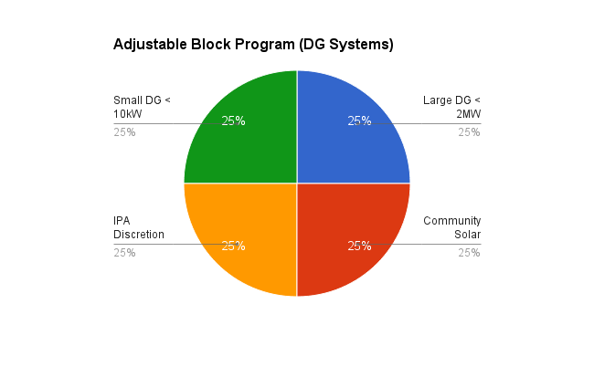
Adjustable Block Incentives
Renewable Energy Credit (REC)
Small DG <10kW
15 Year REC
Paid upfront
Large DG (10kW to 2,000 kW)
15 Year REC
20% paid upon completion, balance over 4 years
Community Solar (<2,000 kW)
15 Year REC
20% paid upon completion, balance over 4 years
Sec 1-75(c)(1)(K), (L), and (M) (p 95)
Notes:
Sec 1-75(c)(1)(K), (L), and (M) (p 95)
DG “adjustable block” program
Modeled after California Solar Initiative and NY Sun programs
Directs IPA to establish program to procure RECs from:
Small DG (< 10 kW) – at least 25%
Larger DG (10 kW – 2 MW with subcategories possible) – at least 25%
Community solar – at least 25%
Remainder allocated at IPA discretion
Contract and payments terms allow for up-front payments for 15-year stream of RECs
Provides for third-party administration and evaluation

Slide 16
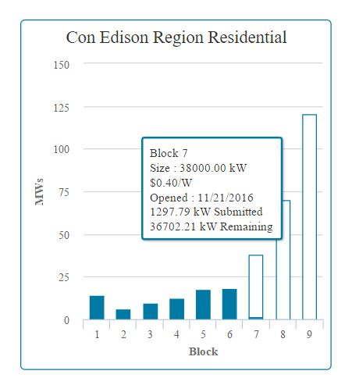
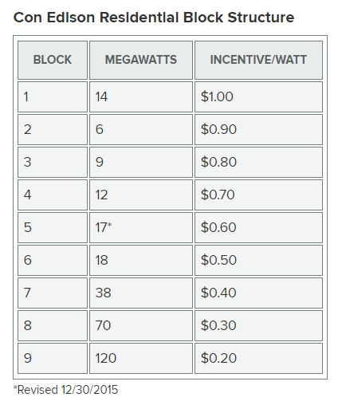
Adjustable Block Program - example
Sec 1-75(c)(1)(K), (L), and (M) (p 95)
Notes:
Sec 1-75(c)(1)(K), (L), and (M) (p 95)
DG “adjustable block” program
Modeled after California Solar Initiative and NY Sun programs
Directs IPA to establish program to procure RECs from:
Small DG (< 10 kW) – at least 25%
Larger DG (10 kW – 2 MW with subcategories possible) – at least 25%
Community solar – at least 25%
Remainder allocated at IPA discretion
Contract and payments terms allow for up-front payments for 15-year stream of RECs
Provides for third-party administration and evaluation

Slide 17
Customer Billing Unchanged!
☒
Demand Charges!
☑
Retail Net Metering!
Demand Charge Language - dropped from legislation
Net Metering - no change from today’s guidelines
Existing Systems grandfathered at full retail NEM for life of system
New Systems -
Study triggered at 3% “total peak demand”
Switches to energy only for new customers at 5%
Community Solar - energy only net metering
Sec. 16-107.5 (p 257)
Notes:
Net-Metering Sec. 16-107.5 (p 257)
Maintains existing net metering program as written in law which is capped at 5% of “total peak demand” (less than 1% of the cap has been reached currently)
Switches to energy-only netting for new customers (i.e. no netting of distribution charges) after 5% cap is reached
Existing NEM customers are grandfathered at full retail NEM (supply + distribution) for the life of their system
Community solar receives energy-only netting (also eligible for REC purchase through the RPS and the DG rebate described below)

Slide 18
Creates DG Rebates for Non-NEM Systems
Requires utility to offer rebates to qualifying DG* and community solar projects (with Smart Inverter)
Rebate Value = $250/kW installed
Payable upfront
Utility can rate base rebate costs
Utility permitted to control inverter for grid reliability and potentially other grid services,
subject to fair compensation through a tariff reviewed and approved by the commission**
Upon reaching 3% NEM penetration, the ICC to study new rebate value based on locational value
Upon reaching 5% NEM penetration, new locational value shall take effect
* Non-NEM Customers (ComEd >100kW peak demand, Ameren >150kW peak demand)
**See Section detail for complex terms and options governing the relationship of DG rebates, net metering, and community solar.
Sec. 16-107.6 (p 276)
Notes:
Distributed Generation Rebate
Sec. 16-107.6 (p 276)
Requires utility to offer rebates to qualifying DG and community solar projects (typically with a smart inverter)
Utility permitted to control inverter for grid reliability and potentially other grid services, subject to fair compensation through a tariff reviewed and approved by the commission (see p 278, ln 20)
Includes complex terms and options governing the relationship of DG rebates, net metering, and community solar.
Upon reaching 3% NEM penetration, the ICC is directed to initiate a process to establish a new rebate value based on locational value of DG resources. (p 282)
The new locational value rebate shall take effect when the utility reaches the 5% NEM program cap.
Until the full locational-value process is approved, C&I and community solar customers will be eligible for an interim $250/kW up-front rebate (p 279, p 283)
Utility is allowed to rate-base and recover costs of the DG rebates as a regulatory asset. (p 284)

Slide 19
MINDING THE SALES GAP
WHY WAIT? GO SOLAR IN 2017!
RPS Implementation potentially begins mid-2018
Adjustable Block SREC likely not published until mid-2018
Small system definition changes from 25 kW in 2017 to 10kW in 2018
SRECs relinquished for 5 years vs 15 years

Slide 20
MINDING THE SALES GAP
WHY WAIT? GO SOLAR IN 2017!
SREC pricing flexibility under 2017 bidding process
Two rounds to try for a higher bidding price before settling for a prescribed SREC schedule
More competitive pricing under competitive SREC bidding scenario = better for the customer
Companies can meet sustainability goals faster by going solar in 2017 vs waiting

Slide 21
Solar Installer Tip - Phasing Projects
Up-sizing inverter to accommodate future growth does not ensure SREC payments for added production capacity
Separate revenue grade meter and inverter for new “phase” are needed if SRECs are expected
In many cases, going forward with the larger system will avoid duplicative costs of electrical design and installation later

Slide 22
Q & A
Thank you for your membership and support!
email: ContactISEA@illinoissolar.org
http://www.illinoissolar.org/ISEA-Blogs
Carbon Solutions Group (contact@carbonsolutionsgroup.com)
SREC Trade (Installers@srectrade.com)

Slide 23
Adjustable Block Incentives - Summary
Category | Goal | NEM | REC | Rebate
Small DG <10kW | 25% | No Change | 15 Year Contract Paid upfront | n/a
Large DG 10kW – 2MW | 25% | No Change | 15 Year Contract 20% when energized Balance over 4 Years | C&I =$250/kW Paid upfront
Community Solar <2MW | 25% | Energy only | 15 Year Contract 20% when energized Balance over 4 Years | $250/kW Paid upfront
IPA Discretion <2MW | 25% | Based on Category | Based on Category | Based on Category
Sec 1-75(c)(1)(K), (L), and (M) (p 95)
Notes:
Sec 1-75(c)(1)(K), (L), and (M) (p 95)
DG “adjustable block” program
Modeled after California Solar Initiative and NY Sun programs
Directs IPA to establish program to procure RECs from: o
Small DG (< 10 kW) – at least 25%
Larger DG (10 kW – 2 MW with subcategories possible) – at least 25%
Community solar – at least 25%
Remainder allocated at IPA discretion
Contract and payments terms allow for up-front payments for 15-year stream of RECs
Provides for third-party administration and evaluation

Slide 24
Systems up to 2MW
<40% single subscriber
200W minimum subscriber
Located in same utility service area
Subscriptions portable & transferable
3 Value streams:
Value of Energy created
REC from ABI
Rebate ($250/kw)
Sec 1-75(c)(1)(N) (p 101)
Notes:
Sec 1-75(c)(1)(N) (p 101)
Directs IPA to establish a community renewables program for systems up to 2 MW
Subscriptions must be at least 200 W; no more than 40% of a project to one entity; be located in same utility service area as project (see def’n of “subscriber” – p 32)
Subscriptions must be portable and transferable
Three value streams:
Bill credits are valued at energy supply rate (covered in the net metering section of the bill, section 16-107.5(l) (pp 267-272))
RECs are purchased through the DG adjustable block program
Community solar also eligible for the DG rebates described in new section 16-107.6(f) (p 283)

Slide 25
Solar for All Program
Work in progress
Provides annual funding ($10M to $20M/year)
Includes Low-Income Job training & a pathway for job placement
Assures funding for Low-Income solar installations
Success evaluated and adjusted through IPA long term planning
Sec 1-75(c)(1)(O) (p 44), Sec 1-56 (p 15)
Notes:
Sec 1-75(c)(1)(O) (p 44)
Provides annual ongoing funding for low-income programs and job training ($10 M to $20 M per year)
Sec 1-56 (p 15)
Creates new Illinois Solar For All Program
Funded using the RERF, plus $20 million annually from general RPS, plus up to 50% of unused “rollover” RPS funds
$14 M of initial funding for 5 different low-income job training programs
Remaining funds allocated to four different low-income solar development programs
Evaluation and program modifications covered through IPA’s long-term planning process
Sec 16-108.12 (p358)
Creates new utility job training programs to establish a solar installer training pipeline for low-income solar projects
Identifies six organizations to receive job training funds
Establishes jobs targets for “persons with a record” and foster care alumni

