Slide 1
Illinois Solar for All
Opportunities to Increase Access to Solar
October 16, 2017 4 pm

Slide 2
Illinois Solar for All
B Corporation 101
Solar for All Overview
Incentive Categories & Levels
Installer/Vendor Requirements
Customer Eligibility
Workforce Development
Notes:
Goal: Bring PV to low-income communities to maximize development of solar to create a long-term low-income solar marketplace through the state
Opportunitie
The bottom line is that we have a real opportunity to support hose who helps make this bill happen. = solar growth in IL MUST include everyone.
Not only can we

Slide 3
Becoming a Certified B Corp

Slide 4
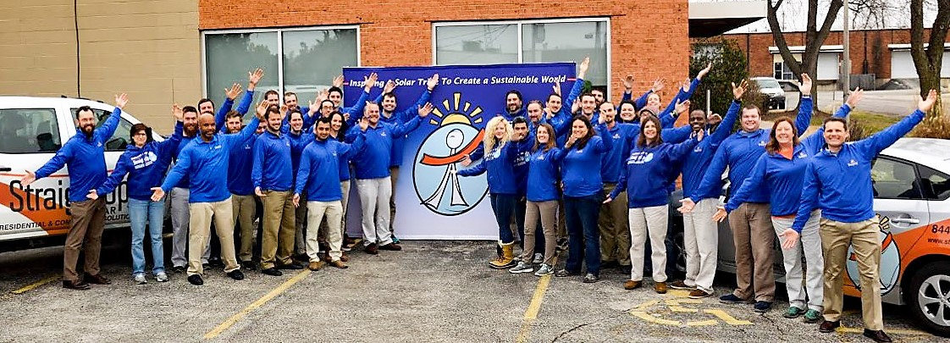
What is BCorp & The SUS BCorp Process
Founded 2006 – 45 Employees – Fully Licensed Electrical Contractor
Over 900 projects, closing in on 10MW
3x Full & 6x Associate NABCEP Certified Professionals

Slide 5
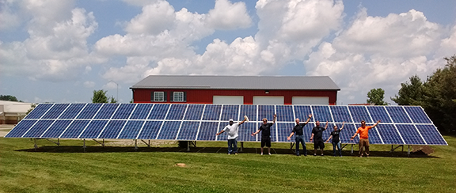
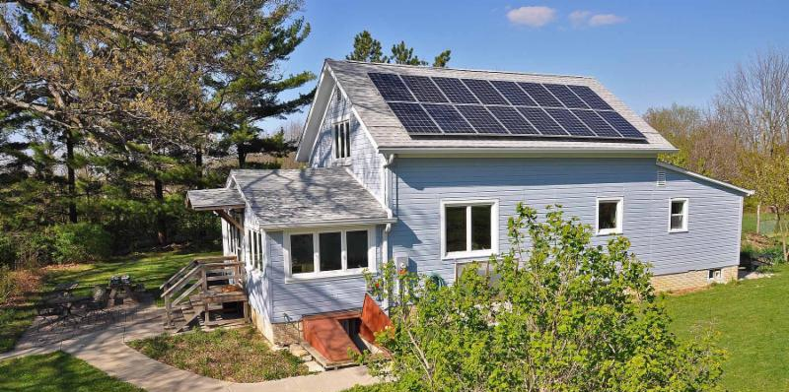
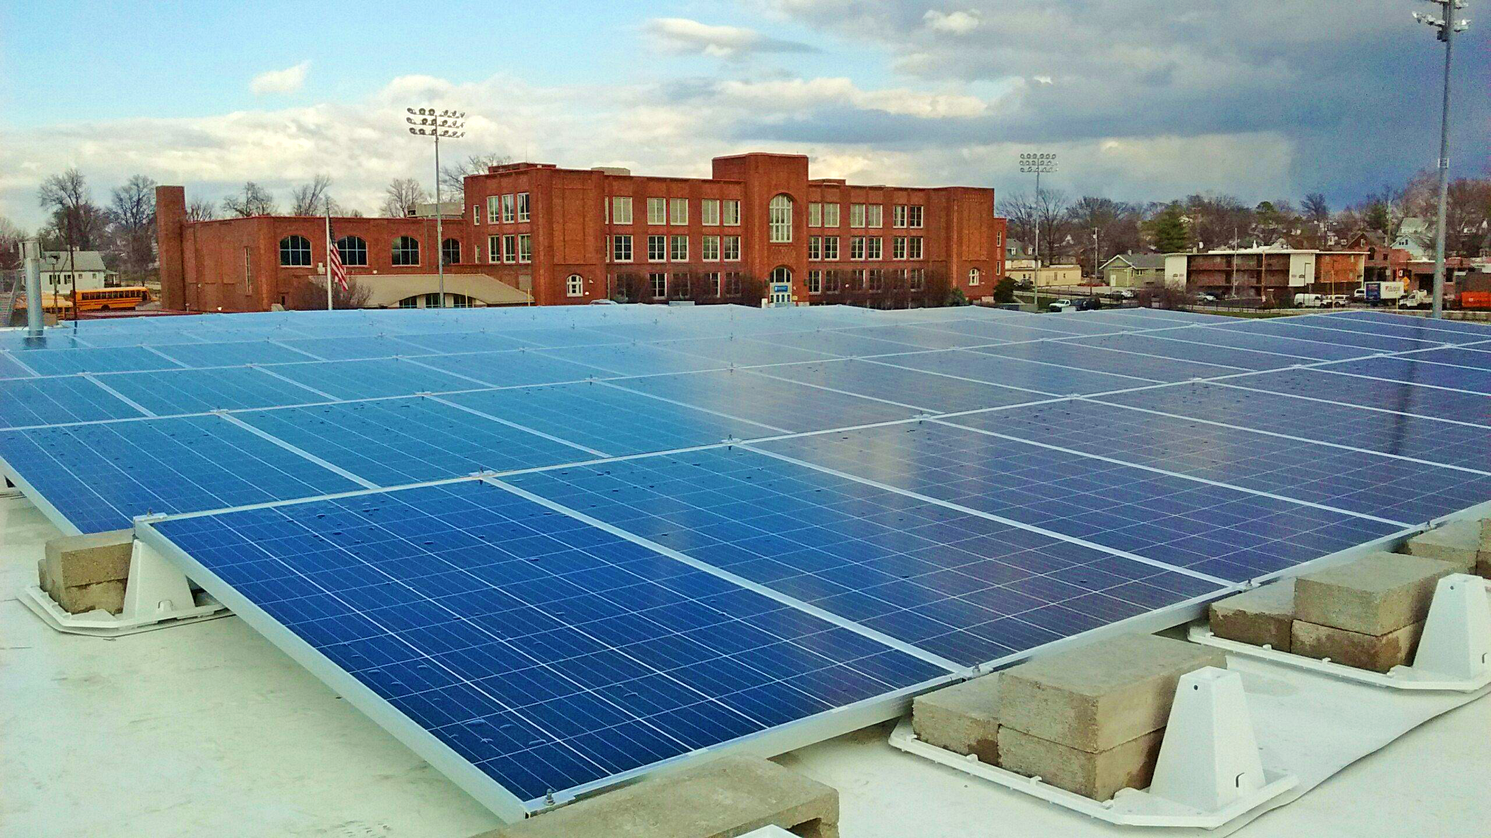
Our Vision & Mission
To inspire a solar Tribe to create a sustainable world.
Empowering communities to create a sustainable future through lasting partnerships that provide the region’s premier solar integrations & customer service at a competitive price.

Slide 6
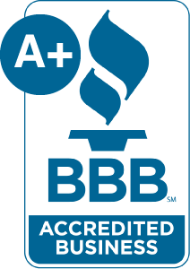
Our CLEARE Values
Community First
Lead the Solar Tribe
Educate the Solar Lesson
Advocate Always
Respect Each Other & The Environment
Excellence in All We Do

Slide 7
What are B Corps?
Notes:
Less than 2 minute video clip link “BCorps”

Slide 8
What is a B Corp to StraightUp Solar?
B Corps are for-profit companies certified by the nonprofit B Lab to meet rigorous standards of social and environmental performance, accountability, and transparency.
Why become a B Corp?
Lead by example & join our bigger Amicus Tribe
Focus on triple bottom line: People, Planet, Profit
Differentiate from competitors
Attract, engage, & motivate talent
Protect mission - CLEARE Values!
Benchmark performance --> improve business
Well-known examples:

Slide 9
Steps to Becoming a Certified B Corp
Learn about B Corp (Hint: Go to bcorporation.net | Read B Corp Handbook)
Seek leadership support and approval
(Hint: Find a B Corp Buddy if you can)
Build an internal team to chart course and divide tasks
Formally register, commit and (prepare to) pay your dues
Review the B Corp Impact Assessment
Create a timeline -- strategy, assessment, reporting, implementation
Divide assessment categories/questions among team
Submit report
Complete Virtual Verification Audit
Celebrate & publicize
Implement lessons to improve rating
Repeat!

Slide 10
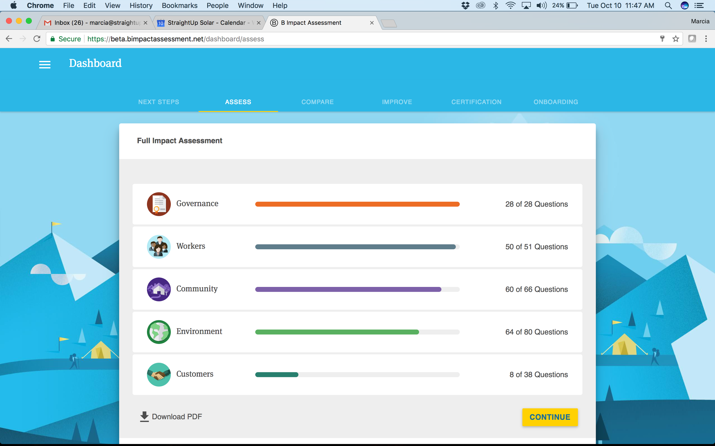
Impact Assessment - Scorecard
Governance
Workers
Community
Environment
Customers
Suppliers
https://beta.bimpactassessment.net/dashboard/assess

Slide 11
Sample of Assessment Questions

Slide 12
The StraightUp Solar B Corps Story
SUS BCorp Commitment Made 2013
SUS BCorps Initial Report Completed in June 2015
SCORE = 94
SUS BCorps Initial Report Completed in June 2017
SCORE = 92*

Slide 13
So How Is SUS Better Today?
New Articles of Incorporation
“StraightUp Solar exists for the purpose of delivering societal and environmental benefit by inspiring a Solar Tribe to create a sustainable world.”
- Article II, Para 2.3, SUS 3rd Amended Restated
Operating Agreement, 28 Jun 2017
B Corps Advisory & Action Committee Established
Formal Strategic Plan & Resource Commitment
Employee Ownership of Our B Corp Destiny

Slide 15
Illinois Solar for All Overview
GOAL: Bring solar to low-income communities to maximize development and create a long-term low-income solar marketplace throughout Illinois.
Energy and economic benefits for low-income customer at reasonable level = no upfront costs or subscriber fees
Immediate, reliable reductions in energy costs = ongoing payments < expected energy savings
Ensure the wholesale market value of the energy is credited to participating low-income customer or organization = NEM
Tangible economic benefits flow directly to program participants (except multi-family housing)
Marketing practices are standard so low-income customer receive clear, standardized information about benefits.
Notes:
Low-income residents should not have to pay up-front costs for on-site DG or an up-front fee to subscribe to community solar projgract
Program should result in immediate, reliable reductins in energy costs for thioe residents or subscibers (any ongoing payments would be smaller than expected energy savings)
Will be required to do NEM
Aprovded bendors will need to provide documentation on how project has no upfront costs to pariticpates
Low-income = 80% of federal poverty level

Slide 16
Solar for All Overview
Funding Sources
Renewable Energy Resources Fund $20M/year from RERF for 3 sub-programs
Portion of funds from utilities’ RPS requirements 5% or $10M per delivery year (whatever is more)
2018-2019 $10M
2019-2020 $11.7M
2020-2021 $11.7M
Additional $10M in 2017, 2021, 2025 for ComEd Workforce Development program
Notes:
$150M was transferred out of RERF – August 2017; State law requires $150M to be transferred back within 24 months of August 2017 but no additional payments are due to RERF =
“IPA doesn’t beelive these tranfers necessiatnt any adjustment to propoposed program design or budget”
5% of the funds available under the plan for each delivery year (or $10M per delivery year) whichebver is greater for the delivery years –5% or $10M every delivery year
Also note FUNDING SHORTFALL & RPS OVERCOLLECTIONS -= IPA will submit plan
$30 M ; $31 M, etc
June 1, 2017; June 1 2021; June 1, 2025

Slide 17
Illinois Solar for All Programs
4 sub-programs
Low-income distributed generation incentives
Low-income community solar incentives
Incentives for non-profits and public facilities
Low-income community solar pilot projects
Notes:
SEPARATE admin from Adjustable Block program,m but buiding on program design of ABP

Slide 18
Illinois Solar for All Programs
Notes:
p. 145

Slide 19
Illinois Solar for All Programs
Low-Income Distributed Generation Incentive
22.5% of funds
Requirement to partner in job training
M-RETS or GATS to verify REC production
Single-family homes = must verify that they are low-income
Two-to-four unit buildings = at least two of the households must be demonstrated to be low income.
Five-unit and larger buildings = either at least 50% of the tenants must be verified as low-income, or the building must be demonstrated to meet the definition of “affordable housing” contained in the Illinois Affordable Housing Act.
Notes:
See Section 8.13.1 for more information on income verification and Section 8.13.2 for more information on income eligibility – p 146
Multifamily buildings can be either master metered or individually metered. For master-metered buildings, the economic benefits of installing a photovoltaic system will not directly impact the tenants of the building because they do not individually pay an electric bill to their electric utility; but instead the benefits accrue to the building owner/manager. Therefore, for master-metered buildings, the building owner/manager will need to commit to passing along a portion of the value of the energy savings from net metering to the tenants through reduced (or not raised) rents, or by other means. The commitment should also include a description of how this will be accomplished. For multifamily buildings that are not master metered, one challenge is that the photovoltaic system will most likely be connected to the main building account that serves common areas and buildingwide load rather than to any individual unit’s account. For these buildings, the owner/manager must either provide the same demonstration of passing along benefits to tenants as for master-metered buildings, or in the alternative, must commit to offering tenants the opportunity (at no additional cost levied by the landlord) to participate in net metering pursuant to the provisions of Section 16- 107.5(l)(1)(B) of the PUA, which allows for net metering of “individual units, apartments, or properties located in a single building that are owned or leased by multiple customers and collectively served by a common eligible renewable electrical generating facility.”

Slide 20
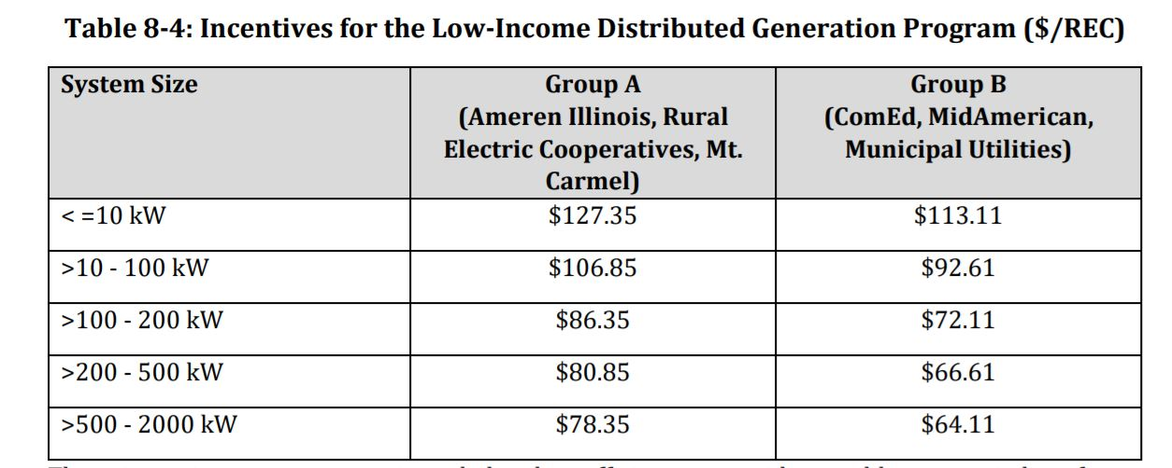
Illinois Solar for All Programs
IPA disclaimer: Illinois Solar for All incentive levels described in this draft Plan should be considered preliminary, and parties should not take actions in reliance on these draft proposals.
Notes:
These incentive payments are intended to be sufficient to provide tangible economic benefits to participants through enabling project developers to eliminate upfront costs to the participants for the installation of photovoltaic projects. The incentive will be a standard incentive and not customized for each project. Projects that participate in this incentive will also be subject to the provisions related to job training discussed in Section 8.9.

Slide 21
Illinois Solar for All Programs
Low-Income Community Solar Initiative
37.5% of funds
Identify partnership with community stakeholders
M-RETS or GATS to verify REC production
Collateral: 10 years = 10% of remaining REC value
Variety of subscriber models:
Anchor tenant that does not qualify as low-income = incentive reduced to account for share of system subscribed by that tenant
Anchor tenant is a not-for-profit organization or a public sector entity = incentive will not be reduced.
All 100% owned by low-income subscribers = incentive level increased by $5/REC
Notes:
Incentives to low-income customer to increase participating of low-income subscribers of community solar projects
For the provision, regarding projects “that are 100% low-income subscriber owned,” the Agency assumes the Act intended the plain meaning of the word “ownership,” and not that projects be merely 100% “subscribed” by low-income customers. For projects that can demonstrate that they are 100% owned by low-income subscribers (including not-for-profit organizations, and affordable housing owners), the incentive level will be increased by $5/REC.
As described in Section 8.15.4, 25% of available funding will be targeted to environmental justice communities
In order to ensure ongoing subscription levels by low-income subscribers, the Approved Vendor will have to provide ongoing collateral for ten years equal to 10% of the remaining REC value and report annually on low-income subscription levels. If those levels are not maintained, then the collateral may be called upon to claw back the incentives to the level of low-income subscription

Slide 22
Illinois Solar for All Programs
Low-Income Community Solar Initiative (cont)
Approved Vendors submitting project must describe partnership with community stakeholders
Definitions:
a public or private nonprofit organization of demonstrated effectiveness that (A) is representative of a community or significant segments of a community; and (B) provides educational or related services to individuals in the community.
The majority of the governing body and staff consists of local residents, • The main operating offices are in the community, • Priority issue areas are identified and defined by residents, • Solutions to address priority issues are developed with residents, and • Program design, implementation, and evaluation components have residents intimately involved, in leadership positions
Notes:
Furthermore, the Agency believes the intent of the Act was to create substantial partnerships, going beyond just holding a few community meetings. In addition to information regarding location, development and participation, these partnerships should include a description of how the partnership shows that it is responsive to the priorities and concerns of low-income members of the community.

Slide 23
Illinois Solar for All Programs
IPA disclaimer: Illinois Solar for All incentive levels described in this draft Plan should be considered preliminary, and parties should not take actions in reliance on these draft proposals.
Notes:
These incentives for Low-Income Community Solar Projects are for the portion of the project that is subscribed by low-income subscribers.
In order to receive the incentive at the time of energization, the Approved Vendor will have to verify the level of low-income subscribers to the Project as outlined in Section 8.13.1.
The Agency notes that the Adjustable Block Program only requires 50% of subscribers (in kW volume) to be identified at the time of energization, and that residential adders are granted only if the project meets the residential subscriber level after one year of operation.
This principle will apply to Low-Income Community Solar as well. Only 50% of the low-income subscribers will need to be identified by the time the project is energized to receive the incentive.
However, the amount of incentive payment will be prorated to the low-income subscription level. After one year, the remaining incentive will be paid based upon the low-income subscription level achieved by that time. In order to ensure ongoing subscription levels by low-income subscribers, the Approved Vendor will have to provide ongoing collateral for ten years equal to 10% of the remaining REC value and report annually on low-income subscription levels. If those levels are not maintained, then the collateral may be called upon to claw back the incentives to the level of low-income subscription

Slide 24
Illinois Solar for All Programs
Incentives for Non-Profits and Public Facilities
15% of funds
Support on-site PV DG not-for-profit customers and public sector customers
Pay-back time for project is reduced from comparable sized projects
IPA invites comments on appropriate determination on definition
Notes:
p. 150 Given that the objective of the Illinois Solar for All Program is in part, “to bring photovoltaics to lowincome communities,”338 it could be reasonable to infer that the non-profits and public sector customers that in some manner serve low-income communities should be given specific consideration. However, the Act could also be interpreted such that all non-profits and public facilities would be eligible to participate. This interpretation would be consistent with the General Assembly’s findings that “the State should encourage the adoption and deployment of cost-effective distributed energy resource technologies and devices, such as photovoltaics, which can encourage private investment in renewable energy resources, stimulate economic growth, enhance the continued diversification of Illinois’ energy resource mix, and protect the Illinois environment”339 — which could involve a wider range of photovoltaic facilities that would be eligible for these incentives. A middle ground could be that the Agency require participating projects to meet the standards described in Section 8.11 related to projects having sufficient connection to, and input from, lowincome community members. In addition, the Agency will prioritize projects located in Environmental Justice Communities if funding is limited.

Slide 25
Illinois Solar for All Programs
IPA disclaimer: Illinois Solar for All incentive levels described in this draft Plan should be considered preliminary, and parties should not take actions in reliance on these draft proposals.
Notes:
p. 150 Given that the objective of the Illinois Solar for All Program is in part, “to bring photovoltaics to lowincome communities,”338 it could be reasonable to infer that the non-profits and public sector customers that in some manner serve low-income communities should be given specific consideration. However, the Act could also be interpreted such that all non-profits and public facilities would be eligible to participate. This interpretation would be consistent with the General Assembly’s findings that “the State should encourage the adoption and deployment of cost-effective distributed energy resource technologies and devices, such as photovoltaics, which can encourage private investment in renewable energy resources, stimulate economic growth, enhance the continued diversification of Illinois’ energy resource mix, and protect the Illinois environment”339 — which could involve a wider range of photovoltaic facilities that would be eligible for these incentives. A middle ground could be that the Agency require participating projects to meet the standards described in Section 8.11 related to projects having sufficient connection to, and input from, lowincome community members. In addition, the Agency will prioritize projects located in Environmental Justice Communities if funding is limited.

Slide 26
Illinois Solar for All Programs
Low-Income Community Solar Pilot Projects
25% of RERF funds (only RERF)
Max: $20M/project; $50M total
Can exceed 2 MW threshold
Competitively bid by the agency
Utilities may participate
Must include a project partnership that included community ownership by project subscribers
IPA looking for input on standards to use to assess additional commitments from bidders
Notes:
“must result in economic benefits for the members of the community in which the project will be located.” AND “must result in economic benefits for the members of the community in which the project will be located.”
, but may not be solely distributed to utility

Slide 27
Illinois Solar for All
Customer Eligibility
IPA proposes income eligibility guidelines from HUD
80% of area median income, adjusted for family size.
Area = Metropolitan Statistical Area (MSA), a Fair Market Rate (FMR) Area, or a county not in an MSA or FMR. There are 20 MSAs and FMRs, and 62 other counties in Illinois.
IPA proposes several approaches for administrator to verify income eligibility (p. 160)
Notes:
FOR FIRST TWO SUB_PROGRAMS
Eligibility levels for Illinois Solar For All, based on 2017 HUD guidelines for every area and adjusted for family size, are presented in Appendix F.
For Fiscal Year 2017, the HUD eligibility income limits for Illinois as a whole are shown in the table below. For example, a family of four would be considered “low-income” if their household income were less than $59,300. (Actual eligibility depends on income for an area, rather than for the state as a whole.)
Thus, all households eligible for LIHEAP are also eligible for Illinois Solar For All. Households participating in IHWAP using state funds are also eligible, while those using Federally funded IHWAP (200% of FPL) may be eligible in some areas of the state and some household sizes, but not others.

Slide 28
Illinois Solar for All
Other Requirements
Education: IPA shall ensure collaboration with community agencies = may allocate up to 5% funds for community based groups to assist in grassroots education efforts
EJ Communities: A goal that a minimum of 25% of the incentives be allocated to community solar projects in environmental justice communities
Notes:
BATCHing, etc – ABP must be done first to determine these levels and process
Admin specially selected for S4a

Slide 29
Illinois Solar for All Requirements
Register as Solar for All vendor
Quality Assurance = photo documentation, random site inspections
Description of plans for community involvement in projects (where applicable)
Coordination with the Administrator on income verification
Agreement to allow the Agency to review and approve marketing materials
Agreement to ensure additional consumer protections
Demonstration that for low-income distributed generation and community solar projects that participants do not have any up-front payments
Notes:
State law requires $150M to be transferred back within 24 months of August 2017 but no additional payments are due to RERF
5% of the funds available under the plan for each delivery year (or $10M per delivery year) whichebver is greater for the delivery years – June 1, 2017; June 1 2021; June 1, 2025

Slide 30
Illinois Solar for All
Consumer Protections
Verify there are no upfront payments, or up-front subscription fees
Provide documentation on how projects result in a cash-flow positive experience.
A roof inspection report is required.
Contracts required to offer clear disclosure of the costs 7 days before consummation of the transaction, and the right to cancel the transaction within 7 business days after.
Financing amounts, terms, and conditions must be based on an assessment of the program participant’s ability to repay the debt
Loans should not be secured by the participant’s home or home equity.
Contracts for financial products must offer terms that include forbearance.
Contracts may not include prepayment penalties.
Marketing and contract materials must be in language spoken by customer.
Notes:
If repairs are needed, the Approved Vendor must identify the plan for the repairs and how they will be paid for, ensuring that such costs do not place an unsustainable financial burden on the participant. One $5 = as defined by Regulation Z which is a rule that implements aspects of the Truth in Lending Act and the Dodd-Frank Act.
On #6 =While such unsecured loans may entail a higher interest rate, they avoid the risk of liens and foreclosures.
The Agency welcomes comments on this provision especially, and is interested in discussing alternative underwriting approaches that can provide both security and low-cost financing for low-income households.358
ON 7 = If a participant can show good cause in a request for forbearance, financers must offer a) suspension of total payments for up to three months, b) a suspension of interest payments for up to six months, or c) a reduction in interest rates for up to twelve months.

Slide 31
Illinois Solar for All
Job Training
Must include job training opportunities if available
Coordinate with ComEd’s Workforce Development Plan
Solar Training Pipeline
$3M in 2017, 2021, and 2025
Approve vendors that participate in Solar for All = at least 33% of projects include use one or more job trainees from solar training pipeline
Vendors will be required to document use of job trainees and provide summary of their work.
Agency will consider waivers on case by case basis if Vendor can demonstrate trainees not available in specific area.
Notes:
State law requires $150M to be transferred back within 24 months of August 2017 but no additional payments are due to RERF
5% of the funds available under the plan for each delivery year (or $10M per delivery year) whichebver is greater for the delivery years – June 1, 2017; June 1 2021; June 1, 2025

Slide 32
Illinois Solar for All
Next Steps
ISEA working groups = focus on sub-program issues and suggestions
ISEA will facilitate exchange of suggestions between industry and community advocates before Nov 13
Participate in upcoming workforce training meetings
Notes:
State law requires $150M to be transferred back within 24 months of August 2017 but no additional payments are due to RERF
5% of the funds available under the plan for each delivery year (or $10M per delivery year) whichebver is greater for the delivery years – June 1, 2017; June 1 2021; June 1, 2025

Slide 33
Shannon Fulton
Director of Commercial Sales
StraightUp Solar
Shannon@straightupsolar.com www.straightupsolar.com
Amy Heart
Director, Public Policy
SunRun Inc
amy.heart@sunrun.com
www.sunrun.com

