Slide 1
Smart Inverters 101
ISEA Business Member Webinar
August 22, 2017

Slide 2
Agenda
Introductions
Overview of Smart Inverter Provisions in FEJA
What are “Smart” Inverters?
Overview of Codes and Standards
Perspectives from California
Policy Considerations
Q&A

Slide 3
Overview of Smart Inverter Provisions in FEJA
Requires ComEd and Ameren to offer a rebate to customers who own or operate a DG project (up to 2 MW AC)
In exchange for the rebate, the utility shall be permitted to operate and control the smart inverter tied to the DG project for the purpose of preserving reliability during dist. system reliability events
Smart Inverter Definition:
“Smart Inverter” means a device that converts DC into AC and can autonomously contribute to grid support during excursions from normal operating voltage and frequency conditions by providing each of the following: dynamic reactive and real power support, voltage and frequency ride-through, ramp rate controls, communication systems with the ability to accept external commands and other functions from the electric utility.
Systems installed after June 1, 2017 must have smart inverter associated with DG project to be eligible for the rebate
$250/kW DC rebate initially available to non-residential net-metered customers and community solar
The tariff outlining the rebate will also identify additional uses of the smart inverter that shall be separately compensated. These utility tariffs will be reviewed and approved by the ICC
Expect utility tariff filing late September 2017

Slide 4
What are “Smart” Inverters?
Speaker: Jason Bobruk

Slide 5
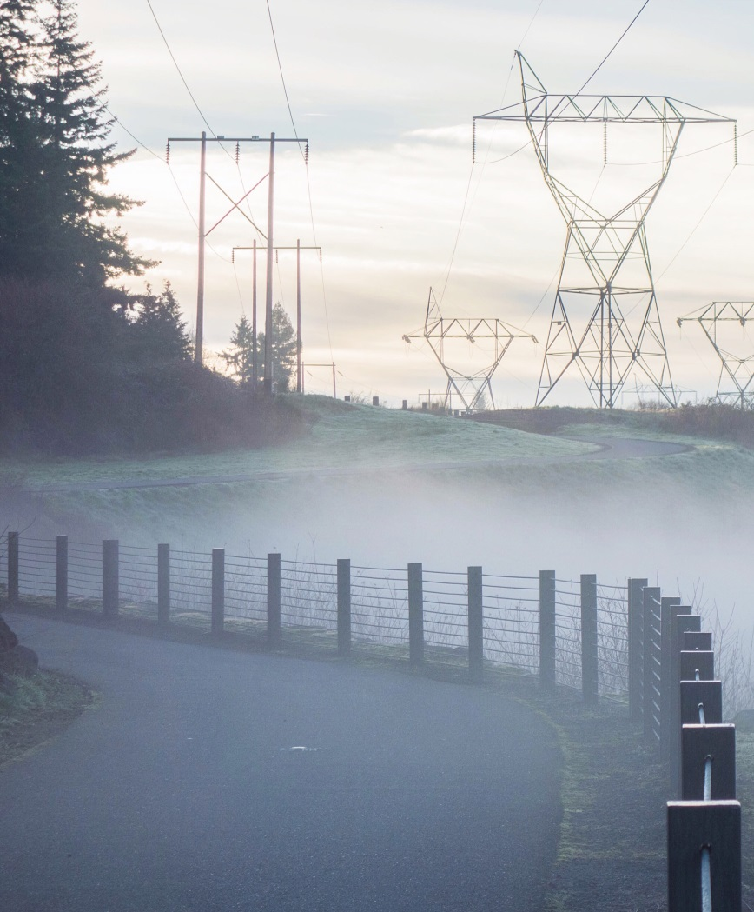
Agenda
The future of (grid connected) solar
SolarEdge Technology
Why do we need Smart Inverters?
What is a Smart Inverter?
What are the features of Smart Inverters?
Notes:
Image: https://hd.unsplash.com/photo-1436464224124-bbac0b4e3d50

Slide 6
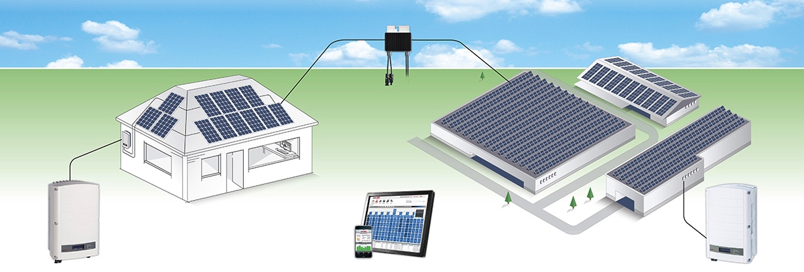
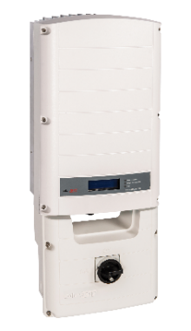
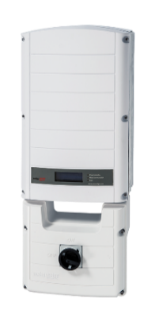
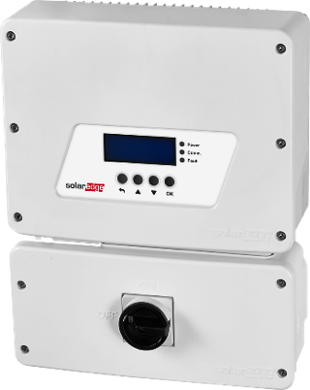
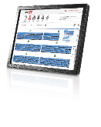
It’s as Easy as 1, 2, 3…
Each solar module is optimized by a power optimizer (DC to DC)
A simplified inverter converts DC to AC
Monitoring portal visualizes performance of each device
Power Optimizer
P300-P800
HD-Wave Inverter:
3 – 7.6kW
240Vac
Single-Phase Inverter:
5 – 11.4kW
240Vac
Three-Phase Inverter
9 – 33.3kW
208Vac & 277/480Vac
Cloud-Based
Monitoring Portal
Notes:
We don’t support 480V delta

Slide 7
Why Should We Care Today?
Continued growth of PV generation puts more stress on grid infrastructure designed for distribution from centralized energy sources
Smart inverters can help reduce grid upgrades needed for increasing PV penetration
September 8th, Smart Inverters are required for 3 major California IOUs and Hawaii
Other regions are expected to follow
Potential retro-active measures favor “future proofing” installations

Slide 8
What is a Smart Inverter?
Smart inverters are PV inverters that stay connected and provide additional functions to help actively support the grid- mainly voltage and frequency
Smart Inverters can receive commands from grid operators and report information
Traditional inverters simply disconnected when the grid voltage or frequency went out of range.
Examples: California Electric Rule 21, Hawaii Rule 14H
Pilots: Arizona Public Service, Green Mountain Power, National Grid
Notes:
https://hd.unsplash.com/photo-1436464224124-bbac0b4e3d50

Slide 9
Which Inverters are Smart Inverters?
SolarEdge uses the same hardware and the same model numbers
Software enables special features – Customizable for each region ( California, Hawaii, Japan, Australia, Germany)
Hardware + software together is evaluated and tested by a NRTL (Nationally Recognized Testing Laboratory) to UL1741 Supplement A
Inverters are labeled with: “Grid Support Inverter” vs. only “Grid Interactive”
http://www.gosolarcalifornia.ca.gov/equipment/inverters.php (downloadable Excel table)

Slide 10
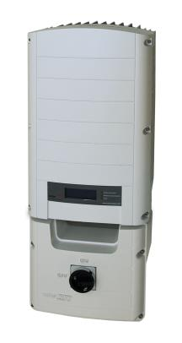
Smart Inverter Functions
Anti-islanding with Grid Support Functions Enabled
Low/High Voltage Ride-Through
Low/High Frequency Ride-Through
Dynamic Volt/VAr Mode
Ramp Rates /Reconnect by Soft-Start
Fixed Power Factor
Frequency-Watt
Volt-Watt
Reactive Power Control
Remote Shutdown / Power Reduction
Grid Monitoring Before Connection
DC Injection Detection
Remote configurability / scheduling
Export Limiting / Curtailment

Slide 11
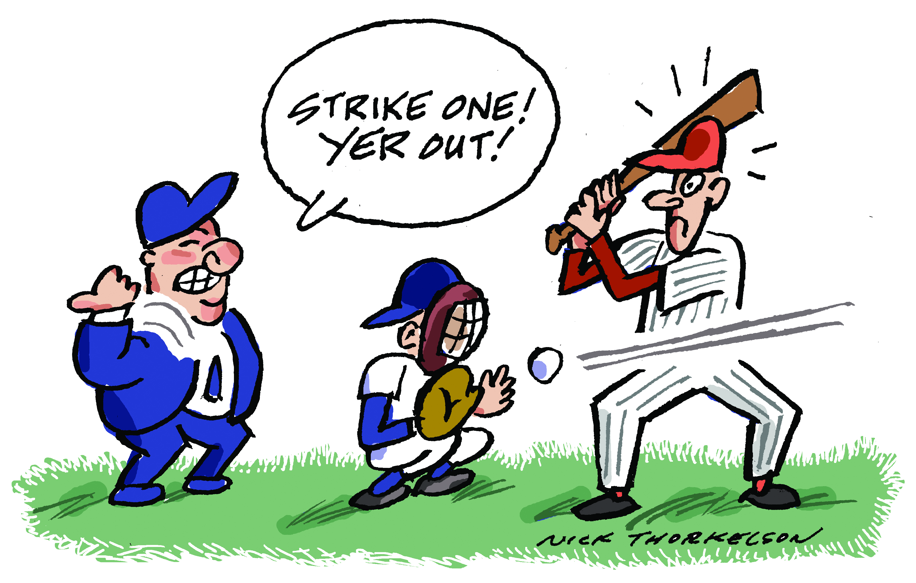
Frequency & Voltage Ride-Through
Purpose: Inverters support the grid during brief voltage or frequency excursions
Previously inverters were required to disconnect when values were out of range– “trip points”
Disconnecting can create more issues with grid stability if PV is a high % of generation
Longer trip times are based on the degree of excursion to help grid stability
5 MIN

Slide 12
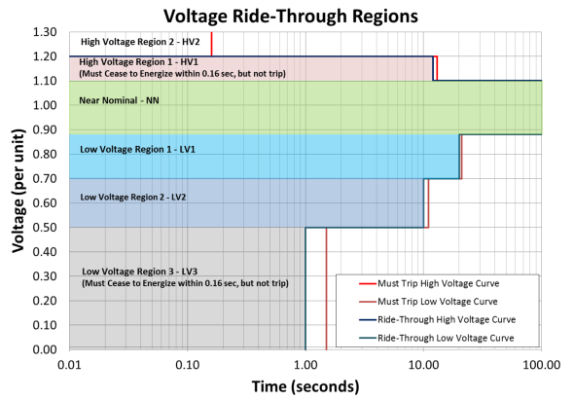
Voltage-Ride Through Example

Slide 13
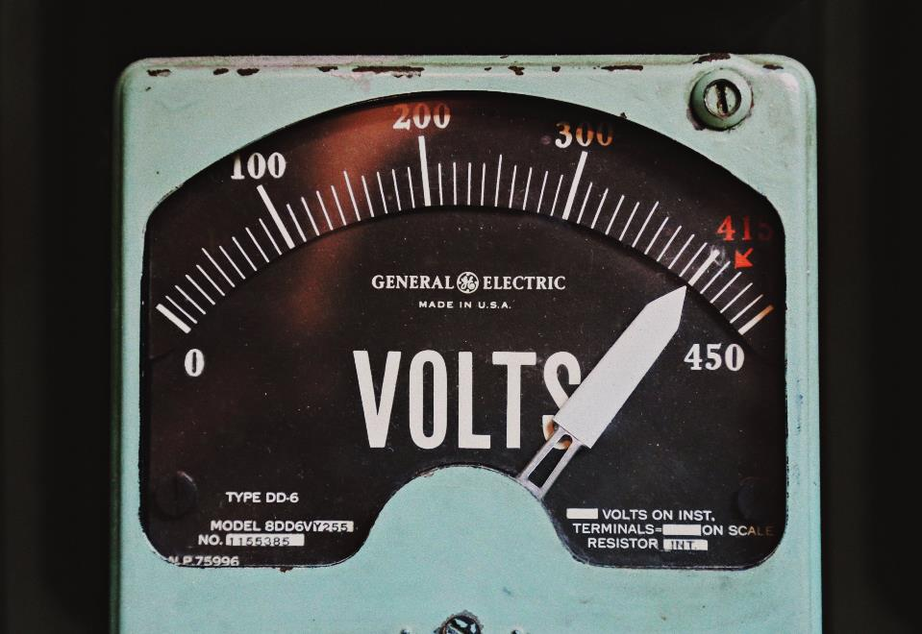
Volt/VAr Mode
Purpose: Variable Power Factor provides active voltage stabilization
Grid voltage nominal, purely active power
Grid voltage high, add ‘inductive’ reactive power
Grid voltage low, add ‘capacitive’ reactive power
Adjusting VArs keeps grid voltage from oscillating; acts like a shock absorber
Intended result is automatic stabilization of grid voltage
Only used when needed -“deadband”
Notes:
Image: https://hd.unsplash.com/photo-1458007683879-47560d7e33c3

Slide 14
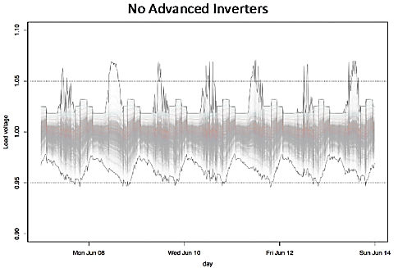
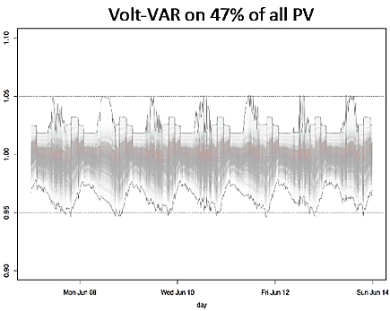
Modeled Example of Voltage Support
Hawaii2015 base case
105%
https://www.nrel.gov/docs/fy17osti/68681.pdf

Slide 15
Fixed Power Factor
Purpose: adjusting reactive power from PV systems can help maintain stable grid voltage
Specification is to allow a ‘preset’ power factor for the inverter (eg 0.95)
At its power limit, the inverter can be set to prioritize reactive power or active power
Pros : easy to implement, single setting, “open loop” no feedback control needed
Cons: Always on even when you don’t needed it reactive priority always affects peak production of the inverter
Reactive
Power (VAr)
II
I
Active
Power
III
IV

Slide 16
Normal Ramp Rate & Soft-Start
Purpose: to help smooth transitions from one output level to the next
Aggregated systems responding to the same event could cause instability
Ramp rate specifies a linear rate for power change
‘Normal’ - rate of change during operation
‘Soft Start’ - rate of change during reconnect
Supports grid by ramping up slowly giving the grid time to adjust to the PV energy coming back online
PV Production
Soft Start
Time
Notes:
Purpose : Help smooth transitions from one output level to another output level.
Ramp rate specifies a linear increase/decrease in power change over time
Aggregated systems responding to a specific event could cause voltage spikes or dips, harmonics, or oscillations
‘Normal’ ramp rate specifies how quickly the inverter can change output based e.g. on changes to solar conditions
‘Soft Start’ ramp rate specifies inverter ramp from zero production (off)

Slide 17
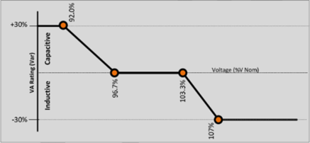
Frequency/Watt
Support grid frequency by changing inverter wattage output
Grid frequency nominal, inverter at max output
Grid frequency high, inverter curtails power
Grid frequency low, inverter increases power*
Higher frequency indicates turbines spinning too fast – increase in load slows turbines
Similar behavior in Germany (VDE-AR-N 4105)
* If available
Notes:
Image: https://hd.unsplash.com/photo-1414338064484-43f58c33aeb3

Slide 18
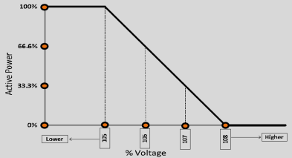
Volt/Watt Mode - (Optional)
To help support grid voltage, an inverter may change its wattage output
Grid voltage nominal, inverter at max output
Grid voltage high, inverter curtails power
Grid voltage low, inverter increases power*
Voltage indicates potential energy in the grid – lowering power input lowers pressure on grid
Similar to frequency/watt
May be used with Volt/VAr - If Volt/VAr doesn’t help enough, Volt/Watt kicks in
Example
* If available

Slide 19
Smart Active Inverter Features
The market is changing – advanced inverter functions can improve PV penetration and grid stability
Solar Generation is evolving to provide similar functionality to other grid sources of energy
Inverters are taking a more active role
Smart Inverter Functionality
Storage / Demand Response
Communications & Aggregation
Cyber security
More?
Notes:
https://hd.unsplash.com/photo-1472162314594-eca3c3d90df1
https://hd.unsplash.com/photo-1435226148432-67c26cc5cbaf

Slide 21
Codes & Standards for Advanced Inverter Grid Support
Ken Boyce, UL
UL and the UL Logo are trademarks of UL LLC © 2017. All rights reserved. No portion of this material may be reprinted in any form without the express written permission of UL LLC. or as otherwise provided in writing.

Slide 22
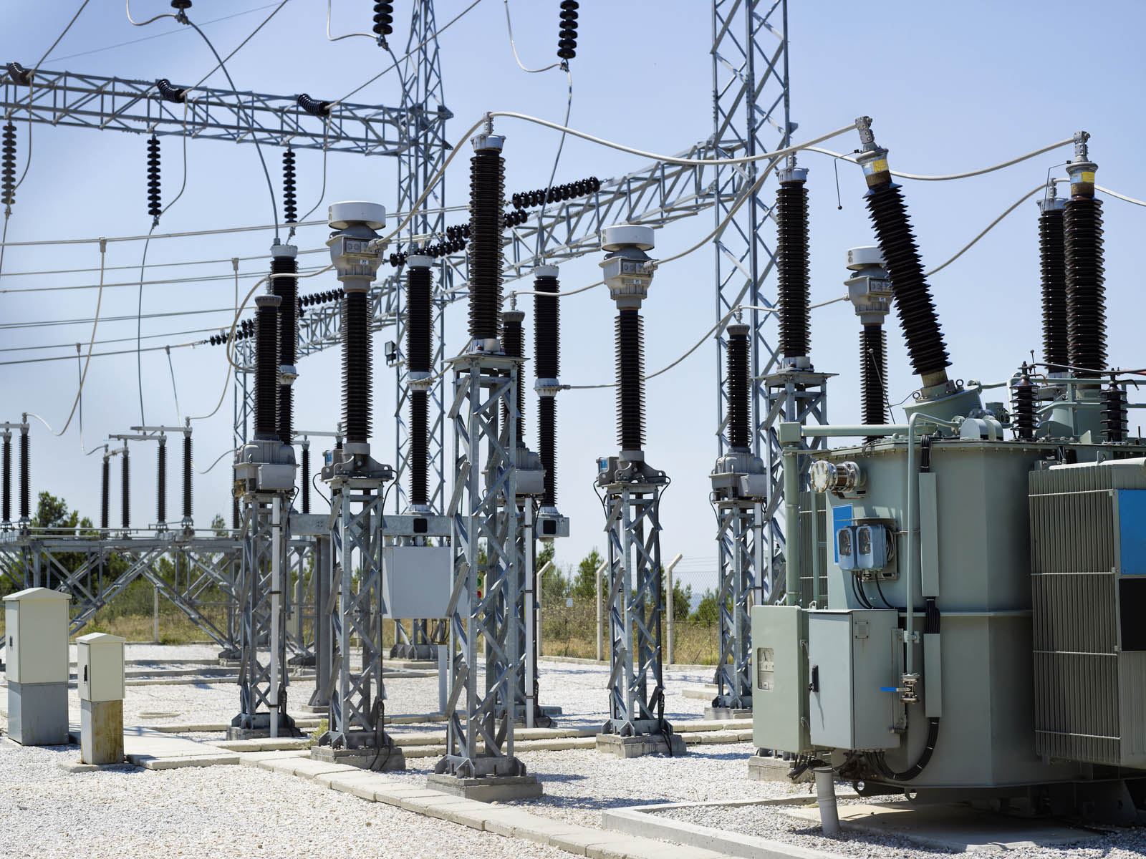
Traditional Power Conversion & Grid Interconnection Standards
IEEE 1547
Interconnection System Requirements
IEEE 1547.1
Interconnection
System Testing
UL 1741
Power Conversion & Interconnection Equipment
Voltage Regulation
Disconnects
Monitoring
Islanding
Power Quality
Temperature Stability
Response to Abnormal Voltage
Response to Abnormal Frequency
Synchronization
Protection from EMI
Surge Withstand
Paralleling Device
DC Injection
Unintentional Islanding
Reverse Power
Open Phase
Reconnect after disturbance
Harmonics
Construction
Testing Normal and Abnormal
Protection Against Risks of Injury to Persons and Connected Equipment
Ratings, Markings and Instructions
Specific DR Tests for Specific Technologies
Production Line Testing
Certifications Address NEC and Electric Utility Interconnection Needs
Notes:
UL1741 and IEEE 1547 established a set of standardized interconnection requirements used to evaluate utility interconnected distributed generation (DG) products for electrical safety and grid interconnection. At low levels of DG penetration, these standards address the needs of Utility Interconnection Engineers and Authorities having jurisdiction (AHJ’s).
Summarize objective of 3 standards and explain that UL 1741 SA will be an optional addition on top of this offering.

Slide 23
New UL1741 Supplement A (SA) for Advanced Technology
Developed specifically for advanced inverters through a cross functional Task Group
Key participation from:
State Regulators
Electric Utilities – CA, HI, and AZ
Inverter Manufacturers
U.S. National Labs – Sandia and NREL
Electrical Power Research Institute (EPRI)
Other interested parties
UL 1741 SA reached consensus and was incorporated into UL 1741 in September 2016 after addressing over 650 comments.
Notes:
Note that there is not a “new document or Standard.” The latest version of UL 1741 has a 60 page supplement that is added to the end that provides the new information/requirements.
Weekly meetings ~ 1.5 years with 40+ members

Slide 24
Advanced Inverter Movement
Which Standards are Used for Advanced Inverter Testing?
UL 1741 SA specifies the test methods to be used with one or more Source Requirement Documents (SRD) for limits and parameter settings.
State of California Electric Rule 21, including inverter revisions, issued by the California Public Utility Commission (CPUC) comprise an SRD which can be used with UL 1741 SA. Other SRD’s may also be used with the SA.
Notes:
While the need for the 1741 SA came initially from CA, it was quickly determined that it would be needed for other utility application as well. The task group drove the document to be generic such that it would meet the needs of multiple utilities.
1741SA provides the testing structure into which the SRDs provide specific test evaluation and compliance criteria Mention 3 CA SRDs and H14 Mfrs can choose to do a superset evaluation to demonstrate compliance with all 4 documents

Slide 25
Utility Interactive Product Types
Utility
Interactive
Grid Support Utility Interactive
Special Purpose Utility Interactive
Traditional IEEE 1547 & 1547.1 Interconnection Requirements
UL 1741 SA Support Functions
Limited Manufacturer Defined, UL Verified Compliance
The above categories clearly define product functions and ratings based on the product’s markings, ratings, manual, and certification documentation.
Notes:
Scott’s Slide
Utility interactive: Current state for UI products. Minimum requirement to interconnect with the public utility. Works well in areas of limited DG penetration.
Grid Support Utility Interactive: Smart inverter functions for reactive response to grid conditions. Works well in areas of increased DG penetration.
Special Purpose Utility Interactive: Select smart inverter functions for customized installation locations. These products may also have specialized features or response ranges outside of typical items evaluated for a given installation challenge.

Slide 26
Differentiation of Utility Interactive Products
UL Certification: Grid Support, Utility Interactive Product
Scope: Safety & Electric Shock Certification to UL1741 including UL 1741 SA for grid support and general grid interconnection per IEEE 1547
IEEE 1547 & IEEE 1547.1 general grid interconnection requirements
Includes Testing to Verify:
UL 1741 electric shock/fire tests
UL 1741 SA grid support tests
Unique tests of IEEE 1547 for general grid interconnection not covered by UL 1741 SA tests
UL 1741: electric shock and fire compliance
UL 1741 SA: grid support functionality per SRD
(e.g., Rule 21)
Utility interactive product with grid support functionality
Deliverable: UL Certification as a Grid Support Utility Interactive product
Notes:
Scott’s Slide
This slide explains how to merge prior requirements with new requirements to result in a utility interactive product with grid support functionality.
It also shows how 1547 interacts with UL 1741 SA
Set up for what the service offering is at UL

Slide 27
UL 1741 SA – Modern Grid Support Interconnection
What Tests are Part of UL 1741 SA?
Required Tests
Optional Tests
(Depends on SRD Being Utilized)
Anti-Islanding (with advanced features active during test)
Low/High Voltage Ride Through
Low/High Frequency Ride Through
Must-Trip Test
Ramp Rate (Normal & Soft-Start)
Specified Power Factor
Volt/VAr Mode
Frequency Watt
Volt Watt
=
~
Notes:
Summarize list of tests and explain compliance with the 1741 Supplement SA is optional BUT it is required for if a MFR is selling a “Grid Support Interactive Inverter”
California and Hawaii and how it relates to the SRD being considered.

Slide 28
UL 1741 SA: SA8 Advanced Anti-islanding
This test addresses unintentional islanding with grid support functions enabled which is not addressed in IEEE 1547
The test is run with function sets enabled to ensure the anti-islanding (AI) method is able to detect an island condition within two seconds of the formation of an island
The following grid support functions are tested in the function sets noted below with all adjustable parameters set to their most unfavorable settings for the AI method used.
FUNCTION SET NUMBER
GRID SUPPORT FUNCTIONS ACTIVE
1
Low & High Voltage & Frequency Ride Through
2
Function Set 1 plus Specified Power Factor, Ramp Rate, and Frequency Watt
3
Function Set 1 plus Volt/VAr mode, Ramp Rate, and Frequency Watt
Notes:
Scott’s Slide

Slide 29
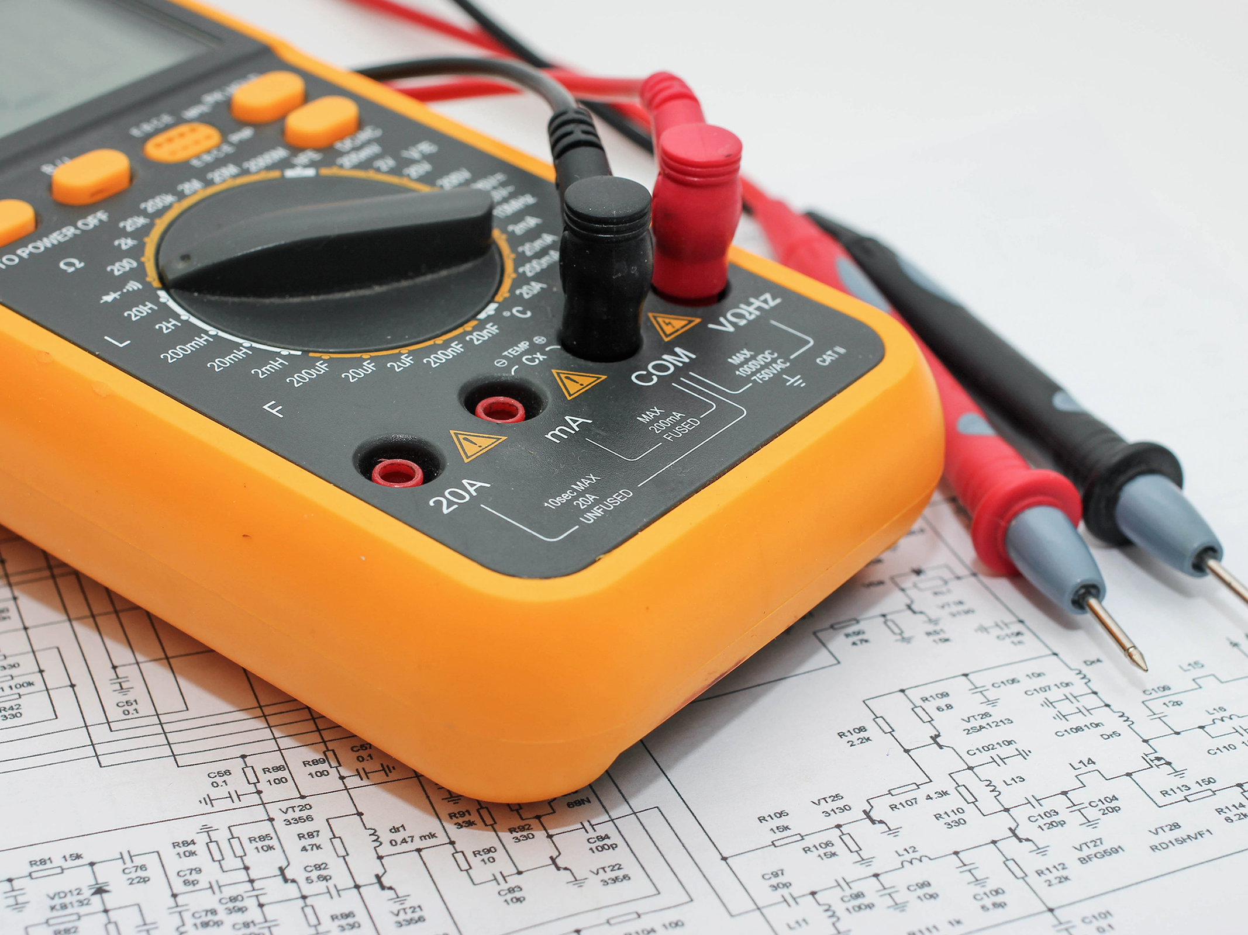
UL 1741 SA: SA 9 Low and High Voltage Ride Through
These tests verify the ride-through behavior of the system in response to low- and high-voltage excursions that are outside the normal range of operation of the area grid. Must-trip behavior areas are also noted below.
REGION
VOLTAGE (% NOMINAL VOLT)
RIDE-THROUGH UNTIL (s)
OPERATION MODE
MAXIMUM TRIP TIME (s)
HIGH VOLTAGE 2 (HV2)
V ≥ 120
Not Applicable
Not Applicable
0.16s
HIGH VOLTAGE 1 (HV1)
110 < V < 120
12s
Momentary Cessation
13s
NEAR NOMINAL (NN)
88 ≤ V ≤ 110
Indefinite
Continuous Operation
Not Applicable
LOW VOLTAGE 1 (LV1)
70 ≤ V < 88
20s
Mandatory Operation
21s
LOW VOLTAGE 2 (LV2)
50 ≤ V < 70
10s
Mandatory Operation
11s
LOW VOLTAGE 3 (LV3)
V < 50
1s
Momentary Cessation
1.5s
Notes:
Ride-Through –State or action in response to an abnormal excursion of the area EPS, in which the EUT does not trip in less than the minimum specified duration.
Mandatory Operation - A prescribed requirement to provide current to the area EPS in response to an abnormal excursion of the area EPS, within the SRD defined range.
Different from IEEE 1547 where trip points could be set based on the design of the inverter. This standard will specify a minimum operating envelope
Note: EUT protective functions needed to prevent damage to the EUT shall be permitted to function during mandatory operation.
Continuous Operation –During normal grid the EUT shall operate normally and export available active and/or reactive power.
Cease to Energize – Stop what you are doing & wait a while.
State or action in which the EUT ceases to export current to the area EPS in not more than the maximum specified time. Cease to energize does not imply galvanic separation (disconnection) of the EUT from the Area EPS.

Slide 30
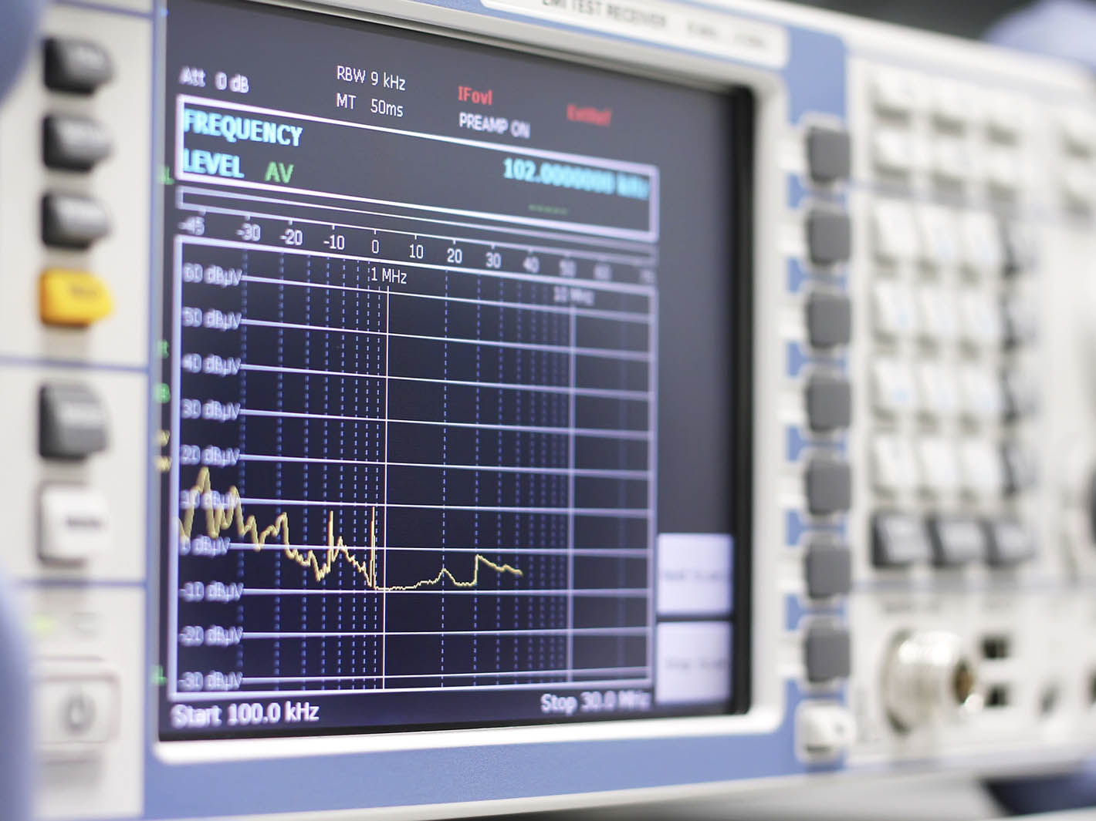
UL 1741 SA: SA 10 Low & High Frequency Ride Through
These tests verify the ride-through behavior of the system in response to low- and high-frequency excursions that are outside the normal range of operation of the area grid. Must-trip behavior areas are also noted below.
REGION
SYSTEM FREQ DEFAULT SETTINGs
MINIMUM RANGE OF ADJUSTABILITY
RIDE THROUGH UNTIL (s)
RIDE THROUGH OPERATION MODE
TRIP TIME (s)
HIGH FREQ 2 (HF2)
f > 62
62.0 - 64.0 Hz
No Ride-Through
Not Applicable
0.16s
HIGH FREQ 1 (HF1)
60.5 < f ≤ 62
60.1 - 62.0 Hz
299
Man. Operation
300s
NEAR NOMINAL (NN)
58.5 < f ≤ 60.5
Not Applicable
Indefinite
Con. Operation
Not Applicable
LOW FREQ 1 (LF1)
57.0 < f ≤ 58.5
57.0 - 59.9 Hz
299
Man. Operation
300s
LOW FREQ 2 (LF2)
f ≤ 57.0
53.0 - 57.0 Hz
No Ride-Through
Not Applicable
0.16s
Notes:
Tim’s Slide

Slide 31
UL 1741 SA: SA11
Normal Ramp Rate and Soft-Start Ramp Rate
Normal Ramp Rate test confirms that an inverter meets a given response characteristic for providing ramp rate responses. An inverter can change the rate at which it increases its power output but is constrained by what the hardware can physically do.
Soft-Start Ramp Rate test establishes ramp-up rates for systems transitions from one output level to another output level smoothly. Sharp transitions could cause power quality issues.
Normal Ramp Rate: Output power adjustment based on available power from DC source.
Soft-Start Ramp Rate: Device ramps from zero to operating power after a trip.
Notes:
Scott’s Slide
Normal ramp rate can be thought of as the ramp up experienced at the start of the solar day or when DG comes online taking PV power available into account.
Soft-Start is important for when inverters or groups of inverters come back on line after a fault. This is especially important for the entire PV system as a whole to interact with the grid in a stable reliable manner even in the event of fluctuating or intermittent PV power.

Slide 32
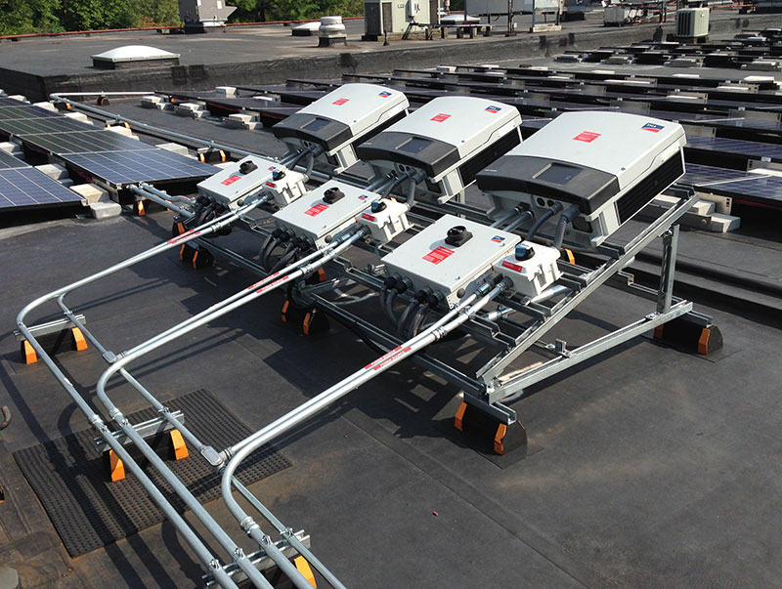
UL 1741 SA: SA12
Specified Power Factor (SPF)
This SPF test verifies inverter performance to provide reactive power to the grid by operating at a non-unity power factor
Non-unity power factor operation of distributed generation is used to assist in maintaining stable grid voltage
The SPF test demonstrates that an inverter is able to shift its power factor within its stated level of SPF accuracy in response to changing active power levels (20-100% of rated)
The SPF is verified at the minimum and midpoint of the capacitive (leading) and inductive (lagging) SPF values centered around a unity power factor
Power Factor Triangle
Apparent Power (kVA)
Inverter decreasing active power as grid frequency increases
Reactive Power (kVAr)
Real Power (kW)
Notes:
Read Slide
SRD set’s the required adjustment for min and mid leading and lagging PF’s required.

Slide 33
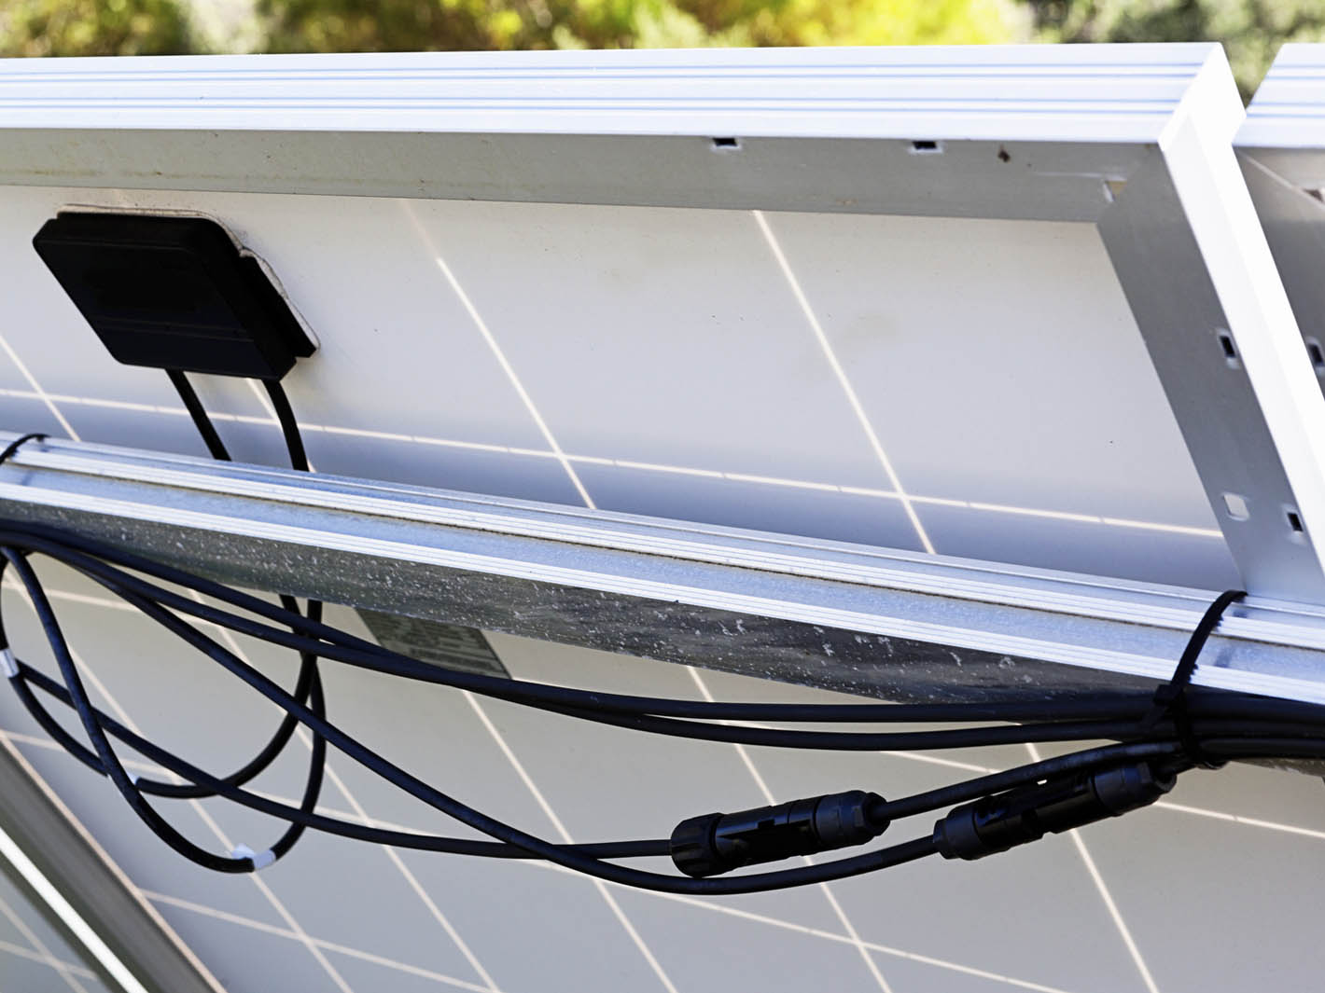
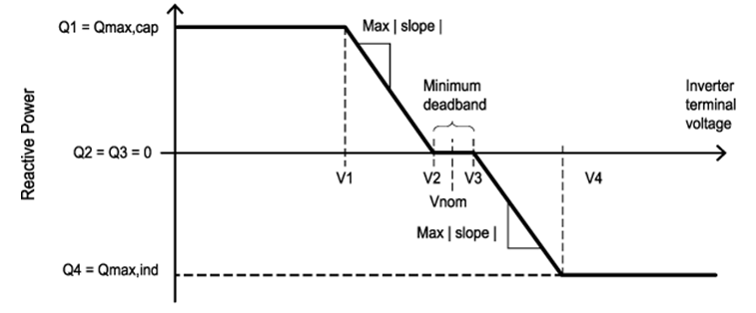
UL 1741 SA: SA13 Volt/VAr Mode Q(V)
Volt/VAr test verifies that an inverter is able to supply or absorb reactive power to/from the grid within the inverter’s stated accuracy for Q(V) performance
Q(V) performance is verified to 3 curves: Most, average, and least aggressive
The Q(V) functionality is used to maintain stable grid voltage when fluctuations are prevalent
Inverters can be configured to prioritize reactive or active power once it has reached its rated KVA limits
Once apparent power KVA limit is reached →
Reactive power is reduced to maximize active power production.
Active Power
Once apparent power KVA limit is reached →
Active power is reduced to maintain reactive power production.
Reactive Power
Volt/VAr Priority Options
Notes:
Tim’s Slide
Presenter Notes:
Indicate that chart represents “Most” curve.

Slide 34
UL 1741 SA: SA14
Optional Test: Frequency Watt (FW)
The FW test verifies an inverter’s ability to provide frequency support to the grid via adjustment of the inverter’s active power output which changes in grid frequency
Both over- and under-frequency responses may not be possible based on the energy source used and/or the mode of operation
PV inverters typically have a maximum commanded power limit and are only able to provide an over-frequency response if the inverter is already at full active power output
The FW function is verified at a maximum and minimum slope as specified by the inverter manufacturer.
Active Power
Inverter decreasing active power as grid frequency increases
(Increasing) Grid Frequency (Decreasing)
Inverter increasing active power as grid frequency decreases
Active
Power
Notes:
Tim’s Slide
Presenter Notes:
Grid frequency increases as a result of excessive generation and or insufficient load. One means for a EUT to provide frequency support to the grid is to change its active power output relative to grid frequency.
As frequency increases, the desired response of the inverter is to decrease active power output. Likewise, as frequency decreases it is desired for the inverter to increase active power output. The desired FW response of a grid support inverter is to reduce its power output so as to not contribute to further increase in the grid frequency.

Slide 35
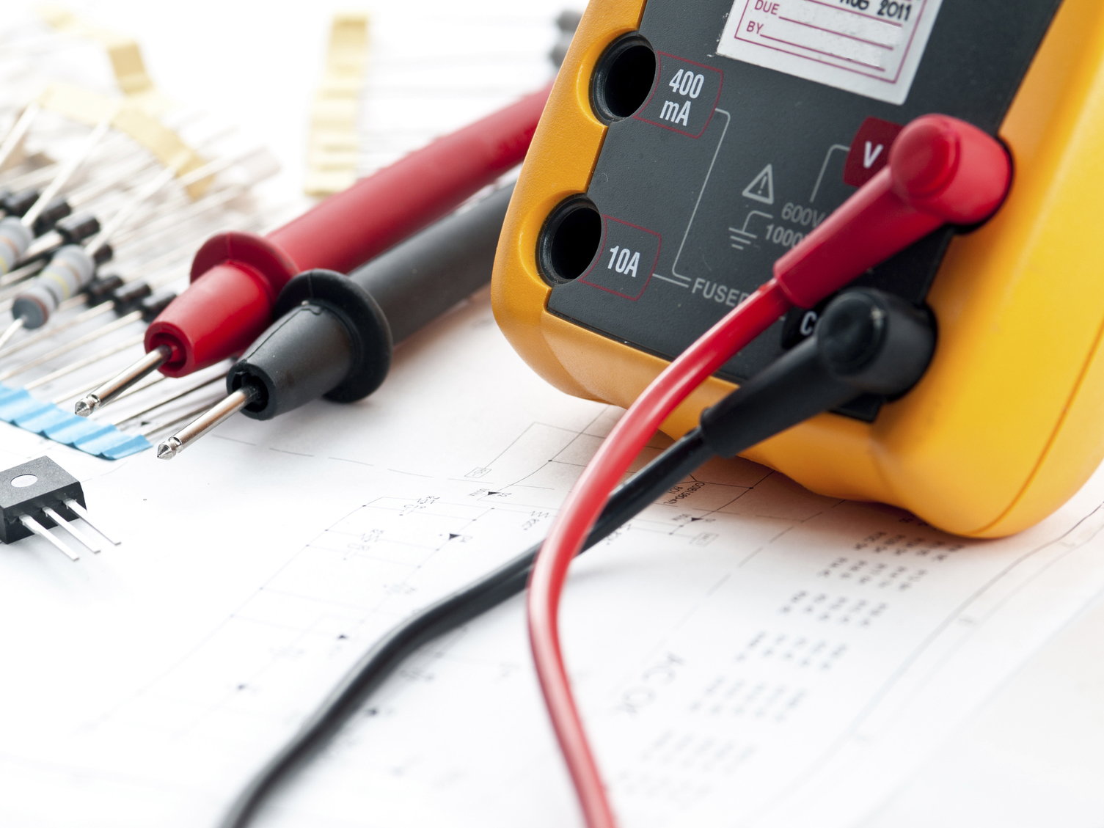
UL 1741 SA: SA15
Optional Test: Volt Watt (VW)
The VW test is similar to the FW test in that it verifies the inverter controls its active output power relative to changes in grid voltage
Active Power
Inverter decreasing active power as grid voltage increases
(Increasing) Grid Voltage (Decreasing)
Inverter increasing active power as grid voltage decreases
Active
Power
Notes:
Tim’s Slide
As grid voltage increases the inverter is supposed to reduce its output power to help prevent the grid voltage hitting an upper voltage trip limit.
The VW test verifies an inverter’s ability to provide voltage support to the grid via adjustment of the inverter’s active power output which changes in grid voltage.
Both over & under voltage responses may not be possible based on the energy source used and/or mode of operation.
PV inverters typically have a maximum commanded power limit and are only able to provide an over-voltage response if the inverter is already at full active power output.
The VW function is verified at a max and min slope as specified by the inverter manufacturer.

Slide 36
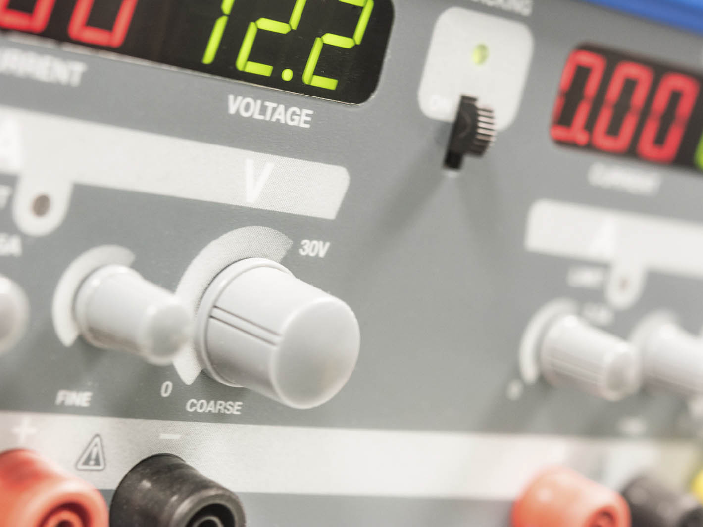
Advanced Inverter Movement
UL has taken the lead with AIT, Rule 21, and UL 1741 SA
UL involved from the beginning with developing the requirements
Creation of global AIT labs with qualified, highly trained staff support delivery of complete test results for various SRDs
Short turnaround times for testing in automated UL labs has resulted in short time-to-market certifications to UL 1741 SA
Notes:
UL has led the development of UL1741 SA for advanced inverter requirements since Q3 2014.
Weekly meetings from 2 to 6 hours plus homework
435 proposal comments
229 ballot comments
22 recirculation comments
Amazing industry and utility support! Most active and fastest standards project I have been involved with. Especially considering we created 60 pages of new standards text.

Slide 37
Thank you!
Kenneth Boyce, P.E.
UL LLC
+1.847.664.2318
Kenneth.p.boyce@ul.com
UL and the UL Logo are trademarks of UL LLC © 2016. All rights reserved. No portion of this material may be reprinted in any form without the express written permission of UL LLC. or as otherwise provided in writing..
Notes:
Icons made by Freepik, Daniel Bruce from www.flaticon.com. Licensed under CC BY 3.0 Licensed under CC BY 3.0 (https://creativecommons.org/licenses/by/3.0/us). Edited.

Slide 38
History of the California Smart Inverter and the Smart Inverter Working Group
Formed in 2013 to develop recommendations for technical steps needed to optimize inverter‐based DERs to support grid operations.
Weekly meetings led to recommendations for smart inverter functionality in three phases.
Tariff Revisions: Proposed and Approved
Phase 1: Autonomous Functions
January 2014
January 2015
April 2015
Phase 2: Communications
February 2015
December 2016
April 2017
Phase 3: Advanced Functions
March 2016
Revised March 2017
TBD
Likely Later of a Date in 2019 or a Time Period Following a Test Standard
August 2017
TBD
Later of (a) March 2018 or (b) 9 Months Following a Test Standard
September 2017
Recommendations Completed
Required Date
DER Action Plan
By 2020, fully operationalize advanced smart inverter functionalities to enhance the integration of DERs into the grid.

Slide 39
Smart Inverter Functions
Phase 1 Autonomous Functions | Phase 2 Communications | Phase 3 Advanced Functions
Anti-Islanding Voltage Ride-Through Frequency Ride-Through Volt/VAR Control Default and Emergency Ramp Rates Fixed Power Factor “Soft-Start” Methods | Three Pathways: IOU – DER IOU – DERMS IOU – Retail Aggregator Default Protocol: IEEE 2030.5 (aka SEP 2.0) | Monitor Key DER Data DER Cease to Energize/Return to Service Request Limit Maximum Real Power Mode Set Real Power Mode Frequency-Watt Emergency Mode Volt-Watt Mode Dynamic Reactive Current Support Mode Scheduling Power Values and Modes
Italicized Phase 3 functions were recently recommended to be optional in Rule 21, as they are either not in the international standard, IEEE 1547, or are optional in the standard. They have also not been fully developed or tested.

Slide 40
Smart Inverter Policy: Presentation to the Illinois Solar Energy Industries Association
Brandon Smithwood, Director of California State Affairs, SEIA
August 22, 2017

Slide 41
Policy Considerations
California’s Smart Inverter Working Group has defined capabilities for communications and advanced functions
Only Phase 1 (autonomous) functions must be operational in the near term
Illinois’ standard on utility control for a “reliability event” is beyond the rules established in California
Debate: where does being a “good grid citizen” end and providing “distribution grid services” begin?
voltage and frequency ride through, anti-islanding, “soft start”… some functions needed to maintain bulk and distribution system at high penetrations of distributed energy resources
Provision of data to the utility, conversation voltage reduction through coordinated volt/VAR and utility operations,…some functions are services to the grid which should be compensated

Slide 42
How to Define a “Reliability Event”
Recommendation: “The unplanned loss of power due to an abnormal condition on the electric distribution system or, when power can be restored by neighboring distribution systems, an abnormal condition on the sub-transmission or transmission system. The utility shall use best efforts to restore control of the smart inverter to normal operations as soon as the reliability event has been resolved.”
The utility can take control of the smart inverter during a reliability event only after the utility has exhausted all other resources. The utility will program their responses to automatically utilize the smart inverter as the last resort resource per recommended use in the draft IEEE 1547.1 standard.
Group Ask: Data from the utility on historical reliability events to be provided prior to filing the initial DG rebate and smart inverter tariff.

Slide 43
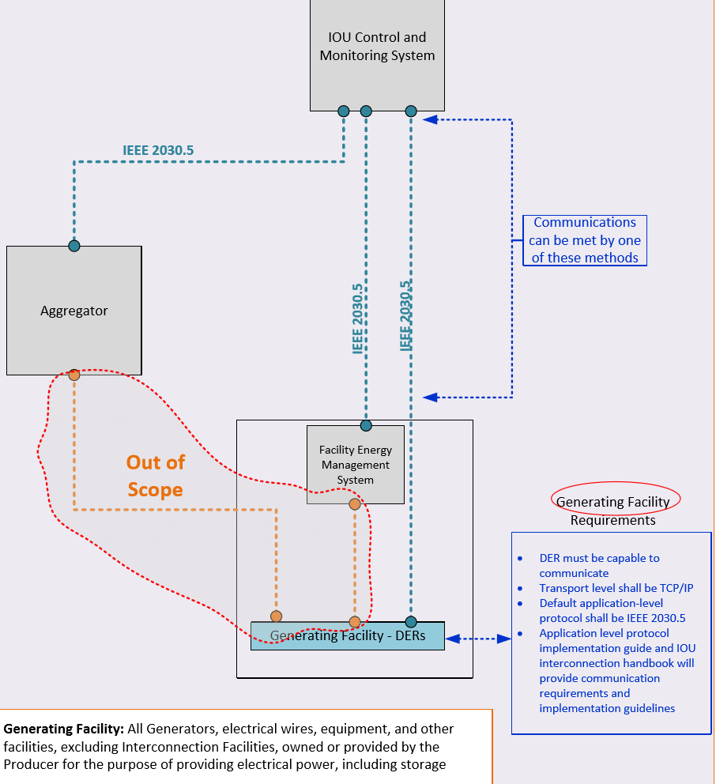
How Does Utility “Control” Work?
Utility Communication with Smart Inverters
Recommendation: The utility should follow the IEEE 2030.5 standard with the ability to communicate through aggregators/integrators or directly with the inverter.
The inverter should follow the draft IEEE 1547.1, and the final standard for IEEE 1547.1 once in effect for communication requirements.

Slide 44
Testing Capabilities and Compensation Needed
Recommendation: The utility shall implement pilot programs and shall provide reasonable compensation as part of such programs.
Recommended pilots include but are not limited to exploring:
1. Communication with the smart inverter through an aggregator/integrator or directly with the inverter
2. Data collection from the smart inverter
3. Basic testing of smart inverter capabilities
4. Future capabilities of a smart inverter
5. High penetration renewable feeder pilot
6. Wide area renewable penetration pilot
7. Value of future alternate compensation streams

Slide 45
Contacts
Rick Umoff, Regulatory Counsel and Director of State Affairs, Solar Energy Industries Association
- manages SEIA Midwest Committee
- rumoff@seia.org
Brandon Smithwood, Director of California State Affairs
- bsmithwood@seia.org

Slide 46
Questions?

