Slide 1
36 Years of DIY Passive Solar, 12 of Wind and PV: Construction and Experience Phil Geil
Passive solar, timber frame, earth sheltered, SIP house
Low voltage switching
Solar thermal pool heating for greenhouse
Wind turbine erection
Solar photo-voltaic panels and wiring
Output

Slide 2
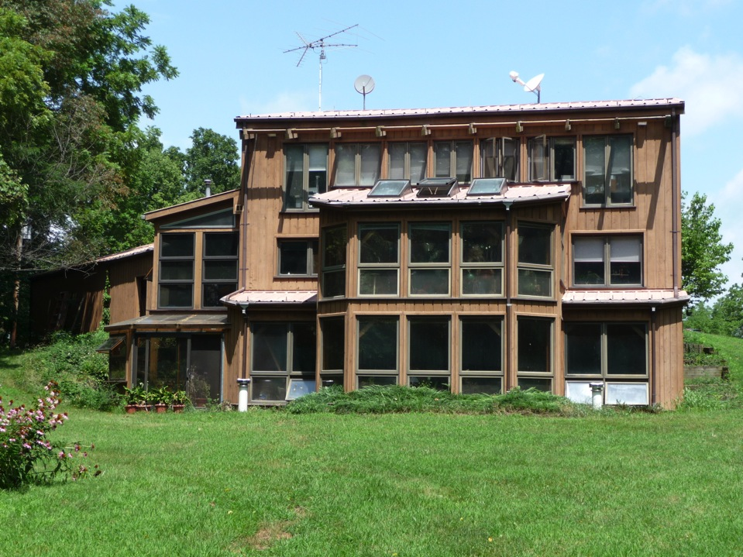

Slide 3
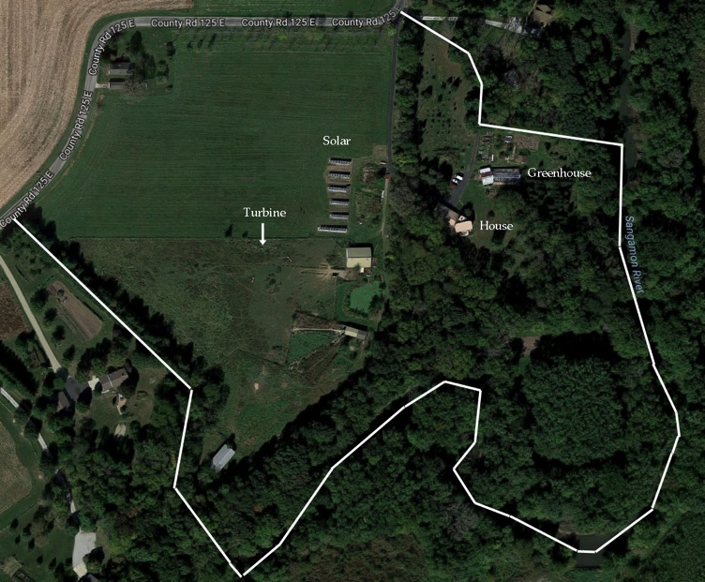
Satellite photo of lot and house, wind and solar locations; are on ca. 30’ high
bank of Sangamon river permitting earth sheltering.

Slide 4
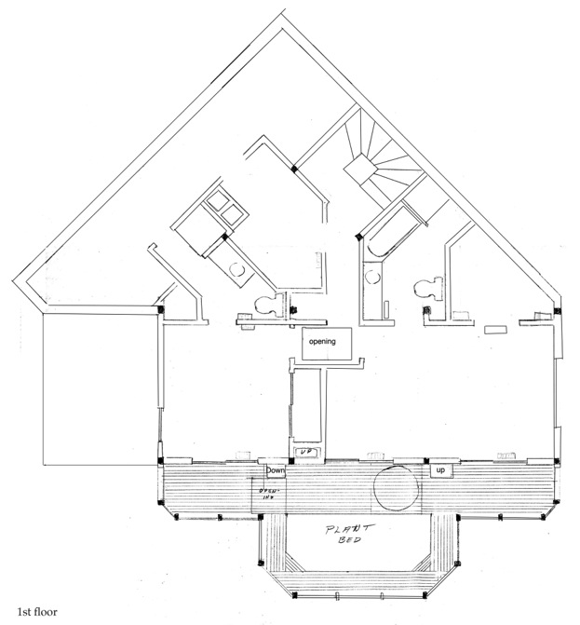

Slide 6
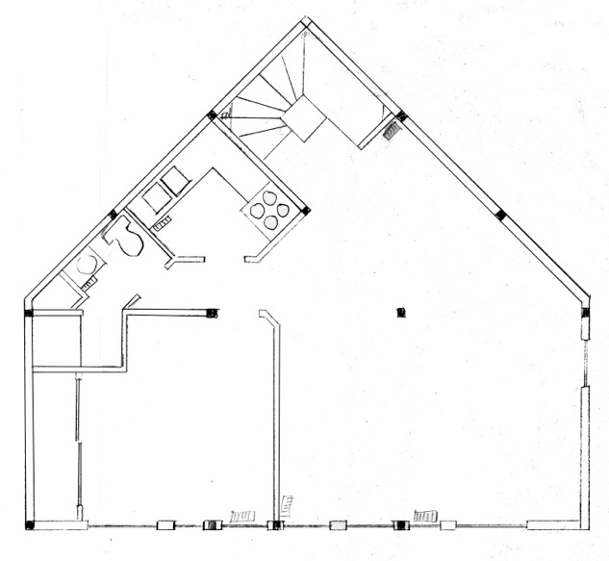
Third floor

Slide 7
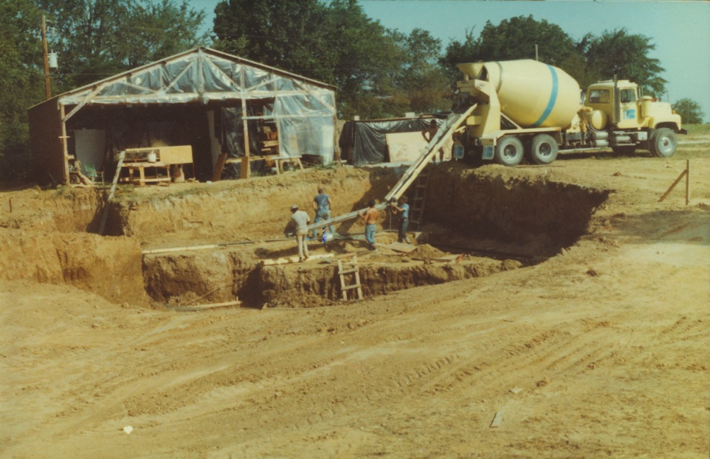
Installation of footing; 30 x 60 “pole barn” garage installed first for storage of timbers and
construction of SIP panels, etc.

Slide 8
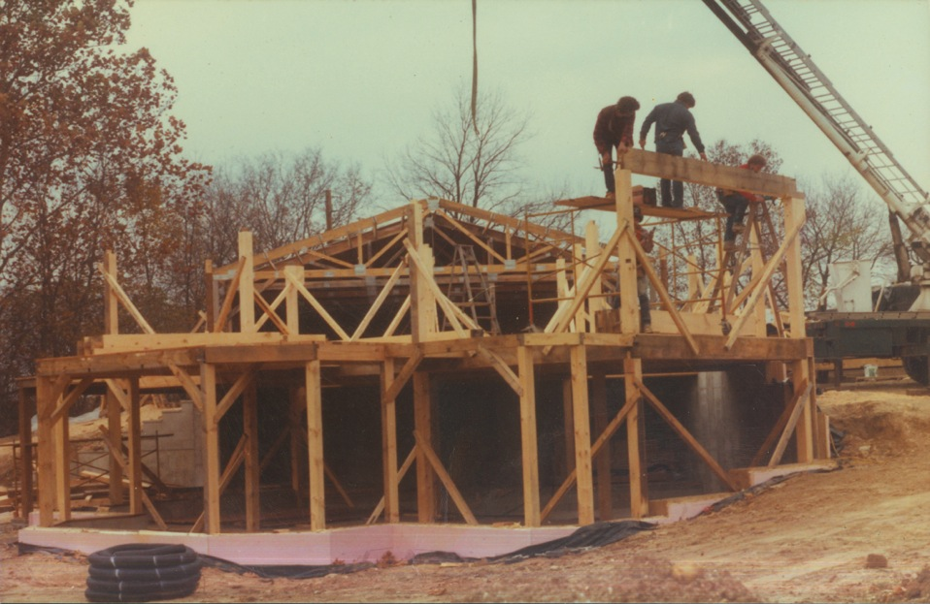
First floor framed, start on second. Note is earth sheltered on N and part of east side.
3” expanded PS foam insulates foundation and under basement floor.

Slide 9
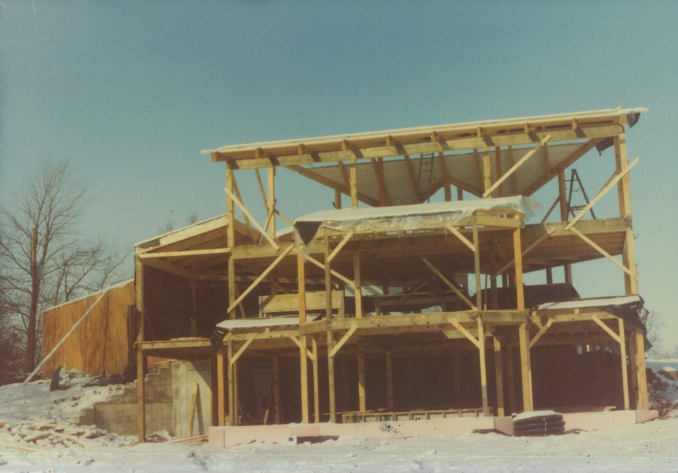
Framing completed; view from the south. 2x6 ceiling (under 8” SIP panels) partially
installed

Slide 10
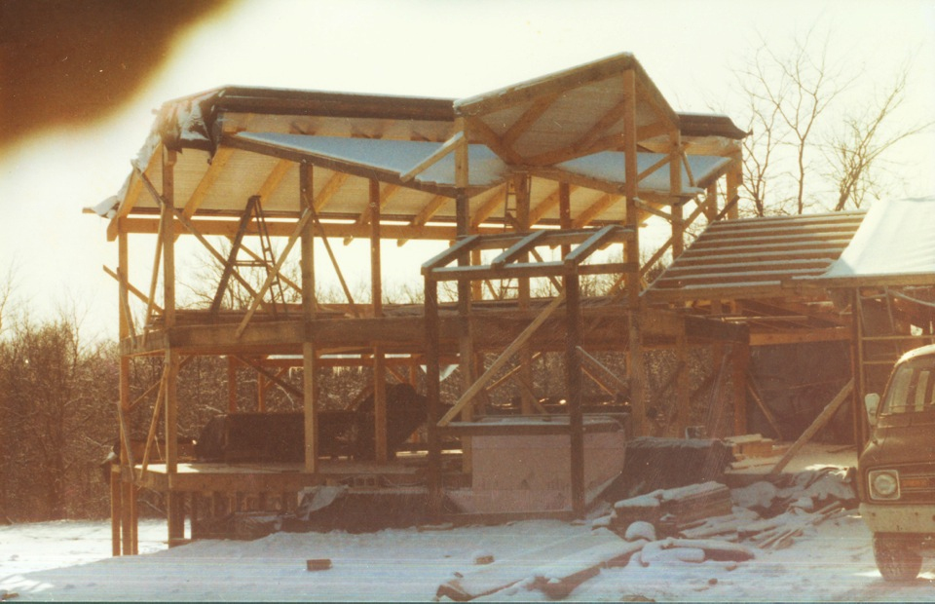
Framing complete, view from the north. Garage connected to house through extension with
first floor storage area under it. Front entry and spiral staircase framing.

Slide 11
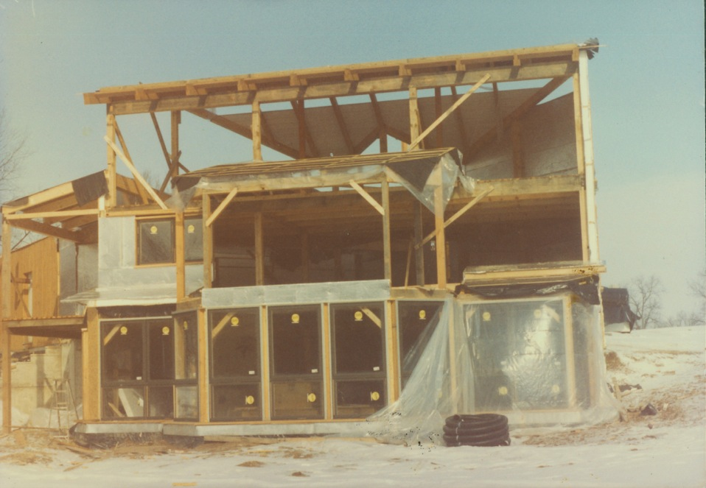
Start of window installation and side wall panels

Slide 12
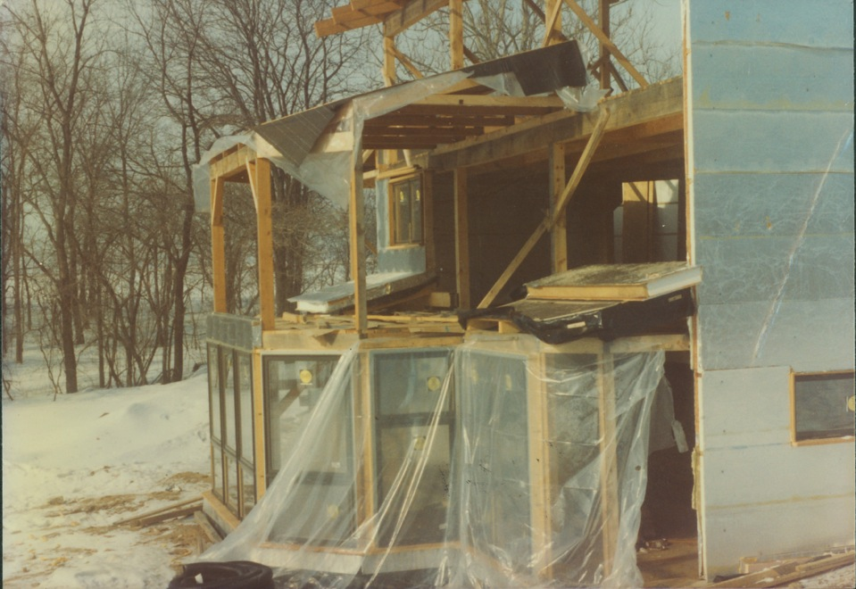
Installation of greenhouse windows. All side wall SIP panels sealed with Al foil on interior and
S. W and E exterior.

Slide 13
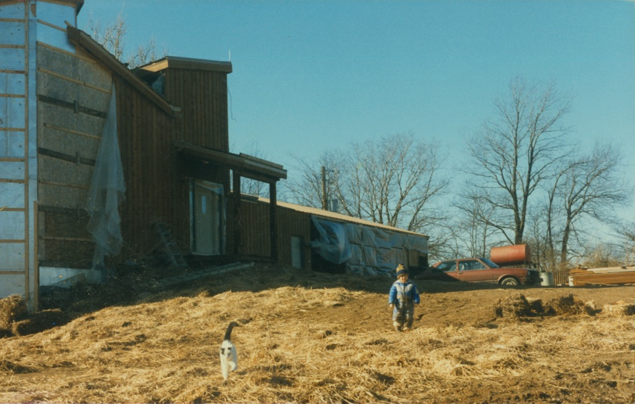
Installation of cedar siding. ¾ in air space between SIP and siding and drywall.

Slide 14
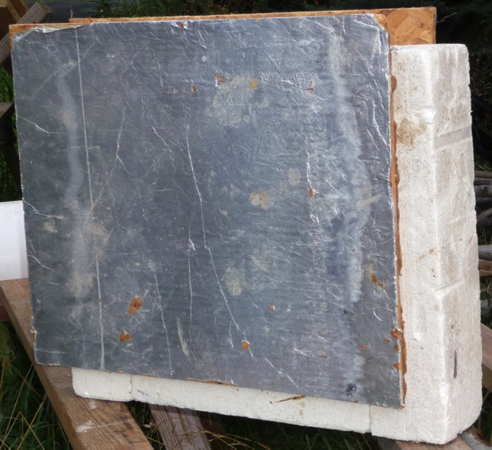
SIP panels construction
Side walls have 5.5 inch
high density expanded PS
foam, plus ½ in OSB panels,
air spaces (2) and drywall.
Roof (steel)has 7.5 in PS +
OSB + 2x6 ceiling. With
added ¾ in air spaces on
both sides plus dry wall
and cedar siding or 2x6,
side walls are R50; roof is
R70. House has
geothermal (well water)
for cooling, and solar and
kerosene heater for
heating.

Slide 15
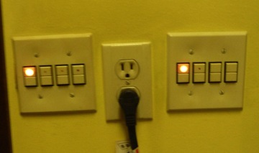
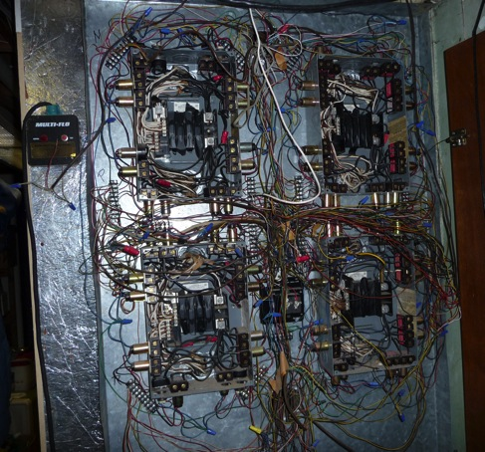
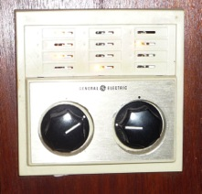
Low voltage switching. Permits as
many switches as desired for single
light, including switches in garage for
barn and greenhouse. Pilot lights (3w)
indicate on/off. Master switch by bed
controls 12 outside & major inside lights.
Relay box in house; switch wiring is 18 gauge,
24V

Slide 16
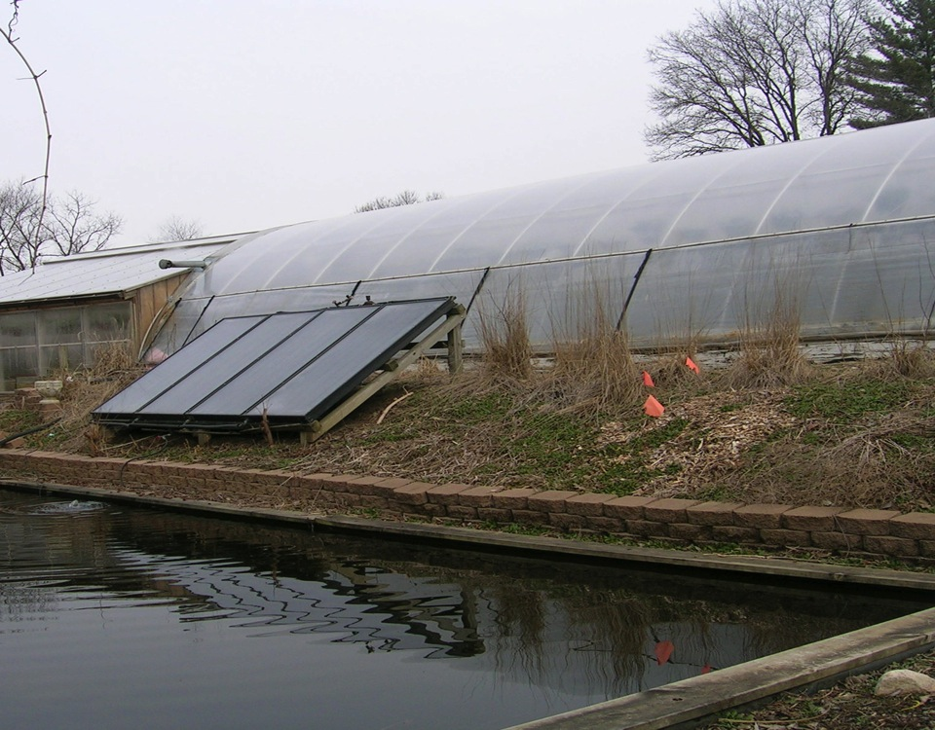
Solar thermal panels for swimming pool in greenhouse (double layer PC panels). Purchased
used from owner who “heated” his house by storing the hot water underground in an
uninsulated tank.

Slide 17
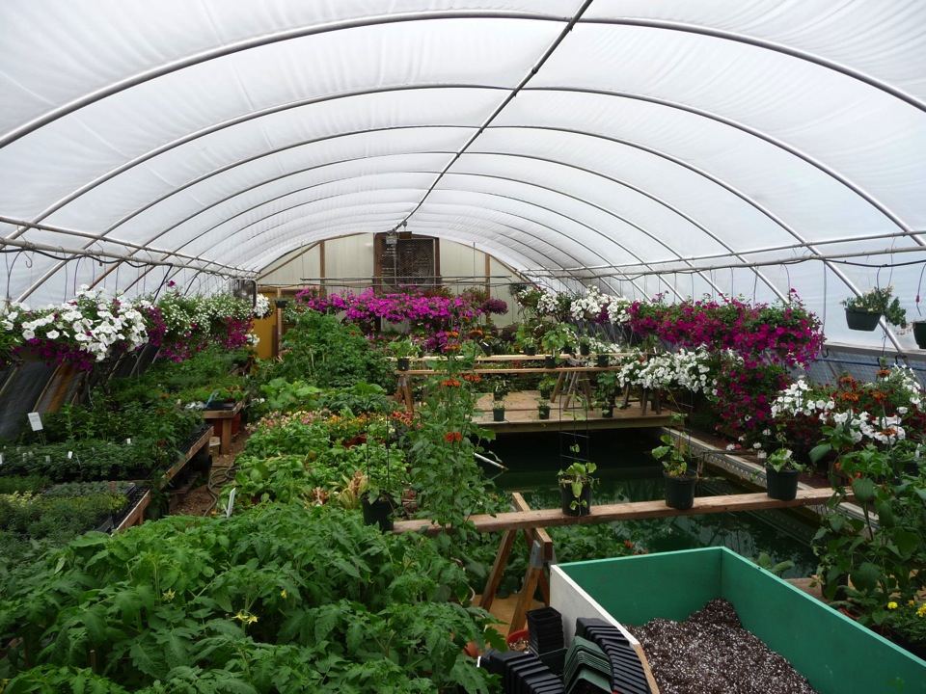
The solar thermal panels heat the swimming pool with greenhouse originally being a
“removable” double layer PE film cover. Now replaced by double wall polycarbonate.

Slide 18
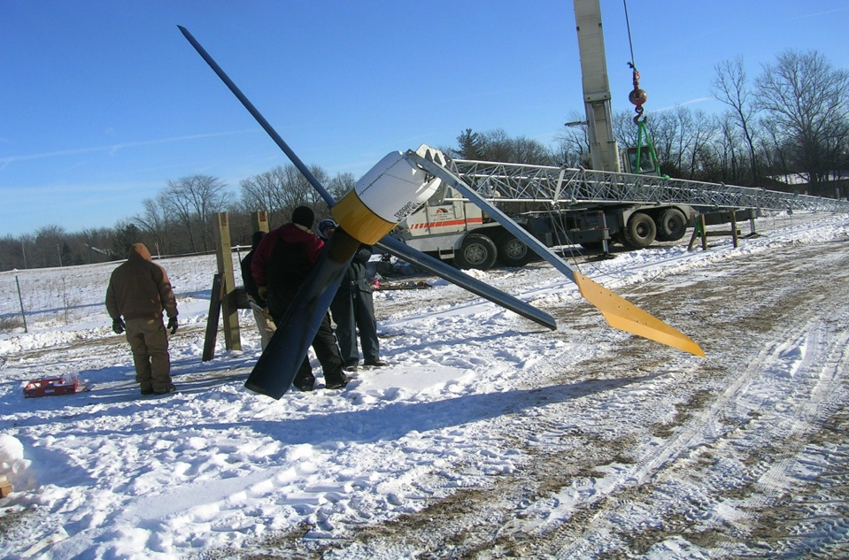
Erection of wind turbine (Bergey 10 kW with Xantrex Gridtek inverter, Feb., 07) Cost ca.
$45,000, no rebate at the time.

Slide 19
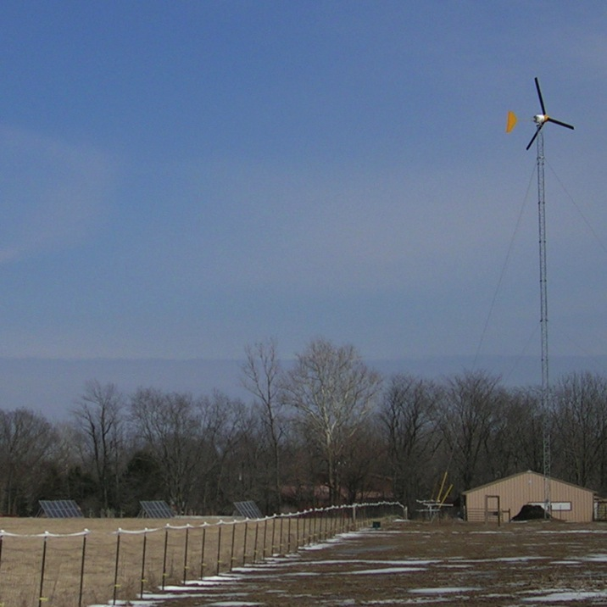
Wind turbine and
initial solar; Feb. 08.
Turbine is located
In horse pasture.
6.8 kW solar self-
installed in summer
07.

Slide 20
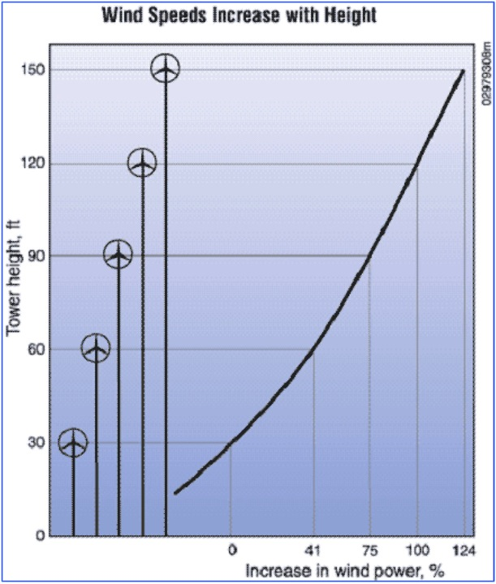
Our tower is 100’ + blades.
County zoning limited to
total of 100’ unless Special
Use permit, until county
decided we were agricultural
for which no limit applies.
We did not think then of
going higher and now would
be cheaper to add more solar.

Slide 21
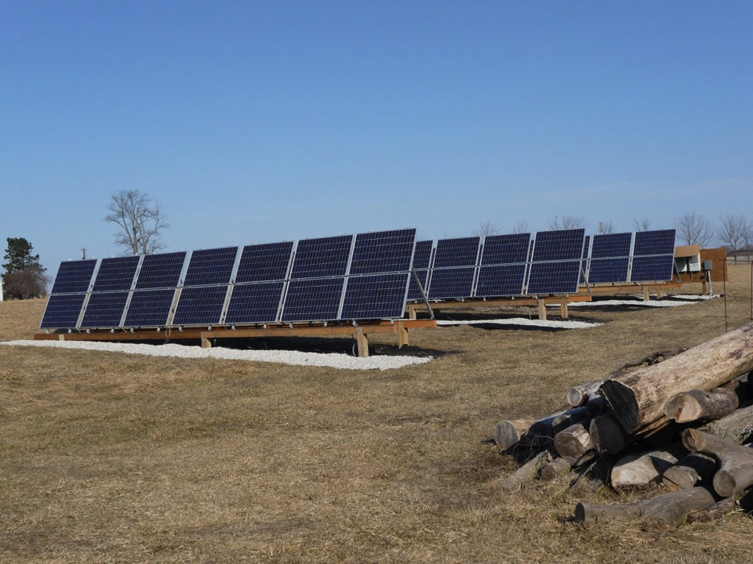
Initial solar panels, self installed Aug. 07 (6.8 kW) and July 08 (1.2 kW). Are “blemished”
Evergreen 180 and 190 W panels with 3 Xantrex 3 kW refurbished inverters. Total cost
$39,500 - $11,600 state grant - $3600 federal rebate (= $24,300).

Slide 22
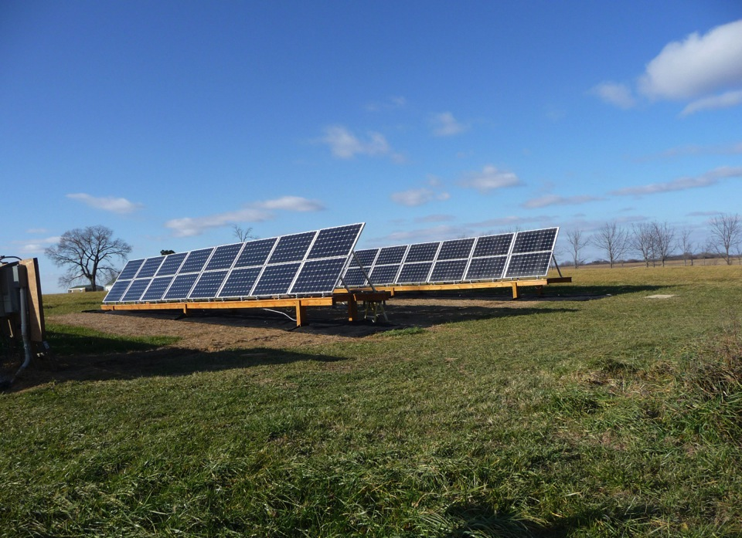
Helios panels self installed Nov. 2012; 8kW of 250 W panels, with Enphase M215 inverters.
Cost $22,000 - $5400 state grant - $6600 federal rebate (= $10,000).

Slide 23
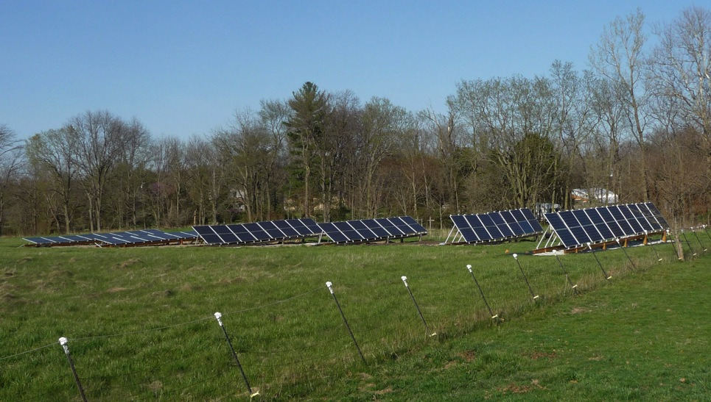
Suniva panels (350 W each, 5.7 kW total) installed in first row in Spring 2016. All panels are
retilted 4 times/year, at 12°, 38°, 65° and 38° (summer, fall, winter and spring) resulting
In 13% greater production than installer estimate for a constant 30° tilt ground mount and
33% greater than for a 14° tilt roof mount.

Slide 24
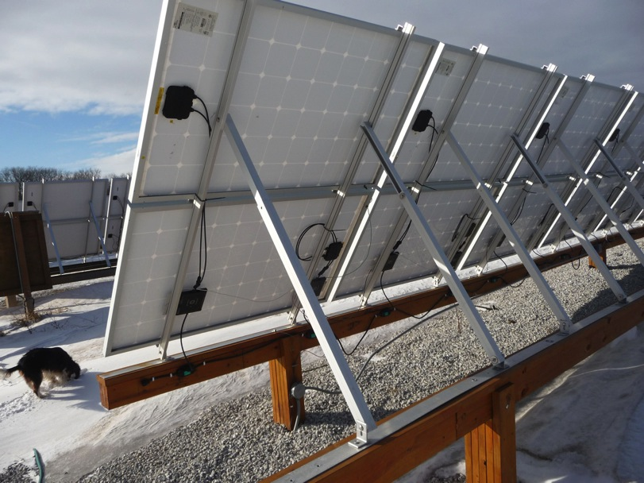
Unirac struts; original claim was they would cover 20 – 65° angles (summer – winter);
Good for 37-65° angles (fall, spring – winter) and separate legs for summer (12.5°)

Slide 25
Enphase Envoy output for Helios panels set at 12 and 65° in late spring; upper panels at
correct tilt. Can observe, over internet, instant panel output and graphs.

Slide 26
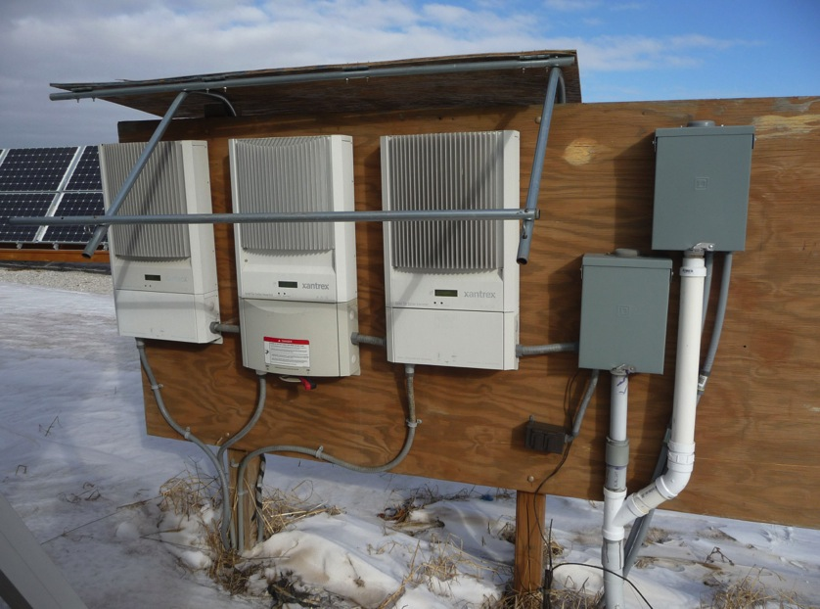
Original Xantrex (refurbished) 3.0 and 3.3 kW solar inverters; all now replaced with
Enphase M215 micro inverters.

Slide 27
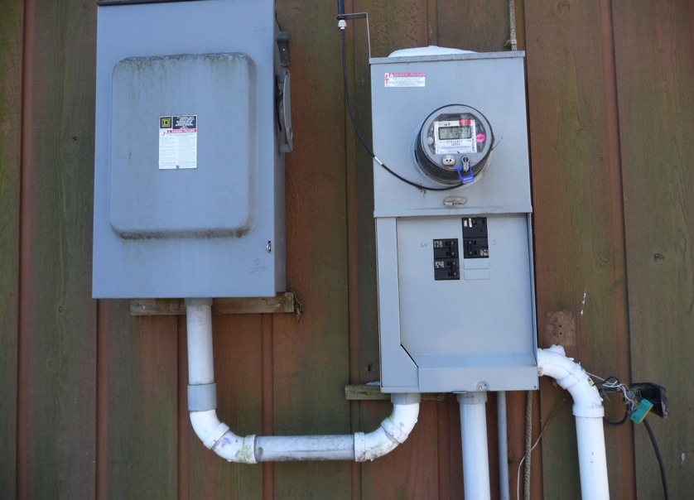
The 3 power lines from 2 sets of panels and wind feed the circuit breakers in a rural
meter base. Net meter reads power direction, total power received (at on and off
peak demand rate) and sent.

Slide 28
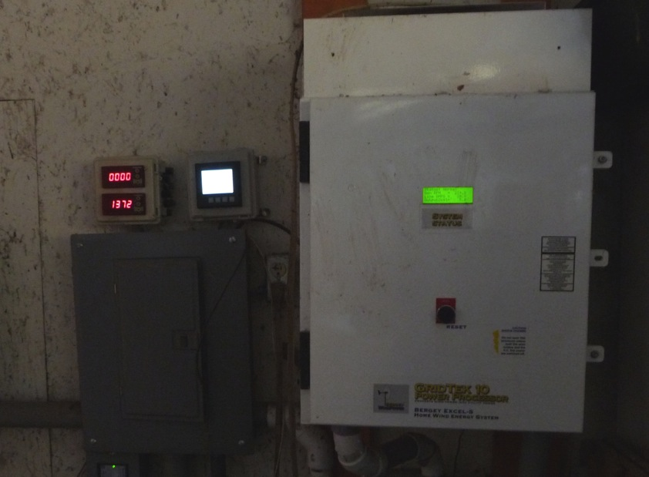
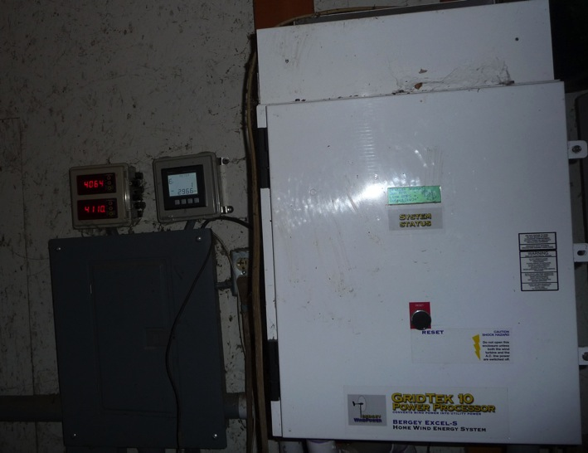
Xantrex Gridtek wind inverter; converts variable AC to DC to 60 Hz AC; reads turbine rpm and kW output. Meters at left read solar and wind output; instant and total. 2nd solar meter added for Helios with Suniva meter in barn.

Slide 29
Wind annual production; 07, from 3/30, 4870; 08, 8262; 09, 5434; 10, 5686; 11, 6210; 12, 5998;
13, 6105; 14, 5830; 15, 5197; 16, 5909; 17, 6601; 18, 5382 (inverter out 2 months); 19, 6186;
20, 6331; 21 (to 6/1), 4555

Slide 30
Solar total annual production (kWh): Evergreen: 2008, 9,739; 2009, 10,732; 2010, 11,380; 2011, 9991;
2012, 10,367; 2013, 9229; 2014, 9202; 2015, 9948; 2016, 9548; 2017, 8096 kWh; 2018, 9435; 2019, 9883; 2020, 9501

Slide 31
Helios panels, 8 kW
Helios annual production (kWh): 2013, 11,473; 2014, 11.414; 2015, 12,095; 2016, 11,853; 2017, 9818; 2018, 11,403; 2019, 10,350; 2020, 10,270; 2021 (to 6/1),4413

Slide 32
Suniva panels, 5.7 kW
Solar total annual production, 5.7 kW Suniva; 2016 (from 4/13) 5068; 2017, 7047; 2018, 8035; 2019, 7764; 2020, 7481; 2021 to 6/1, 3017kWh

Slide 33
Summary
Total production to date (1/1/21): Wind (10 kW) from 2/9/07 – 84672 kWh; Evergreen solar (6.8 kW +1.2 kW on 7/16/08) from 8/16/07 – 129467 kWh. Helios solar (8 kW) from 11/23/12 – 89406 kWh. Suniva solar (5.7 kW) from 4/13/16- 35395 kWh. (Wind inverter repair 3/29/09-5/8/09 and 6/10/18 -7/25/18)
Annual production in kWh: 2008 Wind 8,262, E. Solar 9,739; 2009 Wind 5,434, E. Solar 10,732; 2010 Wind 5686, E. Solar 11,380; 2011 Wind 6210, E. Solar 9991; 2012 Wind 5,998, E. Solar 10,367; 2013 Wind 6105, E. Solar 9,229; H. Solar 11,473; 2014 Wind 5830, E. Solar 9202, H. Solar 11,412. 2015 Wind 5197; E. Solar 9948; H. Solar 12095. 2016 Wind 5909; E. Solar 9548; H. Solar 11583; S. Solar (from 4/13/16) 5068. 2017 Wind 6601, E. Solar 8106, H. Solar 9818, S. Solar 7047. 2018 Wind 5382, E. Solar 9435, H. Solar 11203, S. Solar 8035. 2019 Wind 6186, E. Solar 9883, H. Solar 10350, S. Solar 7764. 2020 Wind, 6331, E. Solar 9501, H. Solar 10270, S. Solar 7481 (E = Evergreen, H = Helios, S = Suniva)
For more information on house construction (earth sheltered, solar heated, geothermal with ERV and 260’ ground loop, low voltage switching, on-demand gas hot water, fluorescent and LED lighting, timber frame with R50 wall, R70 roof self built SIP panels) see http://www.flickr.com/photos/geil-homestead
For more information on the above: phgeil@gmail.com

Slide 34
Total installed costs: Wind ~ $45,000; Evergreen solar ~$35,000 – $10,000 State grant and $2,000 Federal rebate + ~$4,500 - $1,600 State grant and $1600 Federal rebate = Total Evergreen solar ~ $39,500 – $15,200 = $25,300. Helios solar ~ $22,000 - $5,400 State grant and $6,600 Federal rebate ≈ $10,000. Suniva solar $9940 – $2980 Federal = ca. $6960. Maintenance: Wind ca. $300/yr, Solar negligible. Wind inverter replacement, 2018 $7200. SRECs payments received; 2008, for Evergreen (8kW) from Naperville $584.88. Current $94.80/MWh for Evergreen and Helios from Sept. 2016 to June 2020 ($4410.92 for Evergreen and $5453.72 for Helios), $5/MWh (non-self-bonded) for wind ($424.80, bond repayment, 10/30/18), $190/MWh for Suniva since 5/30/17. ($6650 to 6/1/21; note is only $310 less than installed price, ignoring power produced )
Wind system – Bergey 10 kW turbine on 100’ tower; Xantrex inverter replaced by Bergey, 2018. Solar system – 40 180 W + 4 190 W blemished Evergreen thin film panels, 3 refurbished 3.3 kW Xantrex inverters; 32 250 W Helios monocrystalline panels with M215 Enphase inverters; 20 285W Suniva panels with M250 Siemens (Enphase) inverters, UniRac and home built struts. One central inverter replaced with Enphase M190 inverters in Feb, 2014 due to panel short. Others replaced in 2016 and 2017. Panels are retilted 4 times/year, at 12, 38, 65° and 38° (summer, fall, winter and spring), resulting in 13% greater production than installer estimated values for a 30° tilt ground mount and 33% greater than for a 14° tilt roof mount.

