Slide 1
36 Years of DIY Passive Solar, 12 of Wind and PV: Construction and Experience Phil Geil
Passive solar, timber frame, earth sheltered, SIP house
Low voltage switching
Solar thermal pool heating for greenhouse
Wind turbine erection
Solar photo-voltaic panels and wiring
Output

Slide 2
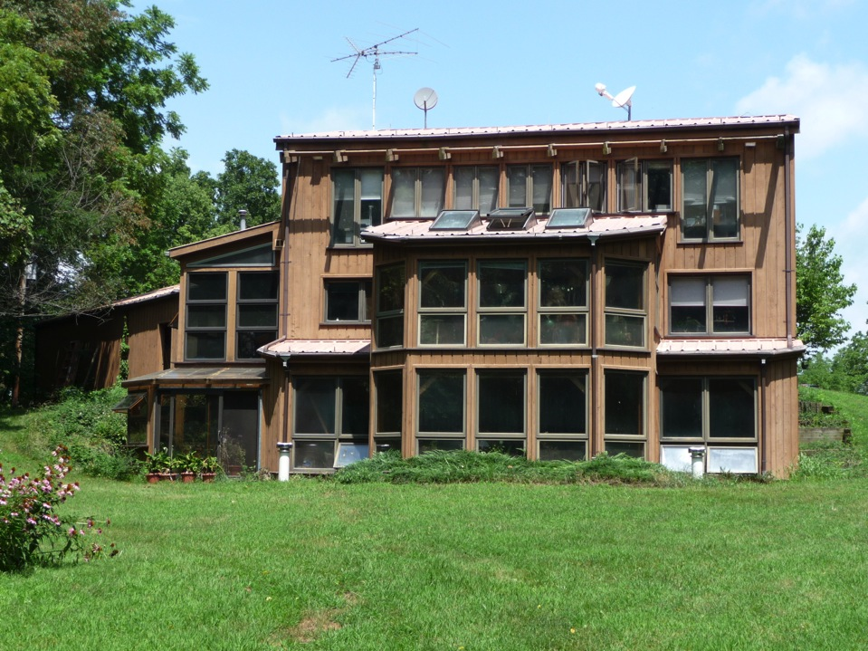

Slide 3
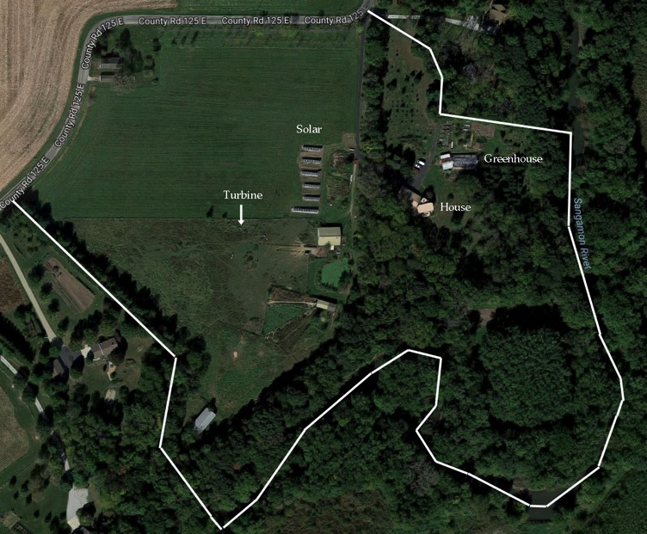
Satellite photo of lot and house, wind and solar locations; are on ca. 30’ high
bank of Sangamon river permitting earth sheltering.

Slide 4
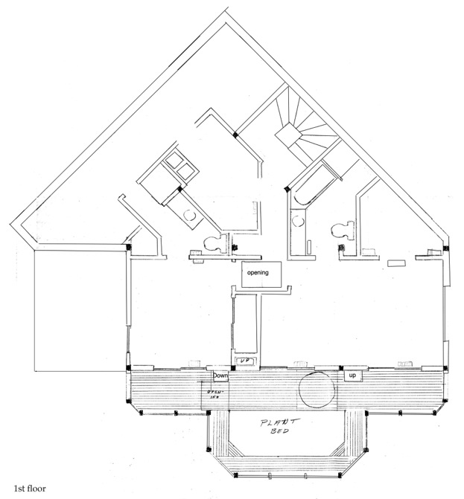

Slide 5
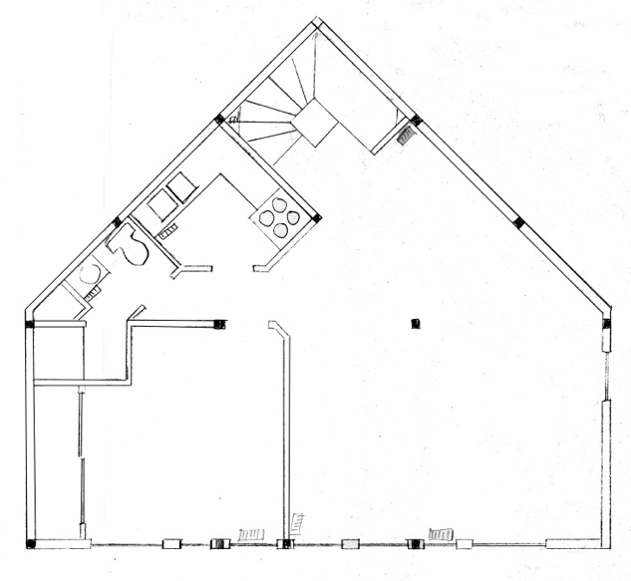
Third floor

Slide 6
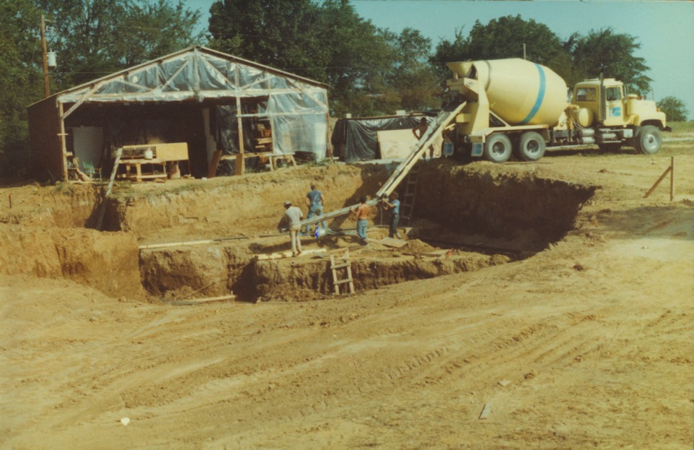
Installation of footing; 30 x 60 “pole barn” garage installed first for storage of timbers and
construction of SIP panels, etc.

Slide 7
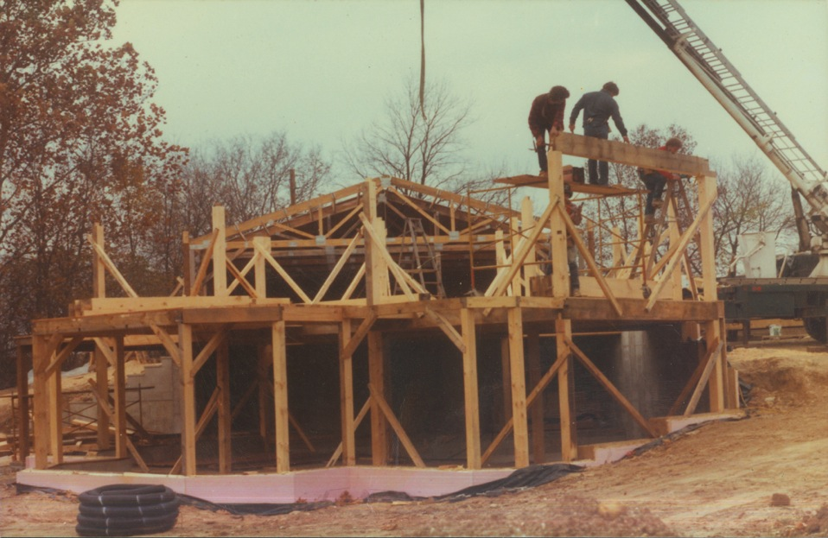
First floor framed, start on second. Note is earth sheltered on N and part of east side.
3” expanded PS foam insulates foundation and under basement floor.

Slide 8
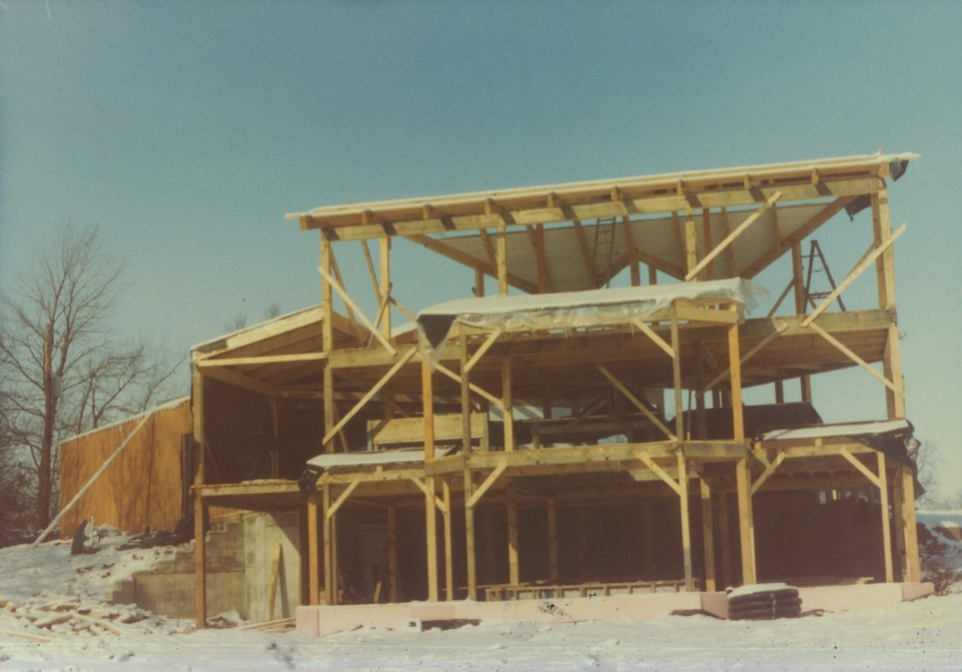
Framing completed; view from the south. 2x6 ceiling (under 8” SIP panels) partially
installed

Slide 9
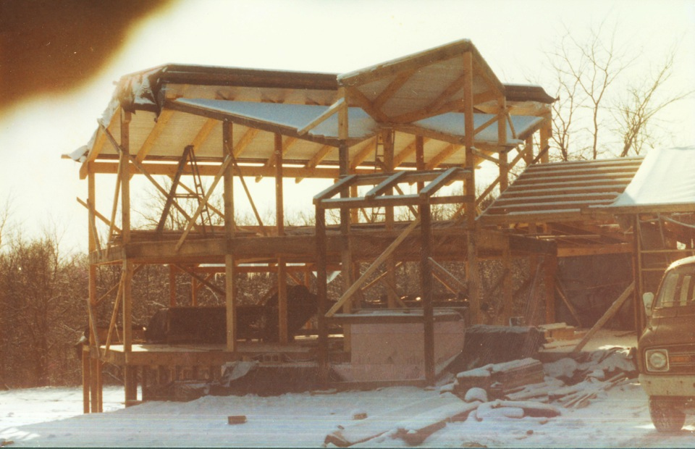
Framing complete, view from the north. Garage connected to house through extension with
first floor storage area under it. Front entry and spiral staircase framing.

Slide 10
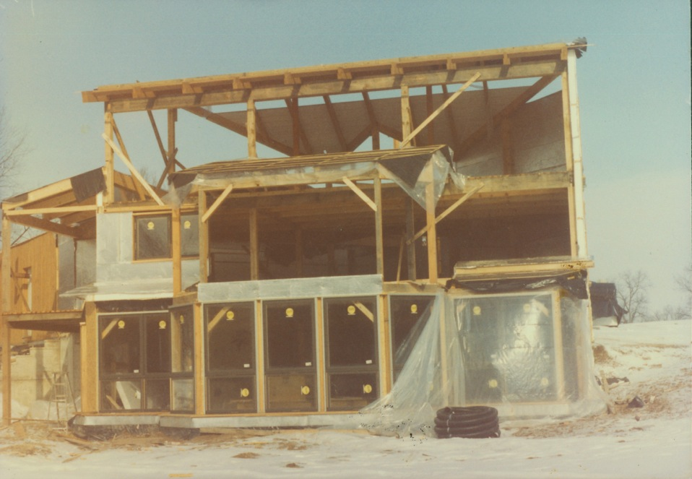
Start of window installation and side wall panels

Slide 11
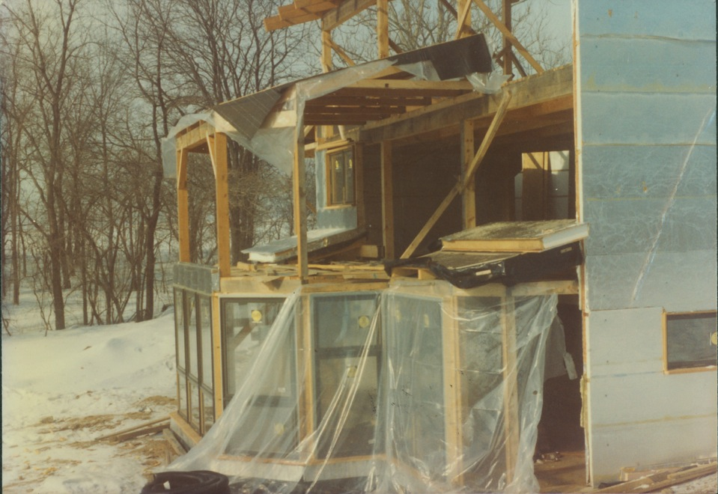
Installation of greenhouse windows. All side wall SIP panels sealed with Al foil on interior and
S. W and E exterior.

Slide 12
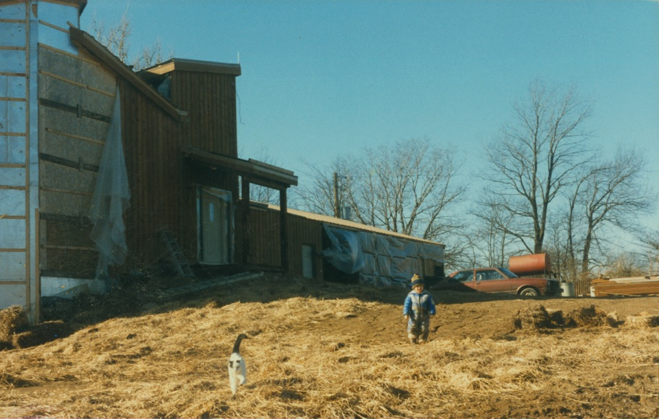
Installation of cedar siding. ¾ in air space between SIP and siding and drywall.

Slide 13
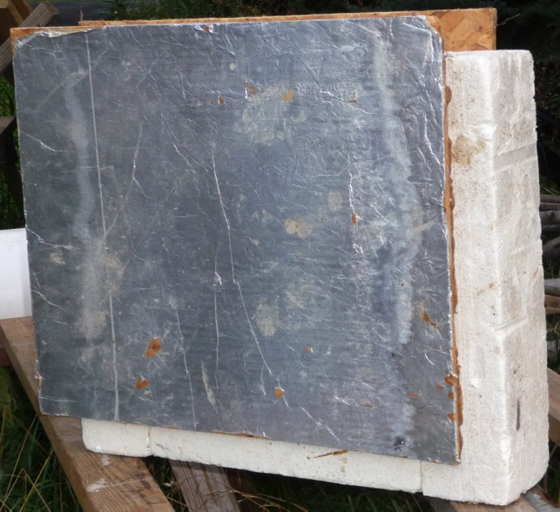
SIP panels construction
Side walls have 5.5 inch
high density expanded PS
foam, plus ½ in OSB panels,
air spaces (2) and drywall.
Roof (steel)has 7.5 in PS +
OSB + 2x6 ceiling. With
added ¾ in air spaces on
both sides plus dry wall
and cedar siding or 2x6,
side walls are R50; roof is
R70. House has
geothermal (well water)
for cooling, and solar and
kerosene heater for
heating.

Slide 14
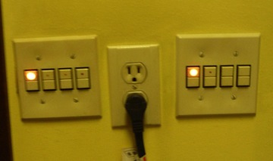
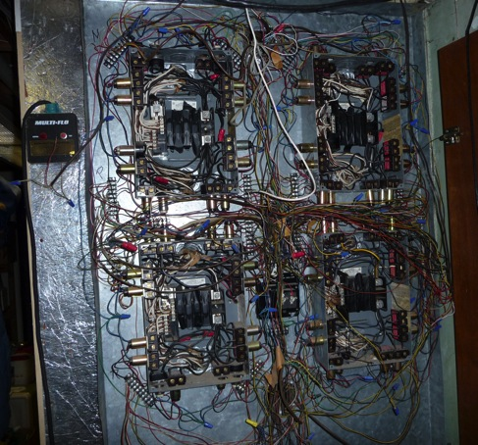
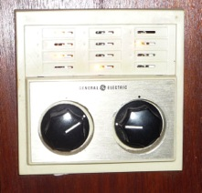
Low voltage switching. Permits as
many switches as desired for single
light, including switches in garage for
barn and greenhouse. Pilot lights (3w)
indicate on/off. Master switch by bed
controls 12 outside & major inside lights.
Relay box in house; switch wiring is 18 gauge,
24V

Slide 15
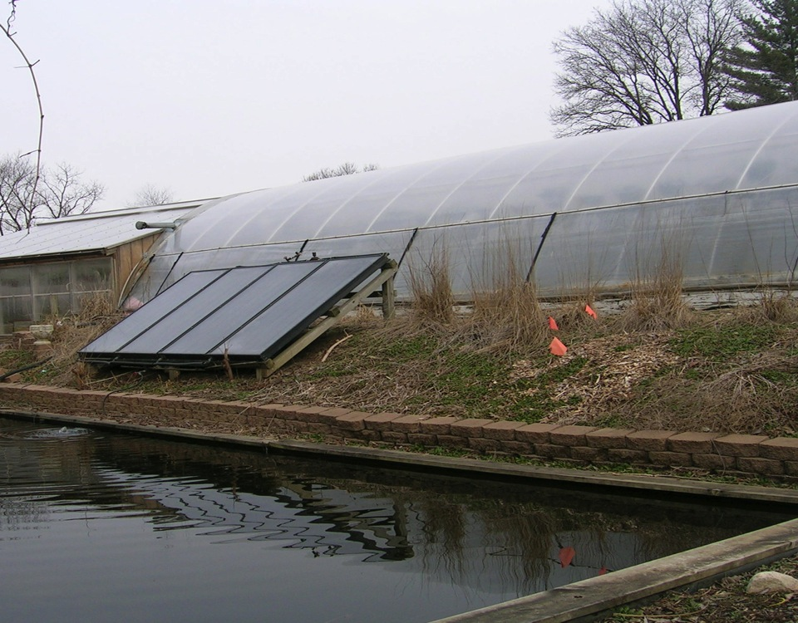
Solar thermal panels for swimming pool in greenhouse (double layer PC panels). Purchased
used from owner who “heated” his house by storing the hot water underground in an
uninsulated tank.

Slide 16
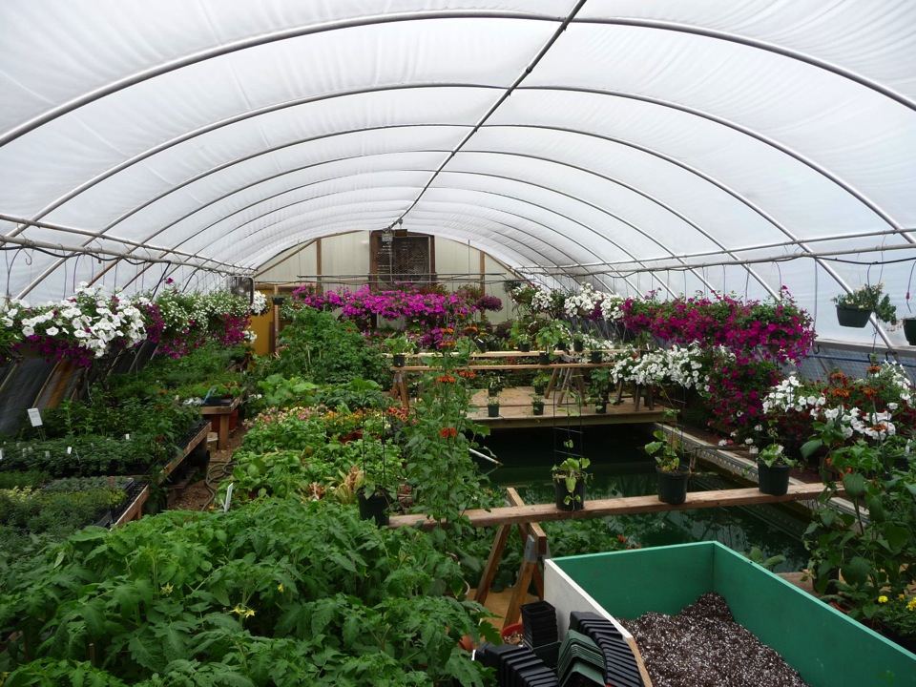
The solar thermal panels heat the swimming pool with greenhouse originally being a
“removable” double layer PE film cover. Now replaced by double wall polycarbonate.

Slide 17
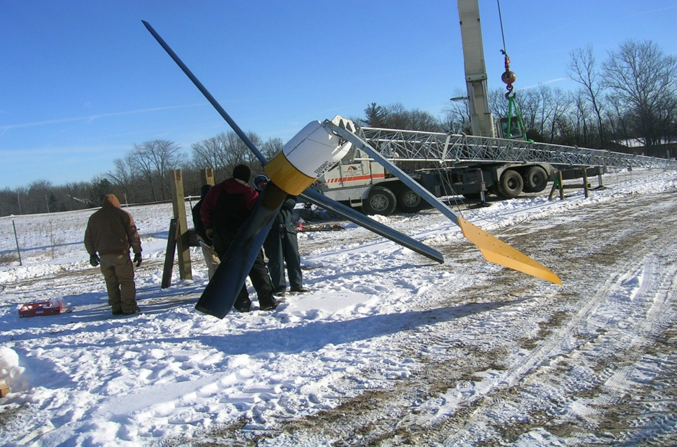
Erection of wind turbine (Bergey 10 kW with Xantrex Gridtek inverter, Feb., 07) Cost ca.
$45,000, no rebate at the time.

Slide 18
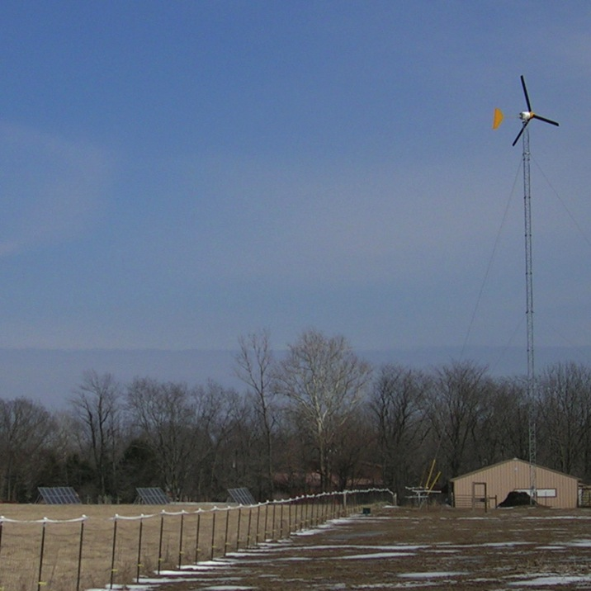
Wind turbine and
initial solar; Feb. 08.
Turbine is located
In horse pasture.
6.8 kW solar self-
installed in summer
07.

Slide 19
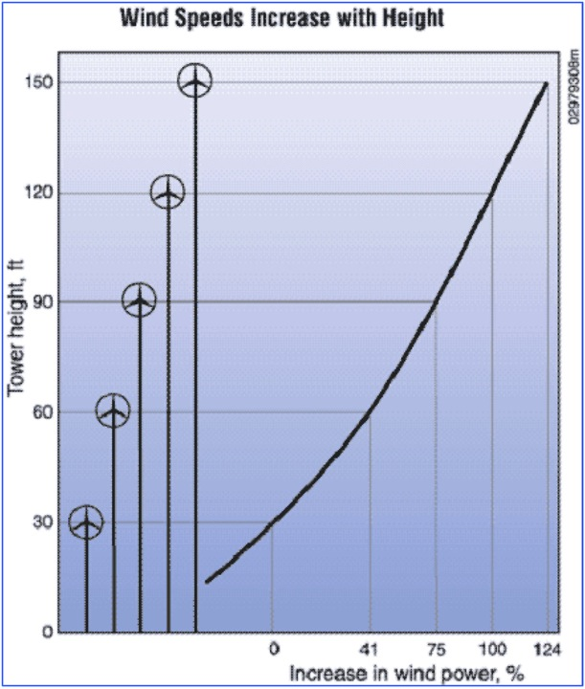
Our tower is 100’ + blades.
County zoning limited to
total of 100’ unless Special
Use permit, until county
decided we were agricultural
for which no limit applies.
We did not think then of
going higher and now would
be cheaper to add more solar.

Slide 20
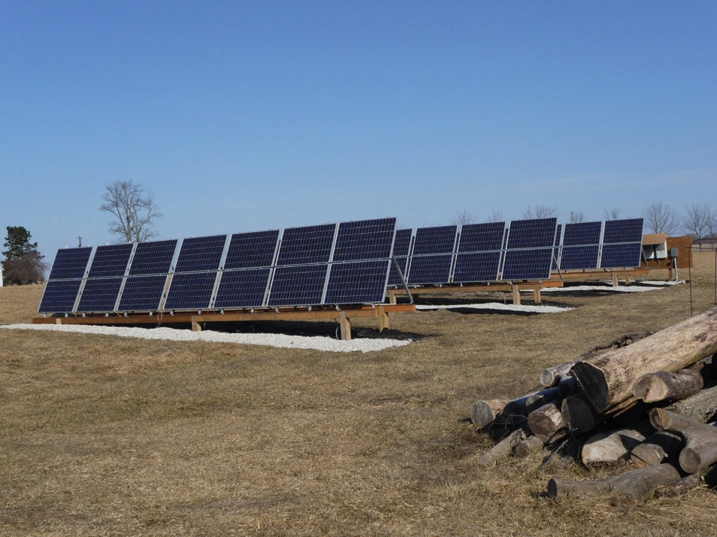
Initial solar panels, self installed Aug. 07 (6.8 kW) and July 08 (1.2 kW). Are “blemished”
Evergreen 180 and 190 W panels with 3 Xantrex 3 kW refurbished inverters. Total cost
$39,500 - $11,600 state grant - $3600 federal rebate (= $24,300).

Slide 21
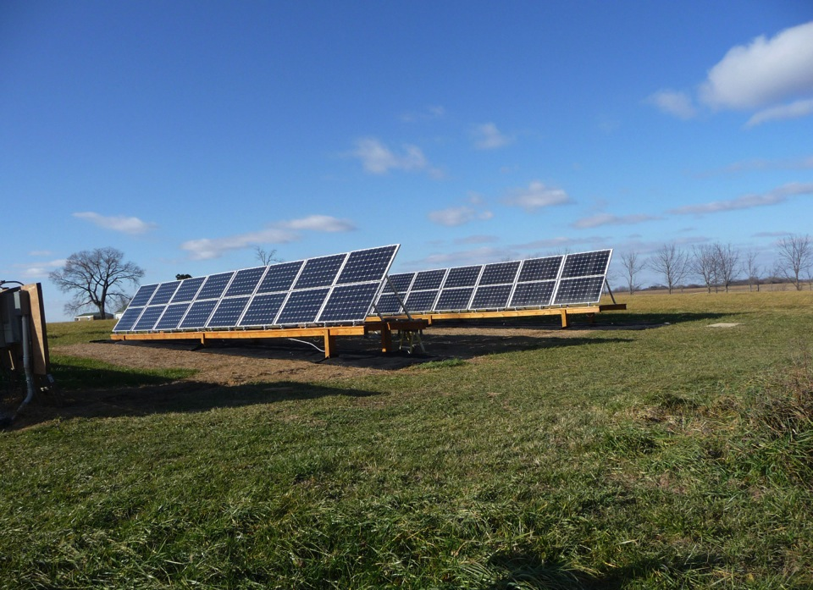
Helios panels self installed Nov. 2012; 8kW of 250 W panels, with Enphase M215 inverters.
Cost $22,000 - $5400 state grant - $6600 federal rebate (= $10,000).

Slide 22
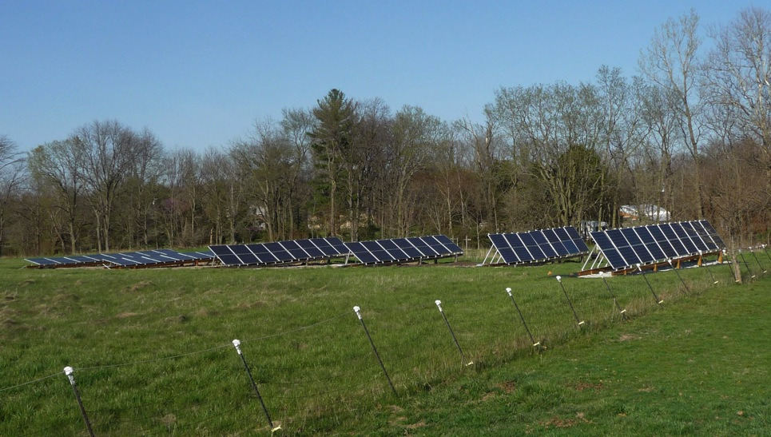
Suniva panels (350 W each, 5.7 kW total) installed in first row in Spring 2016. All panels are
retilted 4 times/year, at 12°, 38°, 65° and 38° (summer, fall, winter and spring) resulting
In 13% greater production than installer estimate for a constant 30° tilt ground mount and
33% greater than for a 14° tilt roof mount.

Slide 23
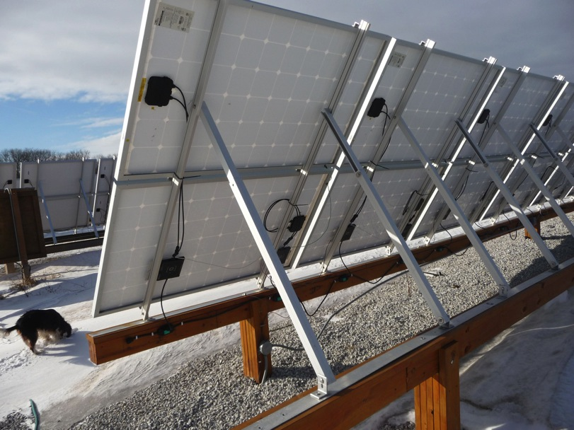
Unirac struts; original claim was they would cover 20 – 65° angles (summer – winter);
Good for 37-65° angles (fall, spring – winter) and separate legs for summer (12.5°)

Slide 24
Enphase Envoy output for Helios panels set at 12 and 65° in late spring; upper panels at
correct tilt. Can observe, over internet, instant panel output and graphs.

Slide 25
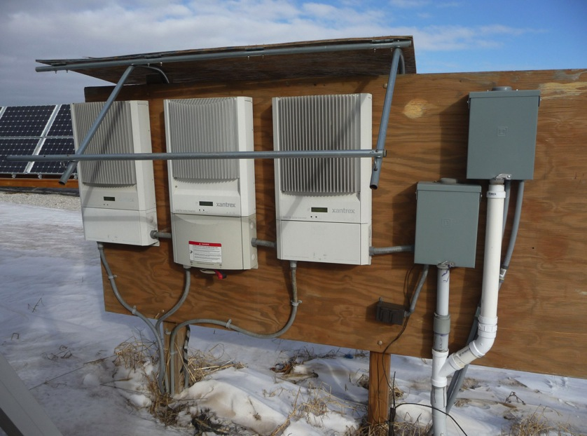
Original Xantrex (refurbished) 3.0 and 3.3 kW solar inverters; all now replaced with
Enphase M215 micro inverters.

Slide 26
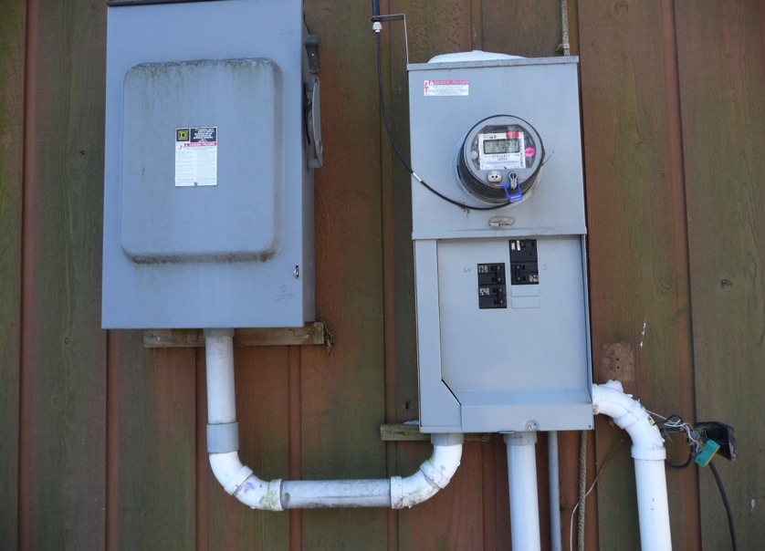
The 3 power lines from 2 sets of panels and wind feed the circuit breakers in a rural
meter base. Net meter reads power direction, total power received (at on and off
peak demand rate) and sent.

Slide 27
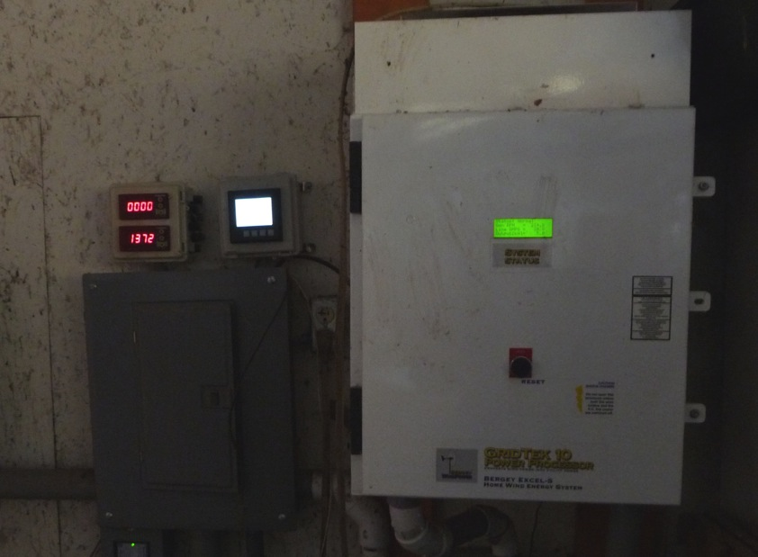
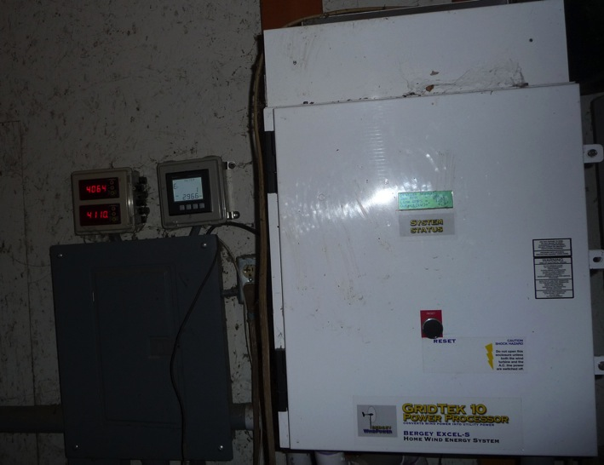
Xantrex Gridtek wind inverter; converts variable AC to DC to 60 Hz AC; reads turbine rpm and kW output. Meters at left read solar and wind output; instant and total. 2nd solar meter added for Helios with Suniva meter in barn.

Slide 28
WIND PRODUCTION
Total annual production: 08, 8,262; 09, 5,434; 10, 5,686; 11, 6,210; 12, 5,998; 13, 6,105;
14, 5830; 15, 5197; 16, 5909; 17, 6601 kWh; 18, 5832 kWh*; 19, 6186 kWh * inverter
replacement for 2 months

Slide 29
Solar total annual production: Evergreen: 08, 9,739; 09, 10,732; 10, 11,380; 11, 9991;
12, 10,367; 13, 9229; 14, 9202; 15, 9948; 16, 9548; 17, 8096 kWh; 18, 9435 kWh;
19, 9883 kWh

Slide 30
Helios and Suniva production. Helios 13, 11473; 14, 11412; 15, 12095; 16, 11583, 17, 9818; 18, 11,403; 19, 10,350 kWh. Suniva 16 (from 4/13), 5068; 17, 7047; 18, 8035; 19, 7764 kWh

Slide 31
Financial information
Total installed costs: Wind ~ $45,000 (No rebates)
Evergreen solar ~$35,000 – $10,000 State grant and $2,000 Federal rebate + ~$4,500 - $1,600 State grant and $1600 Federal rebate = Total Evergreen solar ~ $39,500 – $15,200 = $25,300.
Helios solar ~ $22,000 - $5,400 State grant and $6,600 Federal rebate ≈ $10,000.
Suniva solar $9940 – $2980 Federal tax rebate = ca. $6960.
Maintenance: Wind ca. $300/yr, Solar negligible except for replacement of central inverters on Evergreen system at $59/M215.
SRECs payments received; 2008, for Evergreen (8kW) from Naperville $584.88
Current $94.80/MWh for Evergreen and Helios since Sept., 2016 ; $3890 for Evergreen and $4828 for Helios
$5/MWh (non-self-bonded) for wind (No return as yet)
$190/MWh for Suniva since 5/30/17; $4180
I note the above does not include the savings on our electric bill, with monthly use ca. 3000 kWh and bills to pay only once a year.
For more information on the above phgeil@gmail.com

