Slide 1
How to Work with Municipal Utilities and Rural Cooperatives
Forum #2
Growing New Energy Jobs Downstate
Southern IL – July 25-26, 2017

Slide 2
Agenda
Understanding differences between Investor Owned Utilities (IOUs), Municipal Utilities (Munis) and Rural Cooperatives (Co-ops)
Where are Munis and Co-ops included/excluded in FEJA?
Where does the power these entities receive come from? Examples:
Southern IL Electric Cooperative
Hoosier Energy
Characterizing the Challenges/Barriers to Solar Development in Municipal/Cooperative Territories
Long term Power Purchase Agreements with Power Providers
Decreasing loads due to energy efficiency upgrades by consumers/businesses
FUTURE: Best practices for working with your muni/co-op for development of solar friendly policies
NOW: What to look for in current net metering/interconnection agreements
Mobilizing for change discussion/ Q&A

Slide 3
Understanding Utility Differences
Investor-Owned Utilities (IOUs)- Ameren, ComEd, Mid-American in Illinois
An investor-owned utility, or IOU, is a for-profit business organization, providing a product or service regarded as a utility (often termed a public utility regardless of ownership), and managed as a private enterprise rather than a function of government or a utility cooperative.
In Illinois, the IOUs are publicly regulated by the Illinois Commerce Commission (ICC) and subject to laws that pass(ed) in the legislature such as FEJA and the Renewable Portfolio Standard.

Slide 4
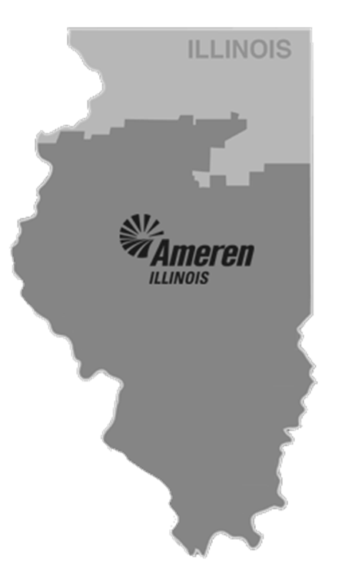
Understanding Utility Differences
Investor-Owned Utilities (IOUs)- Ameren in Southern IL

Slide 5
Understanding Utility Differences
Municipal Utilities
A municipal utility district is a special-purpose district or other jurisdiction that provides services (such as electricity, natural gas, sewage treatment, waste collection/management, wholesale telecommunications, water) to district residents. Municipal utilities are owned by a city, town or village. They are regulated by their municipal governments (mayor, city council, etc.), parts of the Municipal Code, and are generally non-profit.
In Illinois, the Illinois Municipal Electric Association (IMEA)/ Illinois Municipal Utility Association (IMUA) serves member municipal organizations to provide power/information/training/etc.
IMEA members are municipalities that DO NOT generate their own electricity
IMUA members are municipalities that DO generate at least some of their own electricity

Slide 6
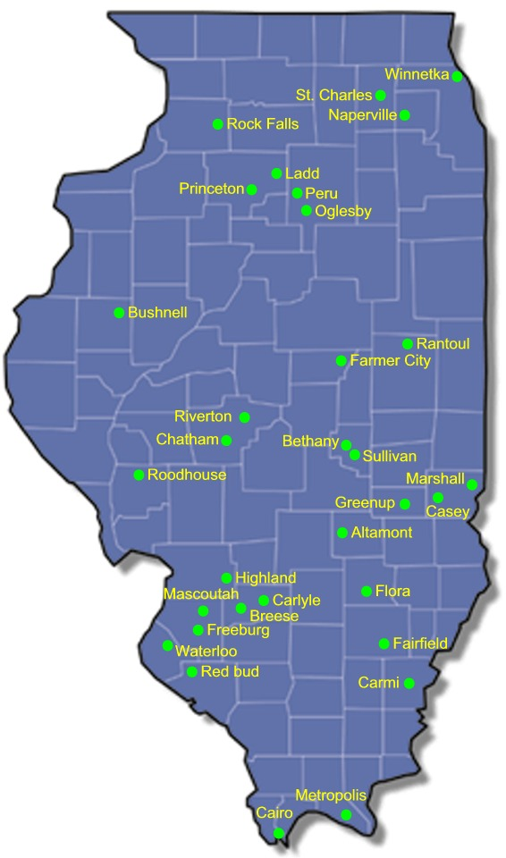
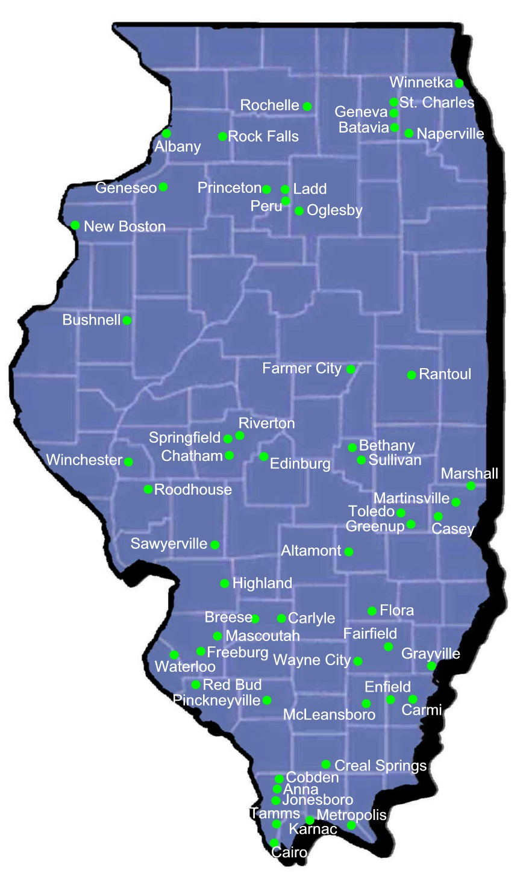
Understanding Utility Differences
IMEA Member Map IMUA Member Map

Slide 7
Understanding Utility Differences
Cooperative Utilities
Cooperatives have member-owners, not just customers. The members of the cooperative are also its customers.
Cooperatives follow a democratic process, not board governance. Every member can vote and has a right to participate in the policy-making process. They also elect local board members.
Cooperatives focus on service, not profits. Electric cooperatives bring electricity to rural areas because for-profit electric companies are reluctant to serve areas where customers may be miles apart. In cities and towns where homes and businesses are close together, power companies make more money per line mile. Though cooperatives don’t ignore the need to make a reasonable profit, they focus on customers because the organizations exist to provide service. Most received federal funding to get their start/may still be subsidized today via grants/other funding mechanisms.
Members participate financially. When cooperatives produce a margin -- revenue that exceeds the cost of providing service -- it’s reserved as capital credits. The reserves are used to build and maintain the cooperative’s infrastructure and facilities and to provide for other service needs. Each member is allotted an amount of the capital credits based on how much electricity the member consumes. This consumption is called "patronage." When deemed appropriate by the board, a portion of capital credits may be paid to members according to the cooperative's bylaws
Cooperatives can be exempt from federal tax. To remain tax-exempt, electric cooperatives must collect 85 percent of their revenue from member customers for providing service.

Slide 8
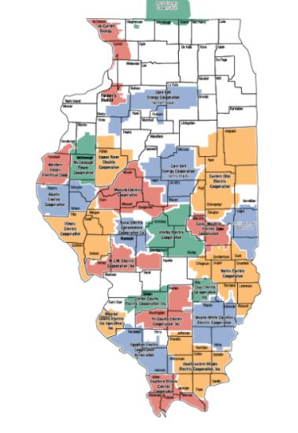
Understanding Utility Differences
Illinois’ Cooperative Map

Slide 9
MUNIS/COOPERATIVES IN FEJA
RPS requirements only apply to the investor owned utilities
RECs can come from anywhere in Illinois and will be bought by utilities, or the IPA (for Illinois Solar for All)
Does not directly create new responsibilities for co-ops and munis
Qualified Persons installation requirements would apply
Intersections with net metering and smart inverter rebates
Developers will be seeking sites for new utility-scale wind and solar projects
Projects must be over 2MW (smaller allowed for brownfield solar), law silent on whether they can be connected to the distribution system
Developers may not be familiar with the various rules for interconnecting systems located in co-ops and munis

Slide 10
Opportunities for households and businesses served by Cooperatives and Municipal Utilities
•Can participate in distributed generation programs and receive payment for RECs
Adjustable Block program
Illinois Solar for All
•Not clear if Community Solar Projects can participate in the Adjustable Block or Illinois Solar for All Programs
•Opportunities for other renewable resources (e.g., biomass) to be determined
60

Slide 11
Preparing for the Future
Ramp up of Solar could be rapid
Other states that have adopted similar solar incentive programs have seen strong increase in solar projects, rates often doubling or more each year
Increased interconnection requests
19% of supplemental photovoltaic procurement projects in rural co-ops; 6% municipal utilities
Investor owned utilities are planning for increased staffing and resources to avoid interconnection becoming a bottleneck
Availability of net metering
REC prices will include assumptions about the value of net metering. For co-ops or munis without net metering policies, this could result in a less attractive overall value proposition for solar projects
Ownership of RECs
Need to clarify who owns RECs, system owner or Co-op?

Slide 12
Where do municipal utilities get their power?
IMEA Electricity Management Services
The IMEA is a joint action agency formed in 1984 by its member municipalities in accordance with the provisions of the Illinois Municipal Code. Its stated purpose is to jointly plan finance, own and operate facilities for the generation and transmission of electric power in order to provide for the current and projected energy needs of the purchasing members. Energy Procurement and Generation IMEA accomplishes its purpose by procuring power using a diversified portfolio that includes: Ownership stakes in generation projects, such as its 15% ownership of two 800 MW supercritical units at the Prairie State Generating Company in southern Illinois and its 12.12% ownership in Trimble County 1 (a 514 MW coal-fired unit) and Trimble County 2 (a 750 MW super-critical, pulverized coal-fired unit) located between Louisville and Cincinnati.
Member-owned and Agency-owned natural gas and diesel-fired generating units that can be called on in times of emergency or when it is economically advantageous.
Execution of long-term energy contracts, including a long-term, cost-based system firm energy contract with a major regional power supplier for up to 250 MW, which runs until 2035.
In 2009, the IMEA Board of Directors adopted a policy that directs the agency to acquire approximately five percent of its energy requirements from renewable resources. Toward that goal, IMEA has entered into a long-term contract to purchase 70MW of wind energy from the Lee-DeKalb wind project owned by FPL Energy Illinois Wind, LLC. The contract runs through 2030.
SOURCE: IMEA Website

Slide 13
Where do cooperative utilities get their power?
Cooperatives get their power from “Power Providers” (see map to the left)
Let’s take a look at Hoosier Energy and Southern Illinois Power Cooperative since we are in Southern IL to disseminate where the power they supply to the cooperatives they serve comes from!

Slide 14
Where do cooperative utilities get their power?
SUMMARY:
Most municipal utilities and rural cooperatives are distribution entities, which means they distribute the power they receive from their Power Provider.
Power Providers are what is referred to as Generation and Transmission entities, which means they generate the power and transport it to those entities that have contracted with them to purchase the power they produce.

Slide 15
Where do cooperative utilities get their power?
Southern IL Electric Cooperative
Southern Illinois Power Cooperative (SIPC), located at the Lake of Egypt, just south of Marion.
Serves:
Southern Illinois Electric Cooperative
Egyptian Electric Cooperative of Steeleville
SouthEastern Illinois Electric Cooperative of Eldorado
Monroe County Electric Cooperative in Waterloo
Clinton County Electric Cooperative in Breese
Tri-County Electric Cooperative in Mt. Vernon
Clay Electric Cooperative in Flora

Slide 16
Where do cooperative utilities get their power?
Southern IL Electric Cooperative (continued)
In the 1990’s, the three aged cyclone boilers were replaced with one circulating fluidized bed boiler. The new boiler is environmentally friendly and burns mostly carbon. While the new boiler was under construction, SIPC also added additional pollution control equipment to Unit 4. Taken together, these improvements allow SIPC to meet environmental standards and insure that the plant will continue to operate well into the future. Both the new unit and Unit 4 burn local coal and carbon.
In the past, SIPC relied on neighboring utilities when demand for electricity was more than they could produce. In today’s market, electricity is traded like any other commodity. To reduce reliance on the market, SIPC built two natural gas-fired combustion turbines. These units can be started when market prices are high or when incoming transmission lines are too congested to import power.
SOURCE: SIEC Website

Slide 17
Where do cooperative utilities get their power?
Hoosier Energy
Located in Merom, Indiana
Serves the Wayne-White Electric Cooperative
Hoosier Energy has made significant strides in recent years to increase renewable energy resources in its generation portfolio, including two landfill methane generating stations, a coalbed methane facility and hydropower and wind energy purchase power agreements. The commitment to renewable energy has been strengthened with plans for utility-scale solar projects and a voluntary board policy to increase the renewable portion of the portfolio to 10 percent by 2025.
In 2010 were fined $950,000 by the federal EPA for violations at their two coal fired plants, had to spend $5 million on environmental projects and reduce harmful carbon emissions by 24,500 tons per year. Sources: Hoosier Energy 65th Anniversary Report/US EPA

Slide 18
Where do cooperative utilities get their power?
Hoosier Energy
This power supplier operates eight power plants, including the 1,070-megawatt Merom Generating Station in Sullivan County, Indiana, and the 250-megawatt Ratts Generating Station in Pike County, Indiana, which are both coal-fired power stations. Hoosier Energy’s generation resources include 50 percent ownership of the 630-megawatt Holland Energy combined-cycle plant in east-central Illinois that uses natural gas as its fuel source as well as two natural gas peaking plants: the 174-megawatt Worthington Generating Station and 66 percent of the 258-megawatt Lawrence County Generating Station, both located in Indiana.
Source: Hoosier Energy 65th Anniversary Report

Slide 19
Context: Characterizing the Challenge
Problem Statement: Utility Portfolio Realities vs. Aspirations
Although a number of cities and counties would like to nurture solar development in their jurisdictions, their ambitions can be hampered by utility supply limits because often cooperative and municipal utilities are locked into long-term supply contracts and face slow or negative load growth. As a result, they have little appetite to develop a solar portfolio.
Core Question: How can a community discern if/when there is potential opportunity for PV development and devise the appropriate strategy for nurturing it?
Solutions exist. A number of communities have successfully engaged their co-op or muni to collaboratively formulate a solar development approach.
Many of these documented cases follow a common blueprint
19

Slide 20
A Strategic Blueprint
What are the steps for devising a solar development strategy collaboratively with your utility?
Step 1: Perform a resource situation analysis Step 2: Articulate community wants
Step 3: Assess the short-term
Step 4: Assess the long term
Step 5: Build a collaborative tactical plan
20

Slide 21
Step 1: Perform a Resource Situation Analysis
What is the utility’s load forecast and resource portfolio?
Next year and over the next 10 years?
What is the load-resource balance?
How much of the utility’s near-term need is fulfilled by existing contracts?
Resource needs? (incremental resources)
Resource opportunities? (complementary resources)
How will the utility’s need change over time?
Load growth
Exogenous drivers & beneficial electrification
Resource commitments
Expiring contracts & retiring generation
21

Slide 22
Step 2: Articulate Community Wants
What are the core drivers of community aspiration?
Sustainability, resiliency, employment/economic growth
What does success look like over the next 1 to 5 years?
What does success look like 5 to 10 years out?
Who wants to help?
Local businesses
Non-profits - churches and community organizations
Individuals, households and multi-family communities
How does solar contribute?
Role of rooftop solar
Role of community solar
Role of grid scale solar
22

Slide 23
Step 3: Assess the Short-Term
Assess load growth
o Are there beneficial electrification opportunities that match community aspirations and build electricity load?
Identify specific needs where incremental resources are needed
Identify specific opportunities where complementary resources would be beneficial
Identify barriers that stand in the way of solar meeting needs and fulfilling opportunities
23

Slide 24
Step 4: Assess the Long-Term
Assess load growth.
o What economic trends and beneficial electrification opportunities are consistent with community aspirations?
Identify probable timeframes when incremental resource needs will emerge.
Identify probable time frames when complementary resource needs will emerge.
Identify timeframes by which barriers to solar development will need to be addressed and overcome.
24

Slide 25
Step 5: Build a Collaborative Tactical Plan
Initiate a collaborative implementation process with your utility and community leaders.
Decide: What can we do now?
What type of solar is wanted and needed?
What barriers will we overcome?
Who will help?
Decide: What should we do next?
What type of solar is wanted and needed next?
What barriers will we overcome?
Who will help?
10

Slide 26
Case Study: Kit Carson
Kit Carson Electric Co-op and the city of Taos are one of a few places that have begun negotiating their way out of power supply contracts to pursue local economic development and solar.
Drivers:
City of Taos has sustainability goals and wants to reduce consumption of fossil fuels, including propane.
G&T contract limited solar generation to 5% and contract extended to 2040.
Desire for more local economic development, including solar PV.
Desire for more transparency over ratemaking.
“Seeking more renewables, Kit Carson Co-op exits relationship with Tri-state G&T,” Utility Dive, June 29, 2016

Slide 27
Kit Carson Financials
The Exit Fee:
Kit Carson negotiated an exit fee from Tri-State G&T of $37 million.
o The basis of the $37 million number is confidential but the CEO of Tri- state noted, “We have reached a mutual and amicable agreement to part ways. The agreement is fair and equitable, and protects the interests of all the association’s members.”
Kit Carson initiated a competitive RFP which resulted in a 10-year contract with an energy provider which will save its 30,000 customers $50 million in power supply costs over 10 years.
Shrinking demand:
Kit Carson has been under- collecting on revenues since the closure of a mine in 2014.
The New Mexico PRC approved a $2 million rate increase in December 2016 to cover its revenue deficiency.
o It appears this is separate from the power supply costs associated with the self-supply contract.
“Seeking more renewables, Kit Carson Co-op exits relationship with Tri-state G&T,” Utility Dive, June 29, 2016

Slide 28
What to look for in current net metering & interconnection policies (residential/small business):
Limit to DC system size: Most munis/co-ops limit this to 10kW (the average US residential household needs 8kW, but not large enough for farms/businesses)? Larger system sizes may require Power Purchase Agreements with Power Provider depending upon territory.
Reconciliation Period: The IOUs have an annual reconciliation period that end in April for solar. Muni and cooperative periods can be: real time, hourly, daily, monthly, quarterly, annual- this can impact system sizing.
Net Metering: IOUs are regulated to provide RETAIL net metering. Munis and co-ops may offer: bi-directional metering, hourly marginal electric value (HMEV), avoided cost…compensation at less than the rate you are paying for electricity you use at times when you feed back.

Slide 29
What can individuals do regarding solar “unfriendly” policies?
Attend your muni/cooperative board meeting(s) and express your concerns to your elected officials/work to educate them about solar and its benefits.
Run for your municipal or cooperative board so you can effect change in a positive way/have a vote. If you are in cooperative territory, check the process for doing this…some have “nominating committees” in which they select who will run for the board, but you can petition to have your name added to the ballot in most cases with a minimal number of signatures.
Educate and organize others about solar/policy changes.
Sign up to receive solar training to be an ISEA “Solar Ambassador” to share knowledge about the solar technology and its benefits to larger groups/boards become an individual member for $45/yr!

Slide 30
Thank You to Our Presenter!
Michelle Knox
Owner/Founder of WindSolarUSA, Inc.
ISEA Co-Chair of Muni/Co-op Working Group
michelle@windsolarusa.com 217.825.4206

