Slide 1
Community Solar Project
Proposal Development
Organization
Presentation Date

Slide 2
What is Community Solar?
Community solar refers to local solar facilities shared by individual community members, who receive credits on their electricity bills for their portion of the power produced. Can also be called a Solar Garden or Solar Farm
Can be sited on:
Rooftops of community centers, churches, schools, or other community buildings
Mall, apartment building, or other multi-tenant building
Remote, offsite locations where land may allow a larger facility and better cost-efficiency

Slide 3
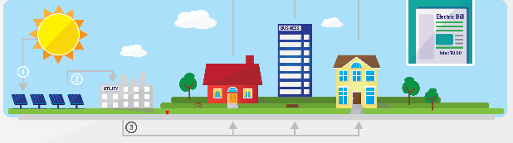
How Community Solar Works
Sunlight hits the solar panels in the community solar field, generating electricity
The electricity generated flows through an on-site meter to the electrical utility grid
The utility company measures the electricity generated, calculates a dollar value for the power, and distributes this dollar value proportionately to the members of the community solar program (residents, businesses, municipalities, and institutions)
The value of the solar electricity produced from the array is applied as a monetary credit to each member’s electric bill

Slide 4
Community Solar Ownership!

Slide 5
Term Definitions
RFP – Request for Proposal, a specific request for proposals on a particular project. Will likely request bidder to describe how they would design and finance a project
RFI – Request for Information, tactic used when there are a lot of potential suppliers or when more information is needed about the responder pool. Release this first if unsure of the scope or challenges of a project
PPA – Power Purchase Agreement, a financial agreement where a developer arranges for the design, permitting, financing, and installation of a solar energy system on a customer’s property at little to no cost. The developer sells the power generated to the host customer at a low fixed rate, and retains any tax credits and other incentives generated from the system

Slide 6
Term Definitions, Cont.
REC – Renewable Energy Credit, an energy commodity that represents proof that 1 MWh of electricity was generated from a renewable source and fed into the grid. Also called green tags or renewable energy certificates. Monetary compensation for the environmental benefits of clean energy
Respondent or bidder, entities that receive the RFP (i.e. solar developers)
Anchor tenant or subscriber, an organization that agrees to take on a large portion of the generation (no more than 40%)

Slide 7
Benefits of Using a Formal RFP
Provides comprehensive, formal reply from suppliers – easier to compare against each other
Demonstrates the attempt to act without a prejudice or preferred supplier
May help negotiate a lower cost
Bidder feedback can help identify additional options that were not considered or temper unrealistic assumptions

Slide 8
Before You Start…
Educate yourself, your community, and your staff
What is community solar? Once it has been identified, understand how the Illinois program works
What are the financial commitments needed for my community, business, family, etc. to participate in a community solar project?
What prep work can make the process easier and more successful? What will attract industry interest and low-cost bids?

Slide 9
RFP Guidance
Craft RFP so that it garners responses that can be more easily compared, apples to apples
Be as specific as possible
Ask for responses in a specific format
Highlight project goals, such as:
We want to retain the RECs for our project, or
We want the lowest cost solar energy possible, or
We want the project sited in our community.
Cast a wide net when sending out RFP
Send the RFP to trade associations and local installers

Slide 10
Important Early Steps
Start with clear, well-defined goals
Early involvement of a broad set of stakeholders
Consider hiring a consultant or owner’s agent
Determine your preferred ownership structure
Identify several potential locations for the facility
Local siting and permitting
Gather team of reviewers and experts to be part of RFP review process

Slide 11
1. Start with Clear Goals
Why do you want to start this project?
Important to clearly communicate what you want
Stay outcome oriented (as opposed to detail oriented) when framing goals and shaping RFP
Allows for flexibility
Info should be reported in a standard format with common metrics
Facilitates easy review and comparison of responses
How many people do you expect to participate in this project?

Slide 12
2. Early Involvement of Broad Set of Stakeholders
Consider inviting local government staff, legal staff, community members, solar developers, landowners, academics, and union members to participate in the pre-RFP process
Consult leaders from other communities who have experience with similar projects
Meet with stakeholders early to allow adequate time to find compromises and solutions to potential objections

Slide 13
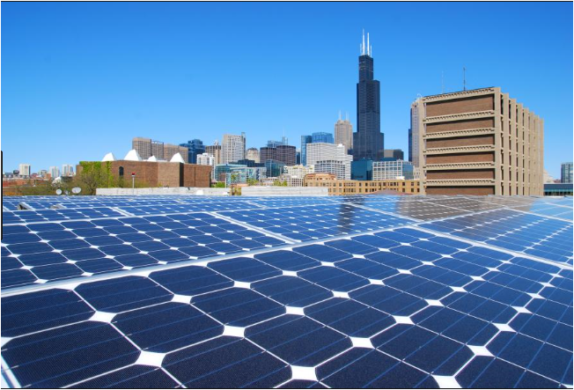
3.Consider Hiring a Consultant
Given the complexity and the negotiations involved in solar procurement, you may want to consider hiring someone with experience in the technical and legal aspects of your project to advise and advocate for you

Slide 14
4. Determine Ownership Structure
Do you want to own the system outright?
Do you want to lease the land?
Do you want to do a power purchase agreement with a developer?
How much risk do you want to assume?
Investor owned? Customer owned? Developer owned? Partnership between the investor, customer, developer?
Additional considerations: Who is this project for? The municipality, individuals or homeowners, a mix? Who will pay and who will retain the benefits?

Slide 15
4. Ownership Models
Developer-owned Model
A third-party owns or operates a project that is open to various models of participation among community members
Nonprofit Model
A charitable nonprofit corporation administers a community
shared solar project on behalf of donors or members
Special Purpose Entity (SPE) Model
Individuals join a business enterprise to develop a community shared solar project
Utility-owned Model
Where allowed by law, a utility owns and operates the project, allowing ratepayers to participate through their utility bills

Slide 16
5. Site Considerations
Local Site
Sited in the community
May be a symbol for community
Limited by local constraints
Remote Site
Sited in utility territory (ComEd/Ameren)
Easier to locate usable and affordable sites
Typically less expensive for subscribers

Slide 17
5. Site Considerations, Cont.
These factors make for a good solar site:
Large, flat land or rooftop with strong structural integrity
Unshaded by trees, buildings, or other obstructions
Access to electric grid capacity
In RFI, provide as much local info as possible, including:
Aerial photos or topographic maps of potential site(s); could include entire community
Prospective site characteristics: size, ownership, hazards, landforms (hills, wetlands, brownfields, etc.)
Local ordinance, zoning information, or zoning pre-clearance
Environmental
If community lacks a good site, consider remote sites

Slide 18
6. Local Siting and Permitting
State level permits
Developer should secure all necessary permits
Ask for identification of required permits in RFI responses
Local permitting/zoning
Does your community have a solar zoning ordinance?
What is necessary to secure a local construction permit?
Have your sites been pre-zoned/approved for solar?
The more information in the RFI, the more attractive it will be for developers

Slide 19
7.Gather Team to Participate in Review Process
Involve participants that developed the RFP in the review of the responses
This team can help frame process through which applications should be selected
Consider conflicts of interest by preventing substantive participation
If a developer or technical professional helps write the RFP, make sure you communicate clearly from the outset about whether they will be able to bid. Additionally, consider compensating them for offering their expertise

Slide 20
Key Elements to a Successful RFP
Cost and financial requirements
Provide site information
Permitting and interconnection responsibility
Team qualifications and solar project experience
Technical specifications
Operations and maintenance
Performance monitoring and performance guarantees
Roof integrity and warranties
Establishing a timeline: milestones with completion dates
Sourcing locally: equipment or labor origin requirements & community benefits
Subscribers: Who is going to buy the power?

Slide 21
1.Cost and Financial Requirements
Respondents to provide:
Cost estimates for installation and maintenance of array
Description of the return on investment over a period of 25 years or greater (specify what unit of measurement to use)
Possible finance options for installation and maintenance, i.e. loan or bond, lease, power purchase agreement, etc.
Information on the value and ownership of RECs
Request that bidders offer two scenarios:
Community owns RECs
Developer retains ownership
5. Respondents should submit documents that demonstrate their financial capacity to cover applicable up-front costs

Slide 22
2. Site Information
Directions to the site and contact information for entity to facilitate bidders’ access to the potential site
It is important for bidders to view the site in order to inform their bid on matters of parameters, measurements, and potential problems or challenges not identified in the pre-RFP process
If site has not been identified or is not know to be ideal, bidders can be requested to help with site identification and assessment in the proposal process.

Slide 23
3. Permitting & Interconnection Responsibility
Common for local governments to require successful respondents fully responsible for obtaining any required state-level or utility permits
Advantageous for communities to assist or pre-secure local permits:
Building, construction, electrical, plumbing, environmental, zoning, etc.

Slide 24
4. Team Qualifications & Solar Project Experience
Local governments should request that respondents submit info indicating qualifications
Procurement staff can identify the most qualified candidate for the contract by looking through:
Company profiles, lists of relevant state licenses and industry certifications, proof of insurance, bonding safety ratings, project team background and qualifications, business references, and any solar project experience

Slide 25
5. Technical Specification
Outline information on respondents’ proposed technical approach as well as the system equipment to be used
For PV: module type, inverters, monitoring and data acquisition systems, balance of system components
Don’t be overly prescriptive, allow for create feedback

Slide 26
6. Operations and Maintenance
Contract with the developer or another party to handle responsibilities or ensure local government staff has training and resources they need to perform this function internally
If jurisdiction chooses the latter, RFP should specify that the successful respondent is responsible for either providing the relevant personnel with O&M manuals or onsite training or both

Slide 27
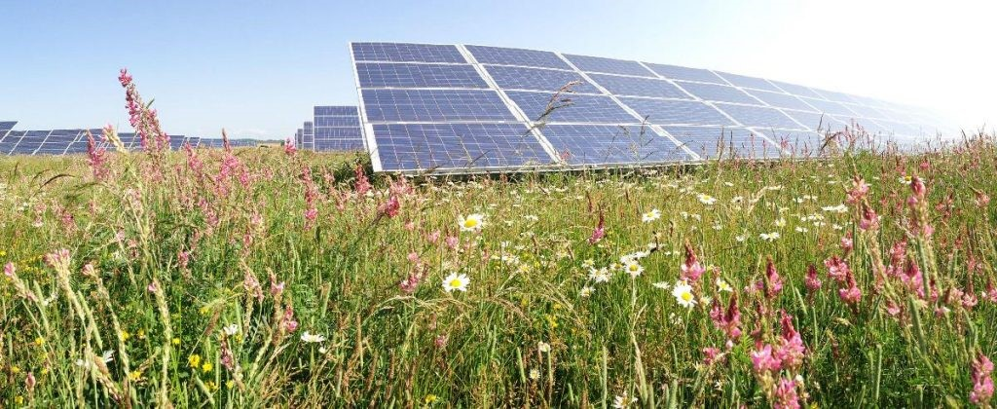
7. Performance Monitoring
Monitoring will ensure system quality, track production for the purposes of calculating number of RECs generated, demonstrate the benefits of the system to the community
Systems can be monitored through inverter kWh displays

Slide 28
8. Roof Integrity and Warranties
It is important to ensure building is structurally sound in order to support solar for roof top projects
Select roofs that will not require replacement for at least 15 years
Mostly south-facing, avoid excessive shading from vegetation or nearby buildings, remain within acceptable ranges for wind and snow loads, have enough space for desired system size, easy electrical or plumbing connection, no significant aesthetic concerns
Respondents should be required to ensure that installation will not adversely impact roof integrity or violate existing roof warranties

Slide 29
9. Establishing a Timeline: Milestones with Completion Dates
Respondents may be required to submit detailed project plans, listing major milestones and anticipated completion dates
Milestones can include: obtaining required permits, equipment purchasing, organizing project finance, commencement of construction/installation and system operation, approval of interconnection requests
It is important to note that projects can be held up at various stages due to unforeseen circumstances, such as the issuing of permits, inclement weather, etc.

Slide 30
10. Sourcing Locally*
Jurisdictions wishing to stimulate a local solar market or ensure that as many of the project benefits as possible are retained in the area can include requirements that respondents use local materials and/or labor
*It is important to determine if local resources are available and cost effective prior to including this stipulations
Local governments can include requirements within the RFP directing respondents to identify and describe any community benefits associated with the project being proposed

Slide 31
11. Subscribers
Anchor Subscribers
Local governmental load
Schools, water department, street & traffic lighting, etc.
Commercial & industrial load
Stores, factories, etc.
Residential Subscribers
How many residential subscribers will participate?
Credit score considerations
Demonstrating a subscriber base will make the project more attractive to developers

Slide 32
Examples
United Power Sol Partners Cooperative Solar Farm, Colorado
http://www.unitedpower.com/cooperative-solar-farm/
University Park Community Solar LLC, Maryland
http://www.universityparksolar.com/
Solar for Sakai, Bainbridge Island, Washington
http://cenergysolutions.org/Programs/SolarForSakai.html
Dairyland Power Cooperative, Wisconsin
http://ruralsolarstories.org/
South View Solar Farm, Elizabeth, Illinois
https://www.jocarroll.com/sites/jocarroll/files/images/South-View-Solar-Farm-FAQ.pdf

Slide 33
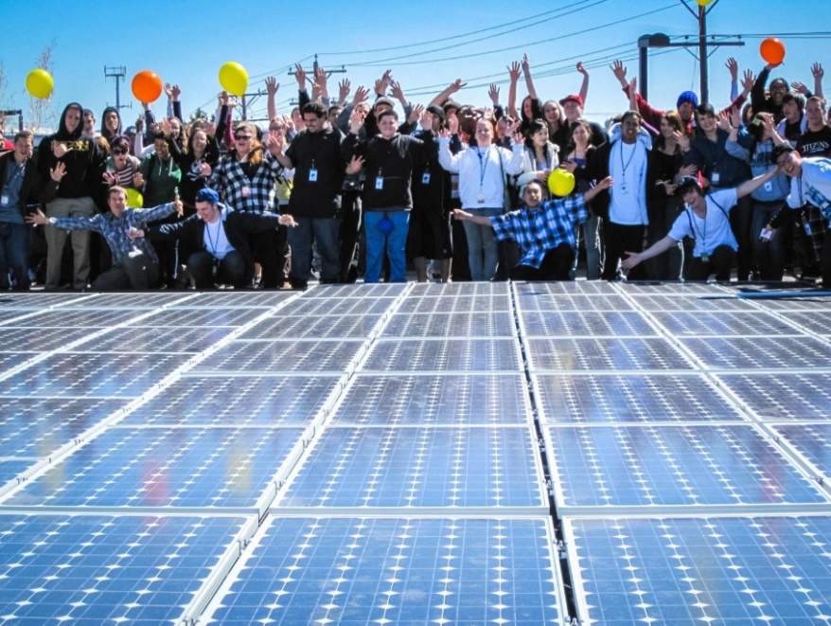
Additional Resources
Illinois Solar Energy Association
www.illinoissolar.org
Coalition for Community Solar Access (CCSA)
www.communitysolaraccess.org/
Solar Energy Industries Association (SEIA)
http://www.seia.org/policy/distributed-solar/shared-renewablescommunity-solar
Interstate Renewable Energy Council (IREC)
www.irecusa.org/regulatory-reform/shared-renewables/
National Resource Energy Lab (NREL)
http://www.nrel.gov/docs/fy11osti/49930.pdf
Vermont Natural Resource Council (VECAN)
http://www.vecan.net/about-the-community-solar-toolbox/

