Slide 1

Community Solar:
How Can I Participate?
Forum #2
Growing New Energy Jobs Downstate
Southern IL – July 25-26, 2017

Slide 2
Our Community Solar Agenda
How Community Solar Works
Top 10 Reasons for Community Solar/Types/Models
Who are the Major Players in a Community Solar Project?
  Examples of Owners
  Examples of Subscribers
Future Energy Jobs Act Overview/Review via IPA Slides
Summary of Incentives
Working with Ameren: System Owners & Subscribers
Working with Rural Cooperatives
FEJA Timeline
Discussion/ Q & A

Slide 3

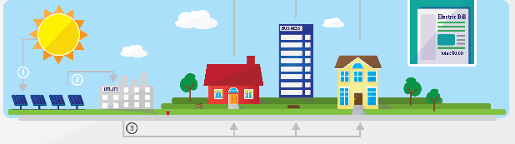
How Community Solar Works
Sunlight hits the solar panels in the community solar field/rooftop, generating electricity.
The electricity generated flows through an on-site meter to the electrical utility grid.
The utility company measures the electricity generated, calculates a dollar value for the power, and distributes this dollar value proportionately to the members of the community solar program (residents, businesses, municipalities and institutions).
The value of the solar electricity produced from the array is applied as a monetary credit to each member’s electric bill.

Slide 4
Where Can Community Solar Be Located?
Can be sited on:
  Rooftops of community centers, churches, schools or other community buildings
  Mall, apartment building or other multi-tenant building
  Remote, off-site locations where land may allow a larger facility and better cost-efficiency

Slide 5
Before You Start…
Educate yourself, your community, and your staff
  What is community solar? Once it has been identified, understand how the Illinois program works.
  What are the financial commitments needed for my community, business, family, etc. to participate in a community solar project.
  What prep work can make the process easier and more successful? What will attract industry interest and low-cost bids?

Slide 6
Sourcing Locally*
Jurisdictions wishing to stimulate a local solar market or ensure that as many of the project benefits as possible are retained in the area can include requirements that respondents use local materials and/or labor.
  *It is important to determine if local resources are available and cost effective prior to including this stipulations
Local governments can include requirements within the RFP directing respondents to identify and describe any community benefits associated with the project being proposed

Slide 7
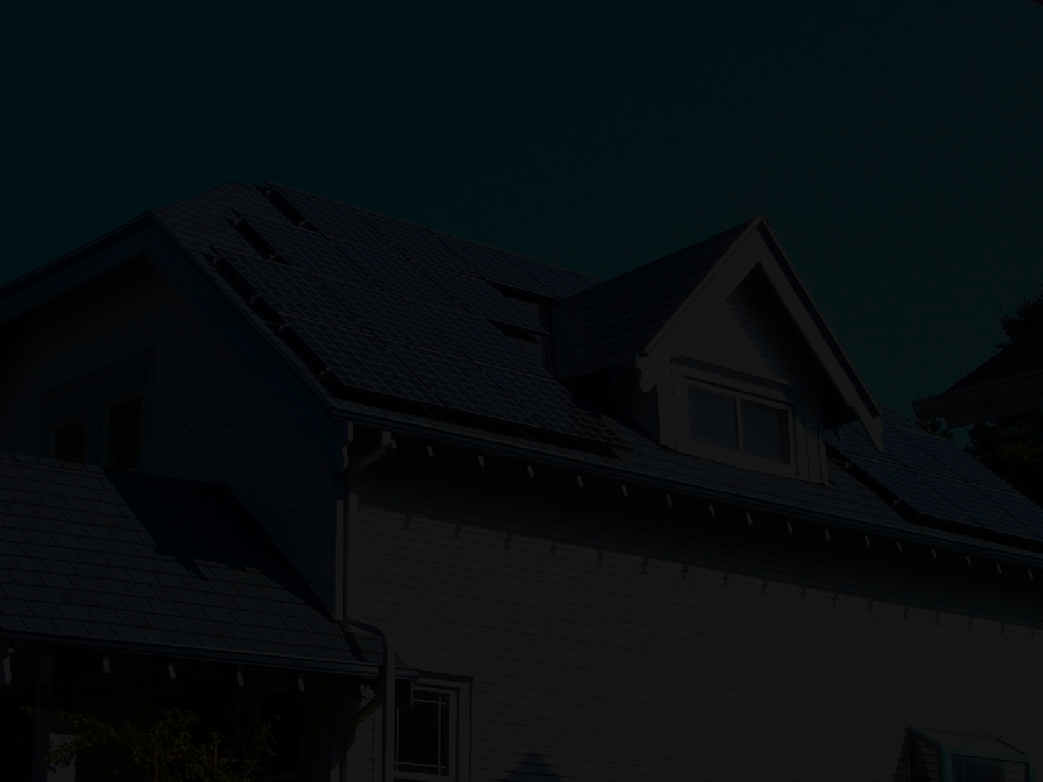

#10: Savings
Every 1-kilowatt share of a community solar project can cut your electricity bill by 13%

Slide 8
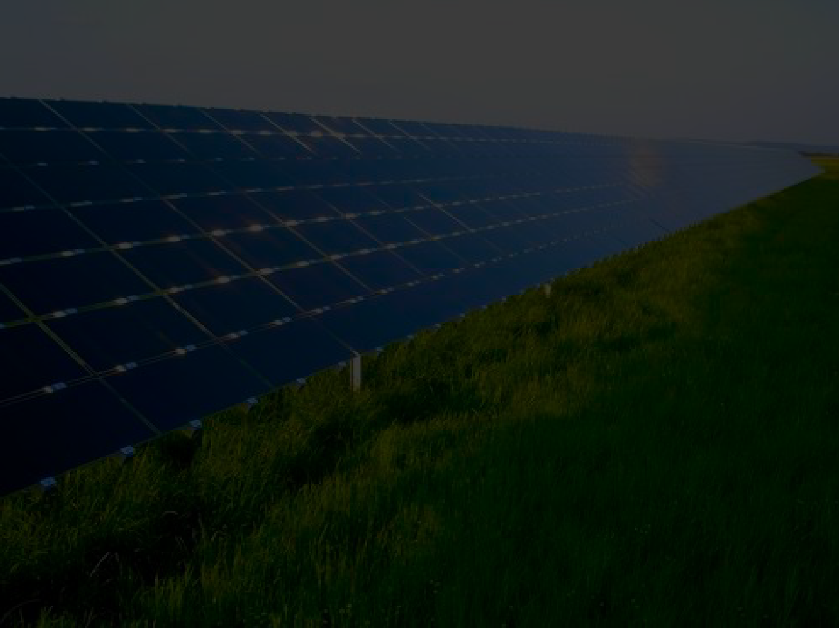
#9: Clean Energy
With a 25-year warranty, solar means you get free, clean energy from the sun for decades

Slide 9
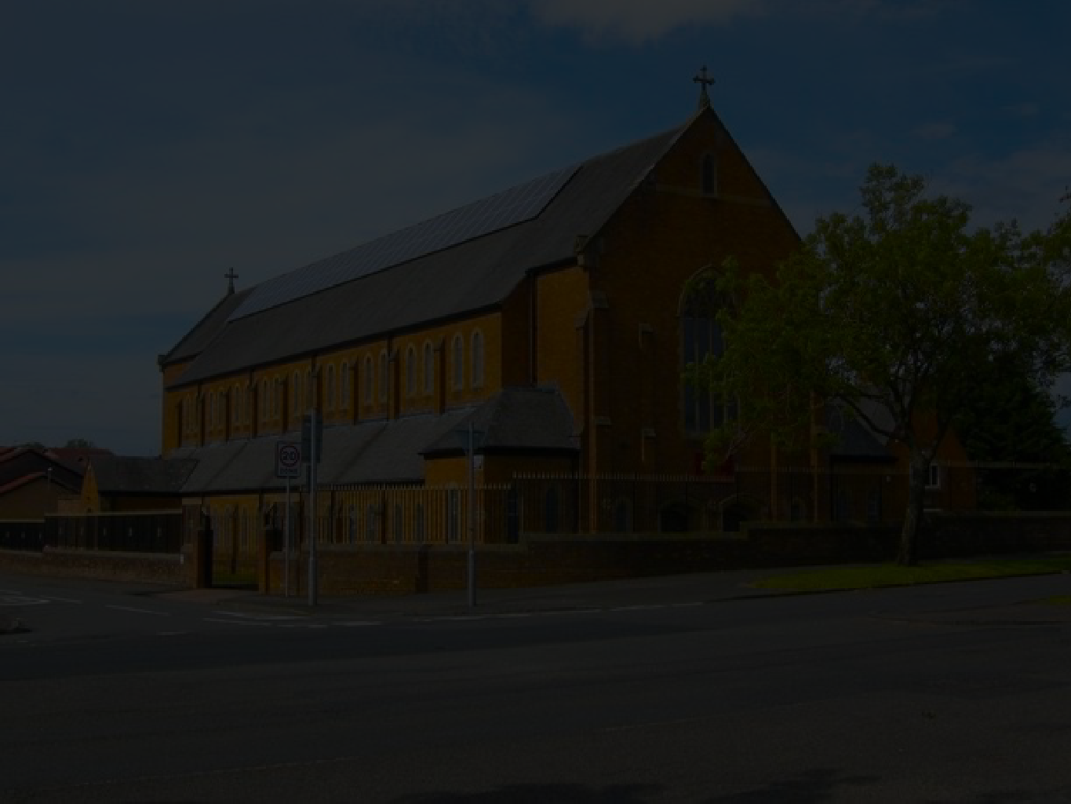
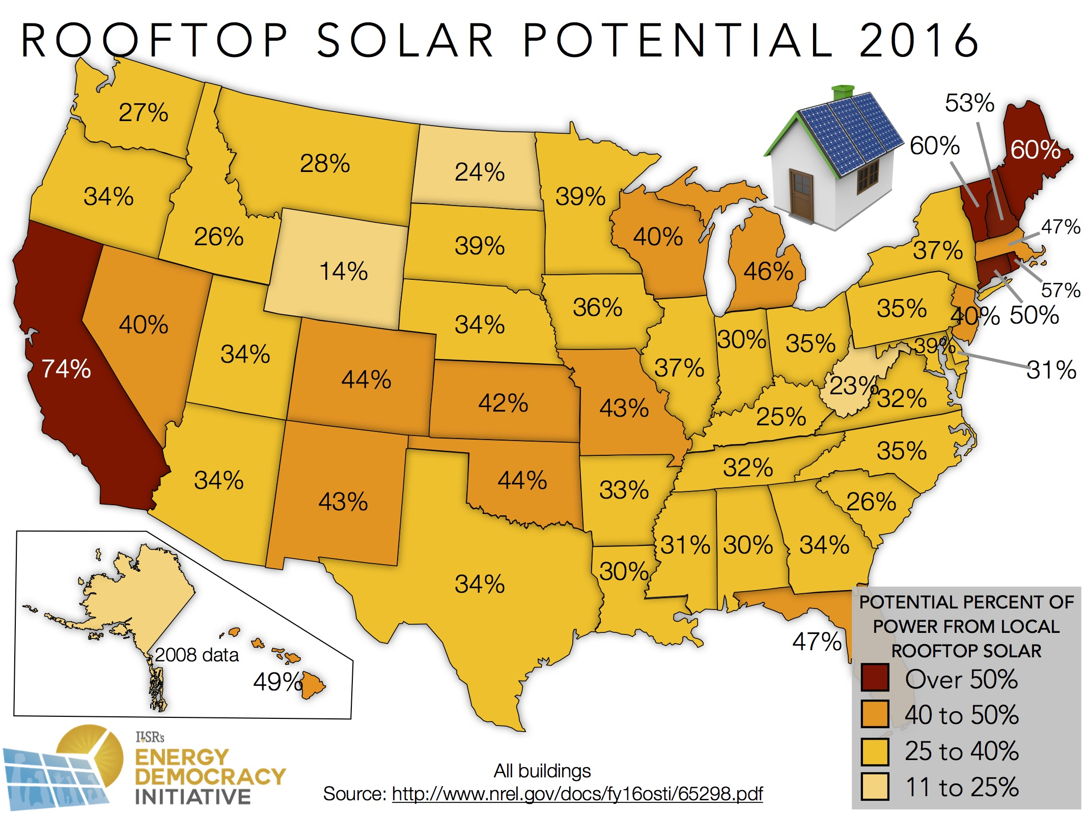
#8: Access to all
Over half of U.S. households don’t have a sunny rooftop, but everyone can be part of community solar.

Slide 10
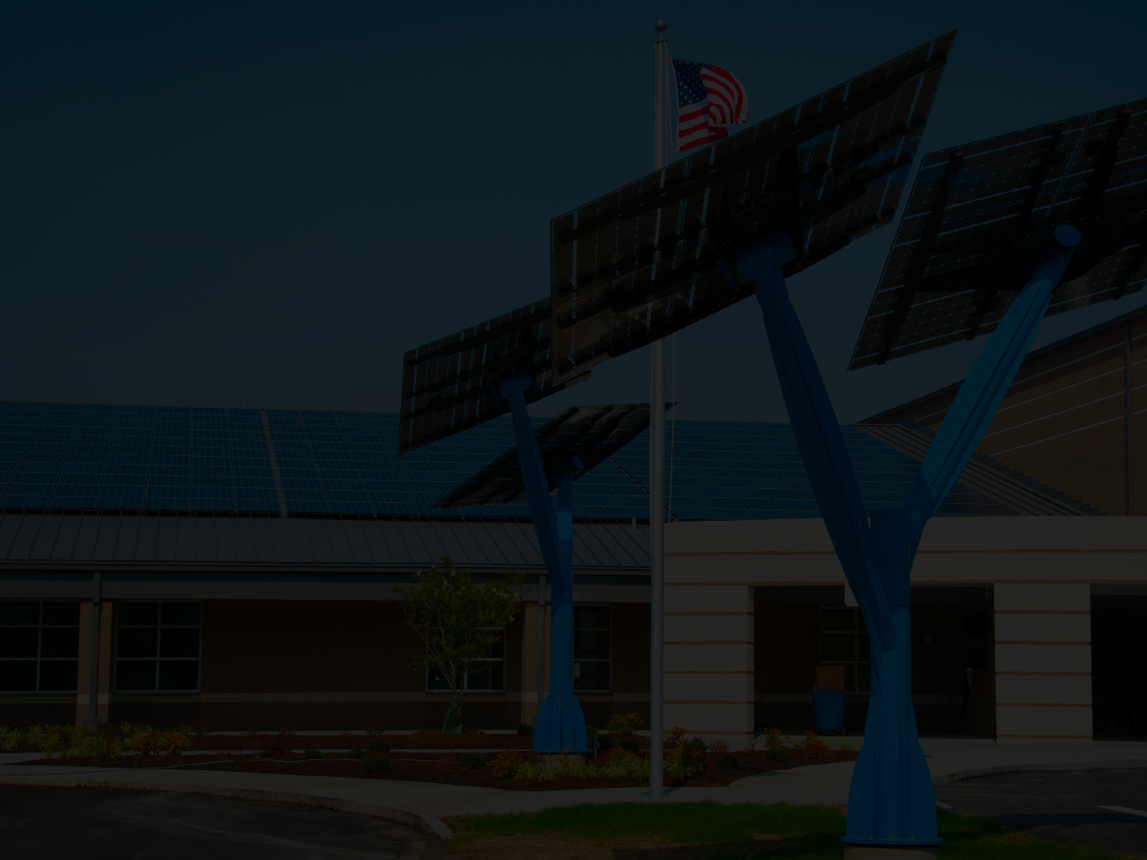
#7: Ownership
Community solar means owning a share of your energy future, and it might come from a library or school rooftop near you!

Slide 11
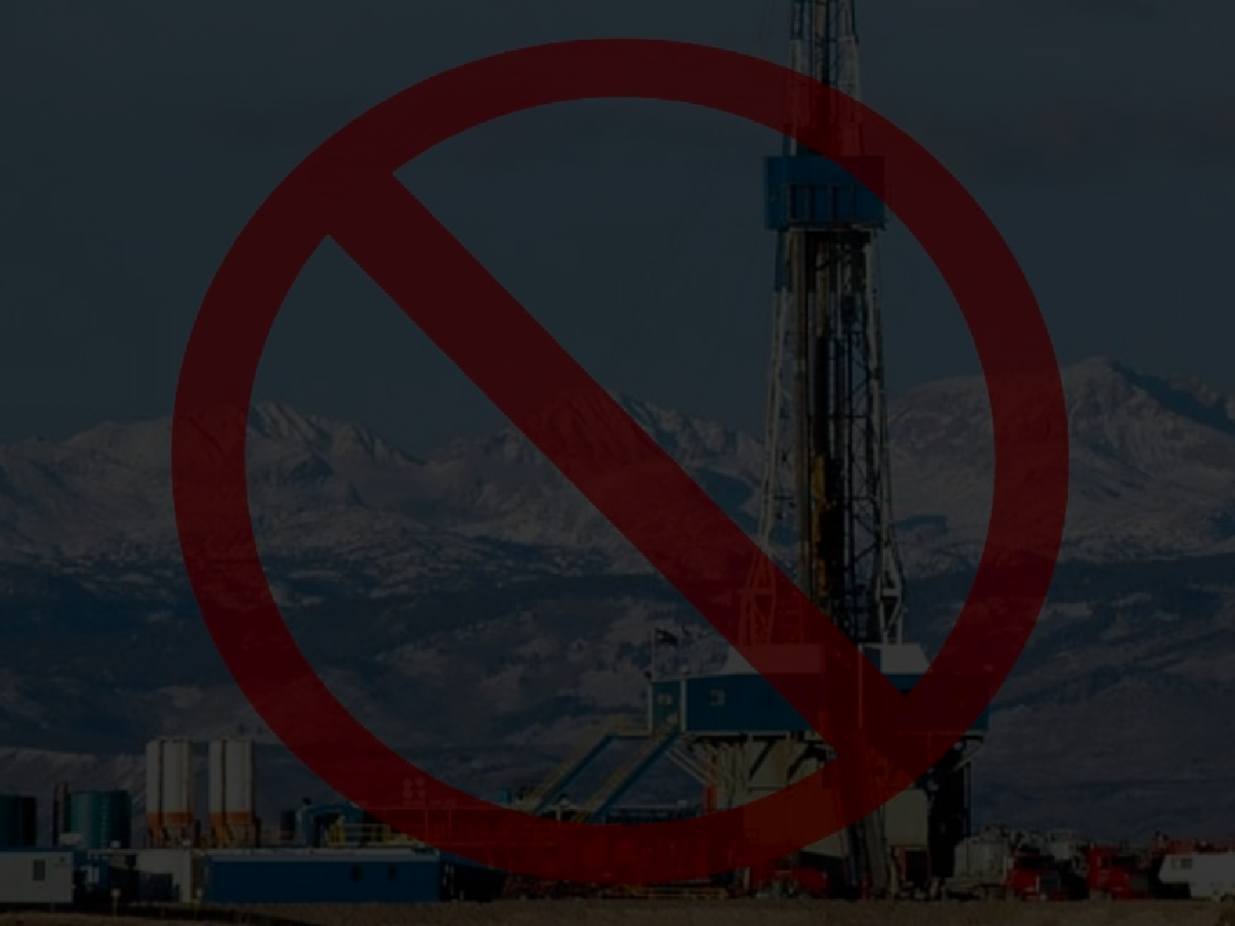
#6: Local dollars
Spending a dollar on community solar electricity means you don’t pay for mines or fracking or pollution

Slide 12
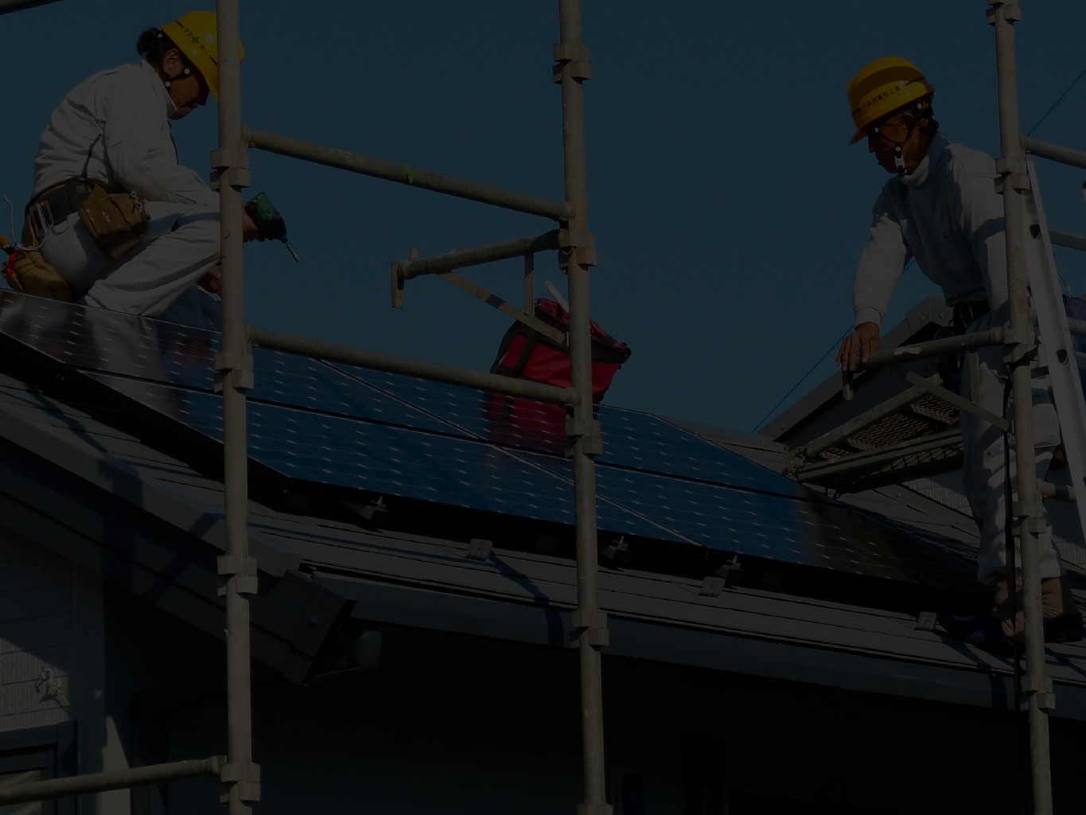
#5: Jobs
Every megawatt of solar creates up to 20 jobs in the local economy

Slide 13
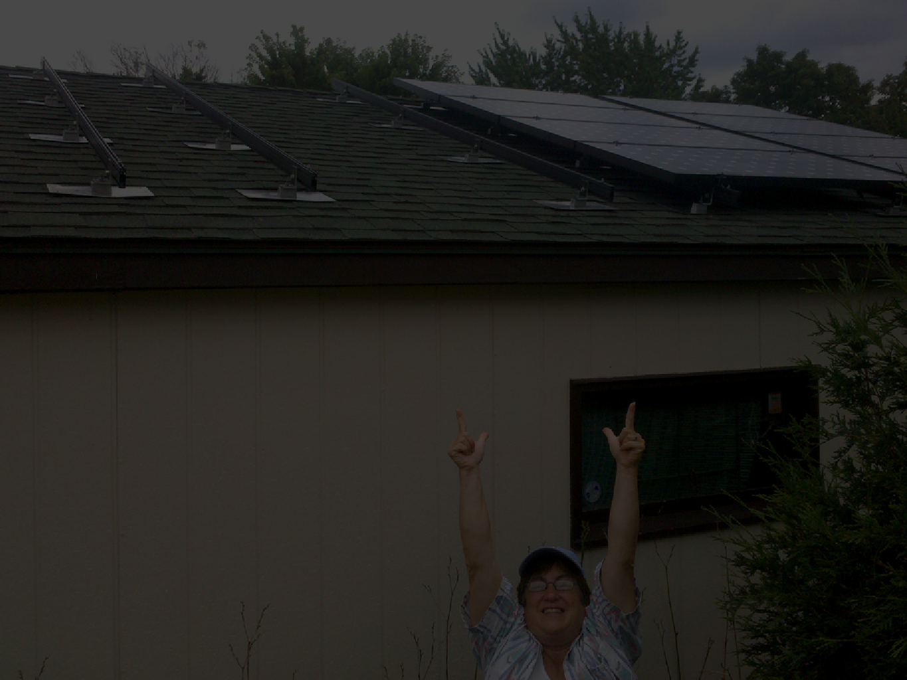
#4: Control
Your electric utility can’t raise rates on energy that you own

Slide 14
#3: Competition
Some utilities are monopolies,
but community solar gives you a choice

Slide 15
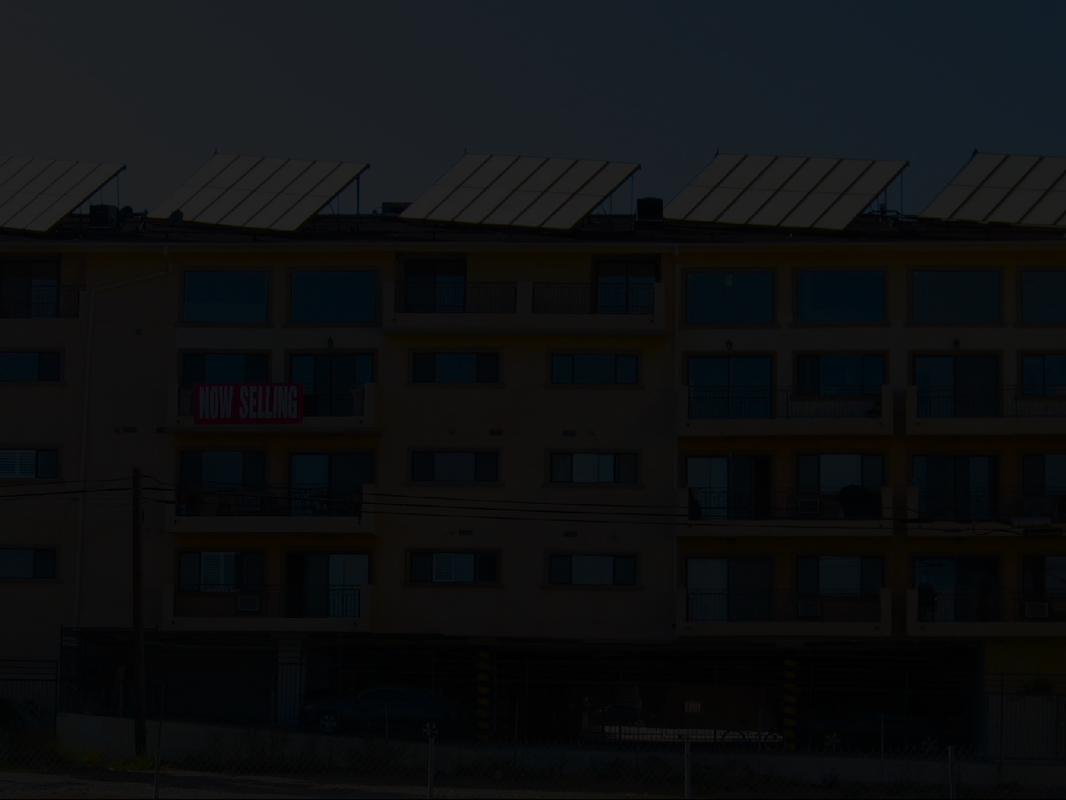
#2: Equity
Community solar means you can own solar without being rich or having a good credit score

Slide 16
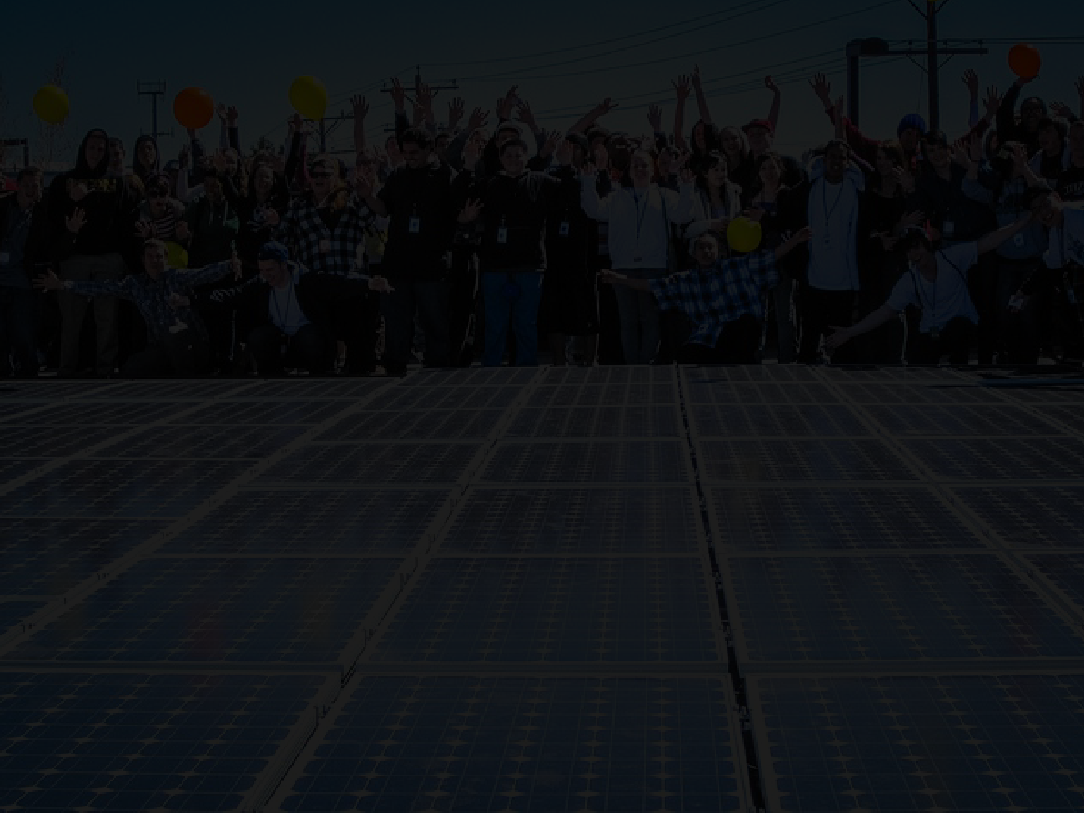
#1: Community power
Owning a share of community solar is the first step toward taking charge of your—and your community’s— energy future

Slide 17
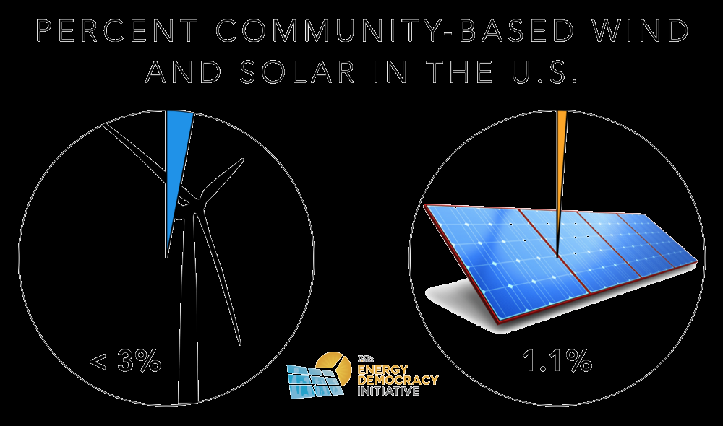

Slide 18

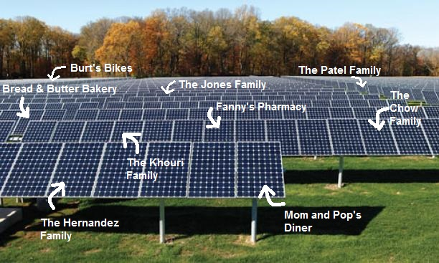
Community Solar Ownership!

Slide 19
A Community Renewable Energy Gold Standard- Best Practices
There are four key principles to successful and meaningful community renewable energy:
Tangible benefits for participants
Flexibility of ownership structure
Additive to other renewable energy policies
Access for all

Slide 20
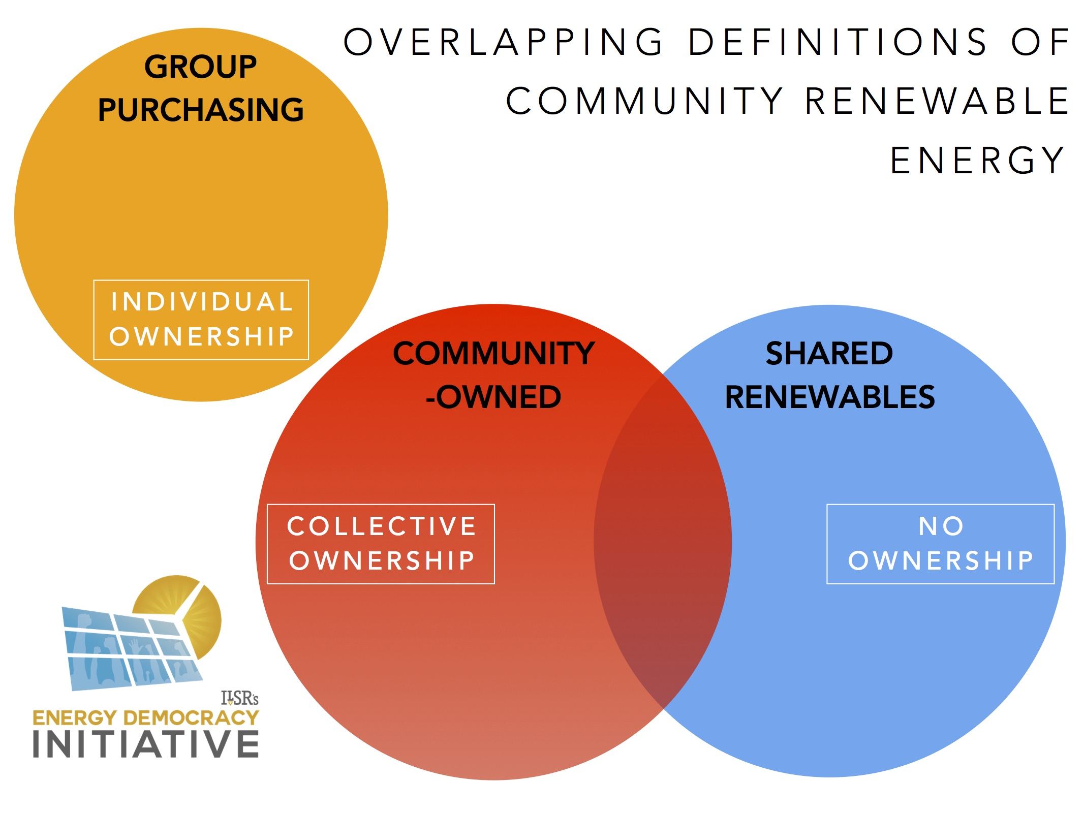

Slide 21
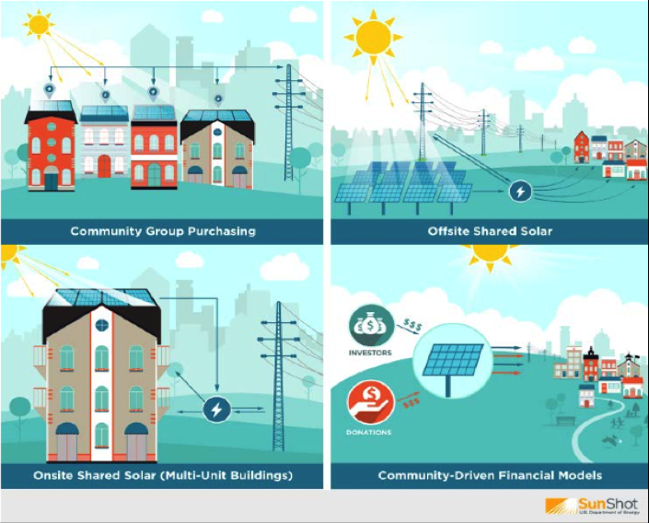
Types of Community Renewable Energy

Slide 22
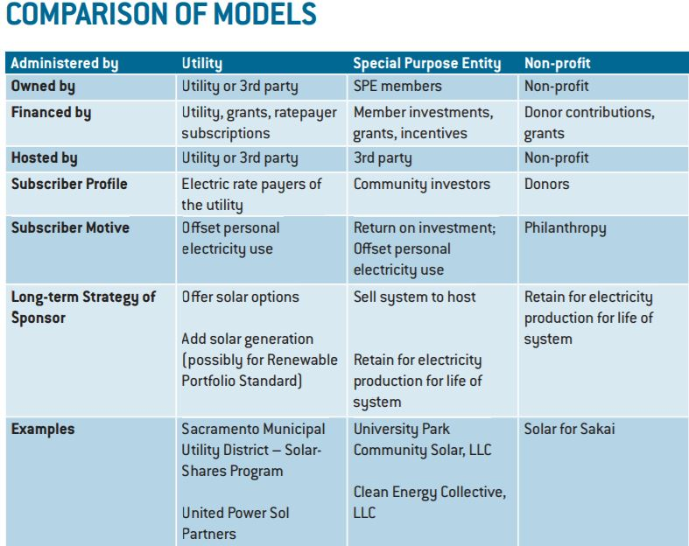
Source: US Department of Energy

Slide 23
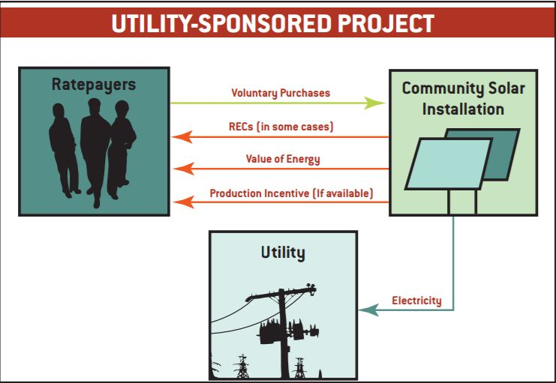
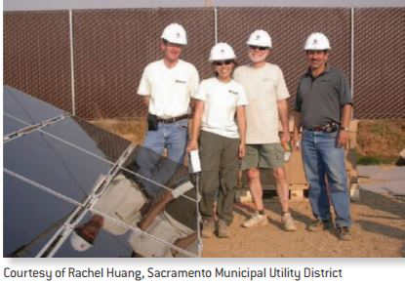
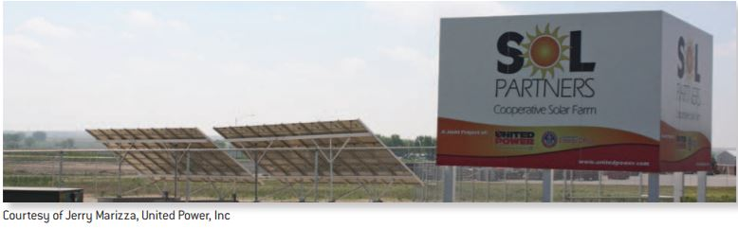
Shared Solar- Utility Sponsored Project-
No ownership by ratepayers
Source: US Department of Energy

Slide 24
Shared Solar- Utility Sponsored Project-
Sol Partners Highlights
PROJECT HIGHLIGHTS
• System Owner: United Power
• Installed Capacity: 10 kW with plans for Phase II
• Participant Agreement: One-time fee to lease a 210-watt panel for 25 years
• Electricity: Customers receive a monthly bill credit for the value of their panel’s production at a solar rate, slightly above the retail rate (currently 11 cents per kWh vs. 10.5 cents retail)
• RECs: Retained by United Power • Number of Participants: 25
FINANCIAL DETAILS
• Total Installed Cost: Phase I: Approximately $10/watt. Phase II: $5.50/watt
• Capital Financing: Utility financed
• Tax Credit: NA (tax-exempt)
• Grants: $50,000 from State Governor’s Office for design
• One-time Subscription cost: $1,050
• Value of electricity credits over 25 years: $900 assuming a constant solar credit rate (but this solar credit rate will likely rise, as will the retail rate)
Source: US Department of Energy

Slide 25
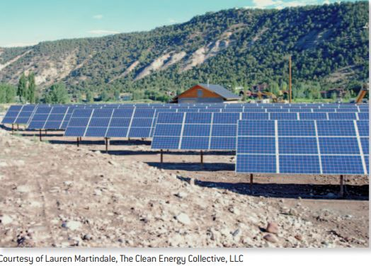
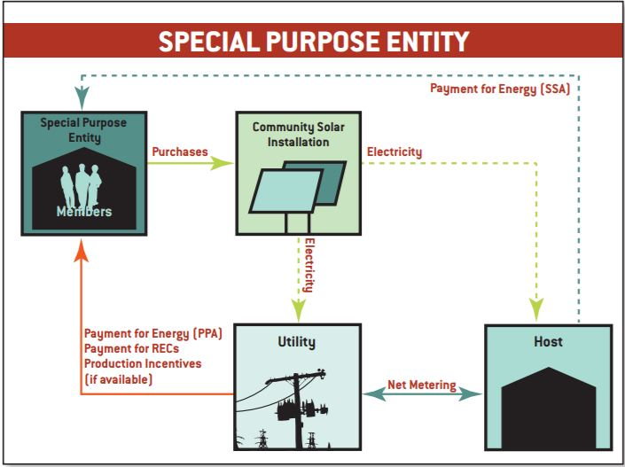
Community Owned- Special Purpose Entity
Members own
The first CEC project is a 77.74-kW array in the Holy Cross Energy service territory (western Colorado). The CEC leased the land, sold the project to customers, and negotiated a PPA with Holy Cross Energy. The PPA rate paid by Holy Cross will escalate as regular utility rates increase. CEC’s RemoteMeter™ system automatically calculates monthly bill credits for customer accounts and integrates directly with the utility’s billing system to apply the credits.
Source: US Department of Energy

Slide 26
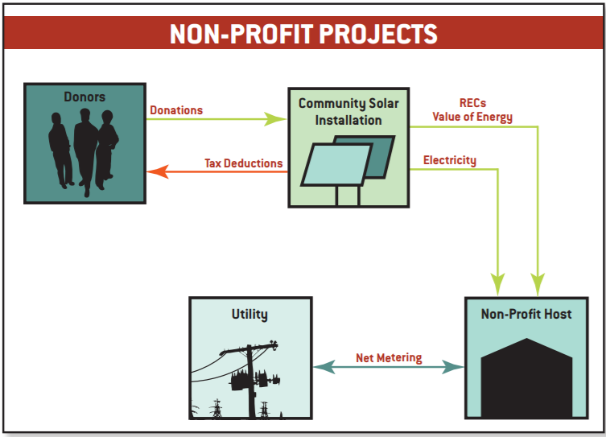
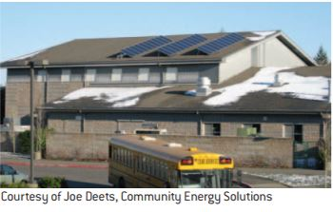
Community Owned- Non-Profit
Funded by Donors/Grants
PROJECT HIGHLIGHTS
• System Owner: Sakai Intermediate School
• Installed Capacity: 5.1 kW
• Electricity: Net metered FINANCIAL DETAILS
• Installed Cost: $50,000 or $9.80/watt
• Grants: $25,000 from utility (Puget Sound Energy)
• Donations: $30,000 via Community Energy Solutions
• Production Incentive: $0.15/kWh from State of WA
Source: US Department of Energy

Slide 27
Who are the Major Players?
Note: In the descriptions below, many of these roles can be performed by the same individual or entity.
Subscribers: Individual electricity customers who participate in a community solar project.
Site Assessor: An expert who studies and recommends solar locations.
Host: The individual, business, community group, or other entity that owns the land that is the site of the community solar project.
Developer: The primary individual or group that organizes the community solar project.
Operator: The individual, business, community group or other entity that maintains the community solar installation.
Funders: Sources of financing for the project.
Outreach Partners: Help recruit subscribers for the community solar project.
Installer: An expert who builds the community solar installation.
Utility: Ameren or ComEd, the utility where the community solar panels are installed.
source: Citizens Utility Board (CUB)

Slide 28
Who are the possible Owners?
Developer-owned Model
  A third-party owns or operates a project that is open to a various models of participation among community members
Nonprofit Model
  A charitable nonprofit corporation administers a community
  shared solar project on behalf of donors or members
Special Purpose Entity (SPE) Model
  Individuals join a business enterprise to develop a community shared solar project
Utility-owned Model
  Where allowed by law a utility owns and operates the project, allowing ratepayers to participate through their utility bills

Slide 29
Who are the possible Subscribers?
Anchor Subscribers
  Local governmental load
  Schools, water department, street & traffic lighting, etc.
  Commercial & industrial load
    Stores, factories, etc.
Residential Subscribers
  How many residential subscribers will participate
  Credit score considerations
Demonstrating a subscriber base will make the project more attractive to developers

Slide 30
What is Community Solar in Illinois?
Defined in the Illinois Power Agency Act
"Community renewable generation project" means an electric generating facility that:
(1) is powered by wind, solar thermal energy, photovoltaic cells or panels, biodiesel, crops and untreated and unadulterated organic waste biomass, tree waste, and hydropower that does not involve new construction or significant expansion of hydropower dams;
(2) is interconnected at the distribution system level of an electric utility as defined in this Section, a municipal utility as defined in this Section that owns or operates electric distribution facilities, a public utility as defined in Section 3-105 of the Public Utilities Act, or an electric cooperative, as defined in Section 3-119 of the Public Utilities Act;
(3) credits the value of electricity generated by the facility to the subscribers of the facility; and
(4) is limited in nameplate capacity to less than or equal to 2,000 kilowatts.

Slide 31
Community Solar is a subset of the
Adjustable Block Programs
• Blocks have a set size and prices that adjust between blocks
• Transparent schedule of prices (set as a value or a formula)
• 15 Year REC contracts
• 20% paid at time of interconnection and energized, balance paid out over 4 years
• Clawback provision to ensure delivery of RECs during the contract
• Provisions to ensure that payments by utilities do not exceed funds collected from rate payers
• Goal to ensure that projects are in diverse locations and not overly concentrated

Slide 32
Defining Subscriber and Subscription
"Subscriber" means a person who:
(i) takes delivery service from an electric utility, and
has a subscription of no less than 200 watts to a community renewable generation project that is located in the electric utility's service area.
No subscriber's subscriptions may total more than 40% of the nameplate capacity of an individual community renewable generation project. Entities that are affiliated by virtue of a common parent shall not represent multiple subscriptions that total more than 40% of the nameplate capacity of an individual community renewable generation project.
"Subscription" means an interest in a community renewable generation project expressed in kilowatts, which is sized primarily to offset part or all of the subscriber's electricity usage.

Slide 33
Portability and Transferability
• “Portable" means that subscriptions may be retained by the subscriber even if the subscriber relocates or changes its address within the same utility service territory
• “Transferable" means that a subscriber may assign or sell subscriptions to another person within the same utility service territory.

Slide 34
Bill Credits
Electric utilities shall provide a monetary credit to a subscriber's subsequent bill for service for the proportional output of a community renewable generation project attributable to that subscriber

Slide 35
Unsubscribed Energy
The electric utility (Ameren in this territory) shall purchase any unsubscribed energy from community renewable generation projects that are Qualifying Facilities ("QF") under the electric utility's tariff for purchasing the output from QFs under Public Utilities Regulatory Policies Act of 1978.

Slide 36
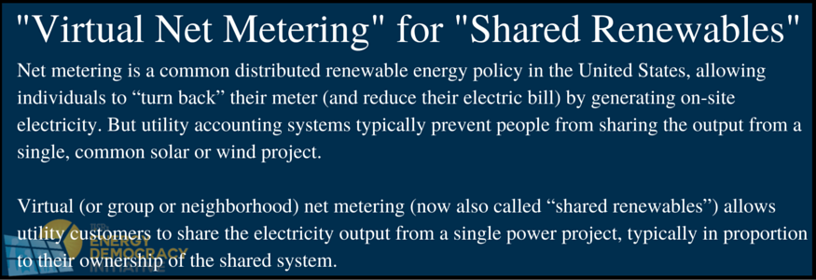
Virtual Net Metering
Source: ILSR Community Solar Report 2016

Slide 37
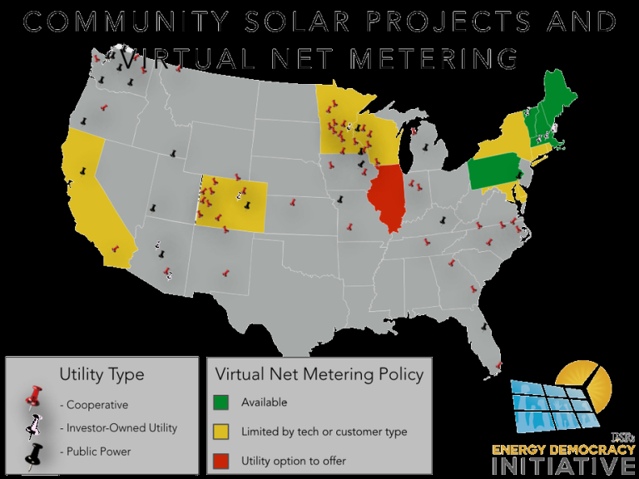
Virtual Net Metering
Source: ILSR Community Solar Report 2016

Slide 38
Virtual Net Metering in Illinois per FEJA
• Virtual net metering allows subscribers to community solar projects to receive comparable benefits to if they had solar panels onsite
• Utilities now required to offer virtual net metering
• Utilities will file tariffs by 8/30/17
• ICC will approve tariffs by 9/29/17

Slide 39
Brownfield Development
What is a “Brownfield”…or “Brightfield”?
Brightfields, defined by the U.S. Department of Energy as solar development on brownfields (contaminated land or closed landfills), have become increasingly attractive to project developers diversifying away from traditional rooftops and greenfield locations.
Two motivators drive this trend: first, location. Brownfields have few other viable uses, but may be close to high-capacity interconnection points in industrial zones. Second is incentives. Federal, state and local governments offer specific incentives to improve brightfield project economics and help hedge against uncertain solar valuation policies.
SOURCE: Greentech Media, July 2016

Slide 40
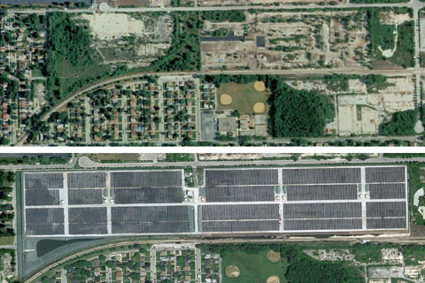
Brownfield Development
Exelon City Solar- Utility not Community, but in ILLINOIS since 2010!
Located in Chicago’s West Pullman Neighborhood
41 acre brownfield site
10 MW solar power plant
Can power up to 1,500 homes
TOP: BEFORE BOTTOM: AFTER

Slide 41
Brownfield Development
Long-term plan: Necessary Components (220 ILCS 5/16-111.5(b)(5)(ii)(B))
• (aa) Identify the procurement programs and competitive procurement events consistent with the applicable requirements of the Illinois Power Agency Act and shall be designed to achieve the goals set forth in subsection (c) of Section 1-75 of that Act.
• (bb) Include a schedule for procurements for renewable energy credits from utility-scale wind projects, utility-scale solar projects, and brownfield site photovoltaic projects consistent with subparagraph (G) of paragraph (1) of subsection (c) of Section 1-75 of the Illinois Power Agency Act
• (cc) Identify the process whereby the Agency will submit to the Commission for review and approval the proposed contracts to implement the programs required by such plan.

Slide 42
Brownfield Development
Not a component of Community Solar?
Per the IPA’s slide regarding “New Project Delivery Requirements”, here is the Solar breakdown: 50% from adjustable block program (distributed generation/community solar), 40% from utility-scale projects, 2% from brownfield projects (non-community solar brownfield)

Slide 43
Brownfield Development
Per the IPA’s presentation slide regarding “New Project Delivery Requirements” here is the Solar breakdown: 50% from adjustable block program (distributed generation/community solar), 40% from utility-scale projects, 2% from brownfield projects (non-community solar brownfield)
Although this “carveout” is for non-community solar, there is not a stated exclusion saying that Community Solar projects cannot be developed on brownfields/mined lands.

Slide 44
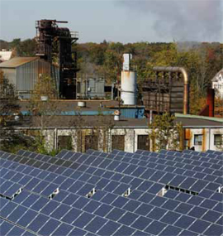
Brownfield Development EXAMPLE
Brockton Brightfields is a 460 kW grid-integrated solar installation on the site of a former manufactured gas facility. (Image courtesy of Brockton Brightfields, City of Brockton, Massachusetts; SCHOTT Solar.)

Slide 45
Summary of Incentives:
30% Federal Tax Credit
5 Year Accelerated Depreciation
Renewable Energy Credits
Virtual Net Metering*
*In Ameren and ComEd territories/Application in municipal and cooperative utilities is not yet defined
Depending on the structure of the Community Solar Project and whether you are a Community Solar System Owner or Subscriber will determine the allocation of these incentive opportunities

Slide 46
Working with Ameren
Community Solar Owners & Subscribers
The next series of slides will provide information to both Community Solar system owners and subscribers as to how Ameren will work with both parties in accordance with FEJA guidelines previously shared via the IPA slides.

Slide 47
Working with Ameren as an Owner of a Community Solar Project
Step 1: Complete an appropriate Interconnection Application based on system size (only Levels 2 & 4 apply here):
Level 2 – Lab-certified interconnection equipment with an aggregate electric nameplate capacity not exceeding the specifications in Section 466.90(b)(2). Lab-certified is defined in Section 466.30. (Application fee is $100 plus $1.00 per kVA.)
Level 4 – Nameplate capacity rating is less than or equal to 10 MVA and the distributed generation facility does not qualify for a Level 1, Level 2 or Level 3 review, or the distributed generation facility has been reviewed but not approved under a Level 1, Level 2 or Level 3 review. (Application fee amount is $1,000 plus $2.00 per kVA, to be applied toward any subsequent studies related to this application.)

Slide 48
Working with Ameren as an Owner of a Community Solar Project
Step 2:
Community Solar System Owner registers their generator by system size via an on-line portal managed by Ameren.

Slide 49
Working with Ameren as an Owner of a Community Solar Project
Step 3:
Community Solar Owner registers subscribers and the amount of generating capacity assigned to the individual subscribers through Ameren's portal. Subscribers need to provide permission for Owners to register them for service under Ameren's Net Metering tariff.

Slide 50
Working with Ameren as an Owner of a Community Solar Project
Step 4: Smart Inverter Rebates
Community Solar System Owner will receive $250/kW rebates for installed smart inverter based on % of subscription. Rebates are paid within 60 days after a completed application is submitted to Ameren.
Once net metering generation reaches 3% of Ameren’s maximum load, the rebate amount will be reevaluated.
Once solar integration reaches 5% of maximum load, rebates will be based on the outcome of the reevaluation proceedings.

Slide 51
Working with Ameren as an Owner of a Community Solar Project
What happens when a subscriber moves?
The Community Solar System Owner will be notified of a subscriber moving. The owner, through the on-line portal, will then need to:
Do nothing if the move is to another Ameren-served site, and there are no geographic restrictions on the location of the subscriber, or
Unsubscribe the subscriber and find a new subscriber if there are geographic restrictions on the geographic location of the subscriber.

Slide 52
Working with Ameren as a Subscriber of a Community Solar Project
How will I be compensated?
The kWh produced from the subscriber’s portion of the Community Solar System will be credited on the Ameren bill on a monthly basis (virtual net metering).

Slide 53
Working with Ameren as a Subscriber of a Community Solar Project
What do I do if I move?
As long as you are staying within Ameren Illinois territory, and there are no geographic restrictions imposed by the Community Solar Owner (e.g. generation is only for residents of a certain community), Ameren will make sure your subscription follows your move.
To ensure there's no disruption in receiving credit for your subscription, make sure that you don't cancel service at your old location before starting service at your new location.
Community Solar System Owner will be notified of the move.

Slide 54
Working with Rural Cooperatives/Municipal Utilities for Community Solar
Question? Can Community Solar in Rural Cooperatives and Municipal Utilities be developed/subscribers participate?
Answer:
• Definition of Community Renewable Generation Project mentions them, but
• Requirements that are related to bill credits and purchase of unsubscribed energy would appear to exclude them
Inquiry to IPA on 7/19: Answer was still undetermined

Slide 55
Working with Rural Cooperatives/Municipal Utilities for Community Solar
Both developers/subscribers will need to wait for IPA determination before development of projects in these territories can occur.
IF the IPA determines development can occur in these territories:
Developers will need to contact the cooperative/muni for interconnection application information BEFORE starting any project. Considerations will include:
  Feasibility study fees
  Fees for infrastructure upgrades (transformer, high voltage lines, etc.)
  Power Purchase Agreement with Cooperative/Power Provider/IMEA/IMUA

Slide 56
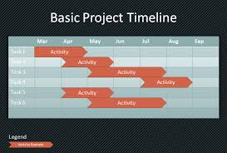
What’s the FEJA Timeline for
Community Solar?
The original timeline for development/comment for Community Solar was August.
The latest update from the IPA indicates a September release date.

Slide 57
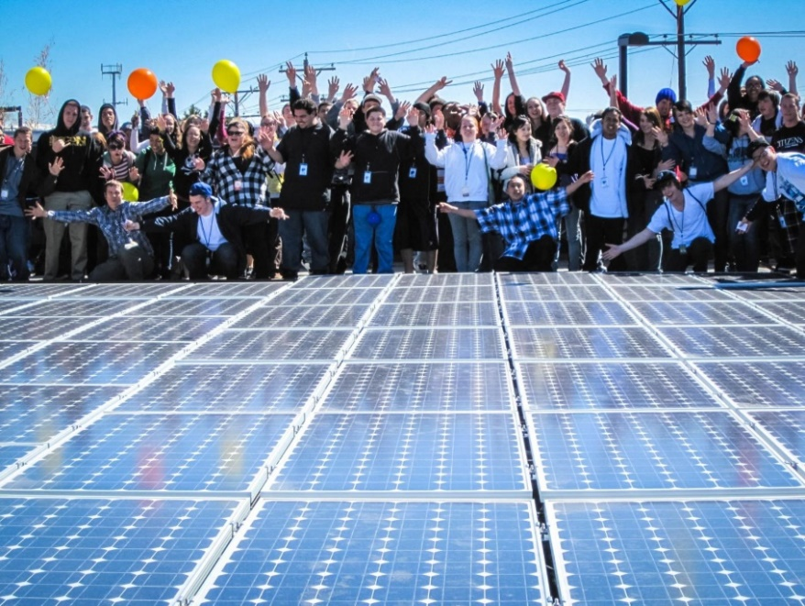
Additional Resources
Illinois Solar Energy Association
www.illinoissolar.org
Coalition for Community Solar Access (CCSA)
www.communitysolaraccess.org/
Solar Energy Industries Association (SEIA)
http://www.seia.org/policy/distributed-solar/shared-renewablescommunity-solar
Interstate Renewable Energy Council (IREC)
www.irecusa.org/regulatory-reform/shared-renewables/
National Resource Energy Lab (NREL)
http://www.nrel.gov/docs/fy11osti/49930.pdf
Vermont Natural Resource Council (VECAN)
http://www.vecan.net/about-the-community-solar-toolbox/

Slide 58

Thank You to Our Presenter!
Michelle Knox
Owner/Founder of WindSolarUSA, Inc.
ISEA Co-Chair of Muni/Co-op Working Group
michelle@windsolarusa.com 217.825.4206

